Slide 1

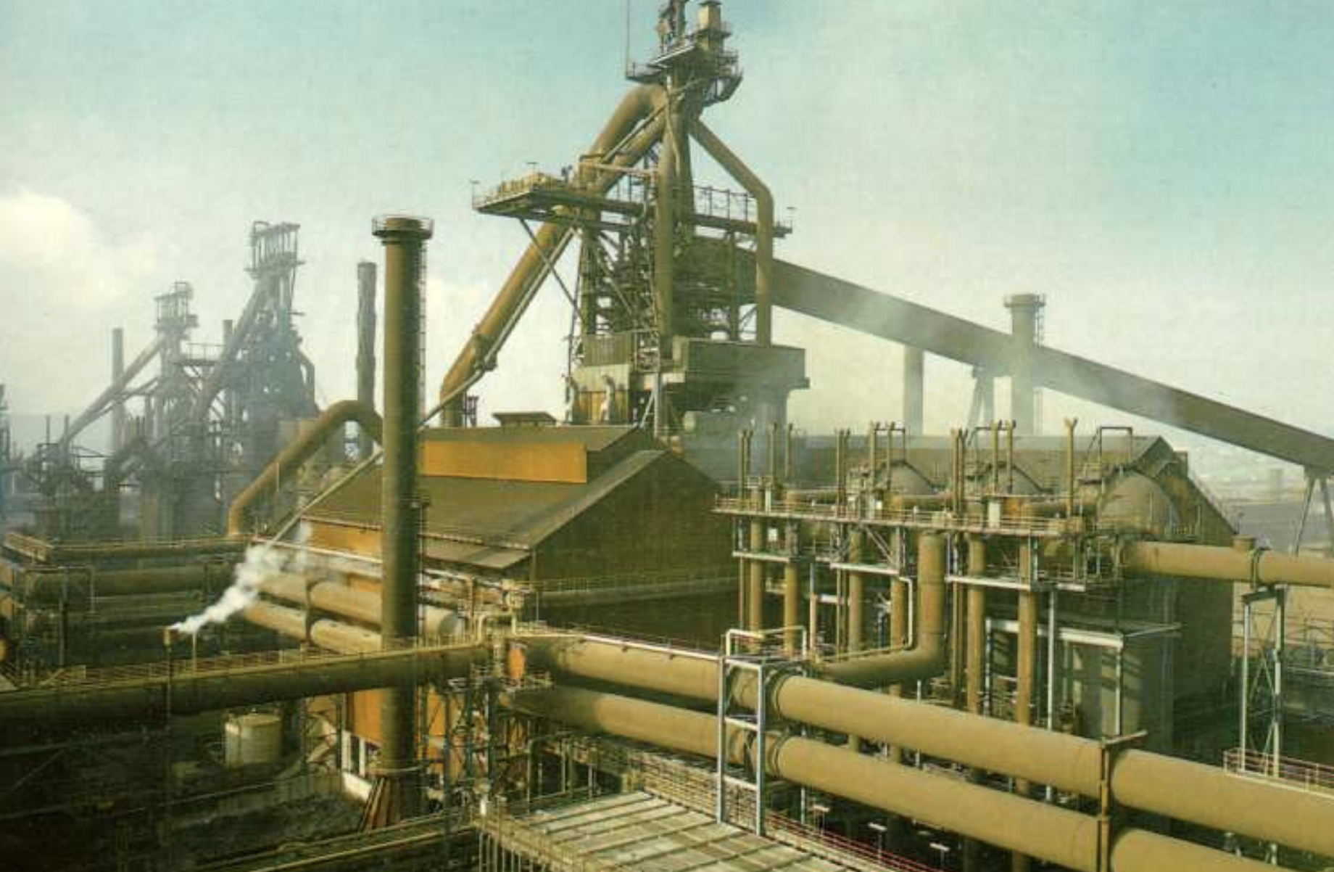




Mitigating the CO₂ burden of steel
Jean-Claude Gérardy
www.phase-trans.msm.cam.ac.uk
Notes:
We all accept completely that steel production using coke in blast furnaces pollutes, so I that is a given.

Slide 2
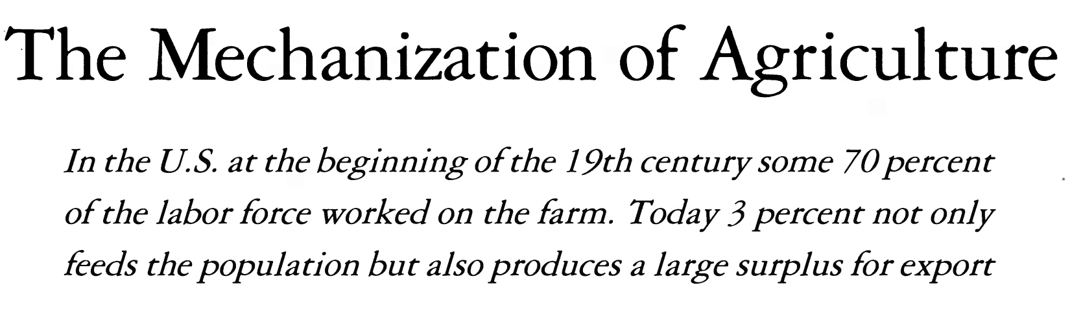
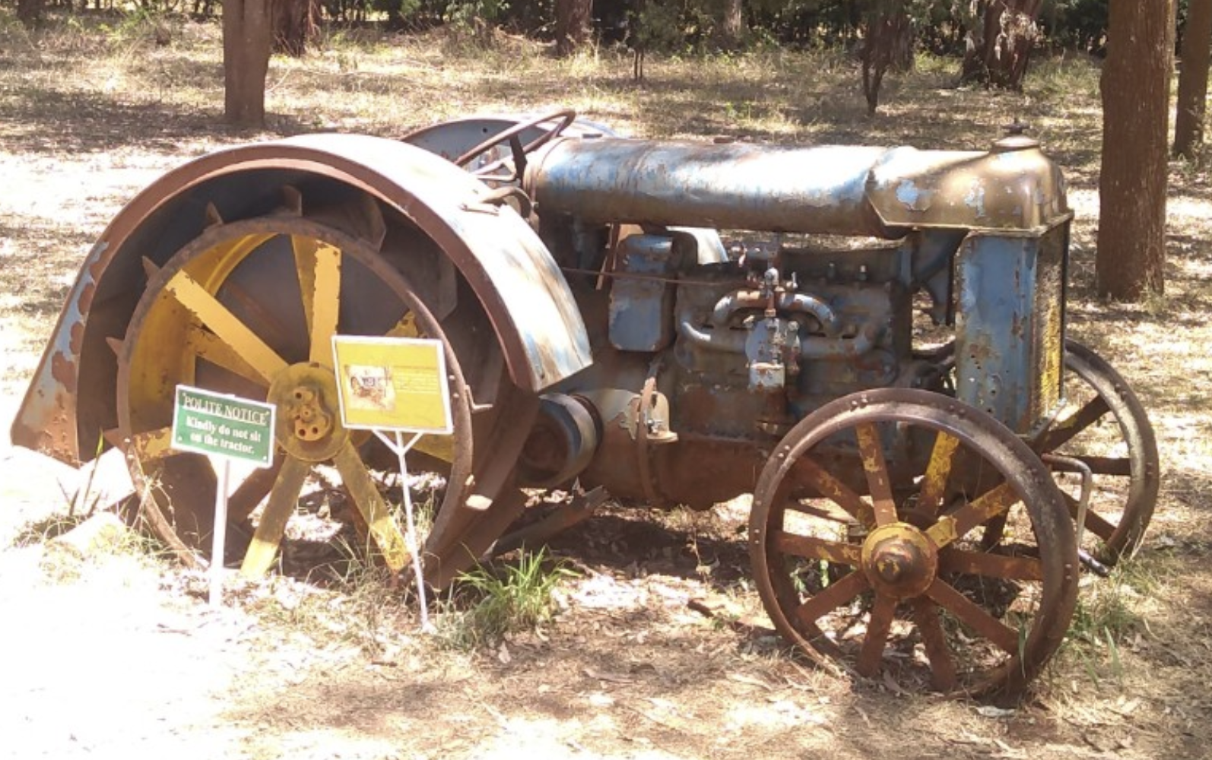
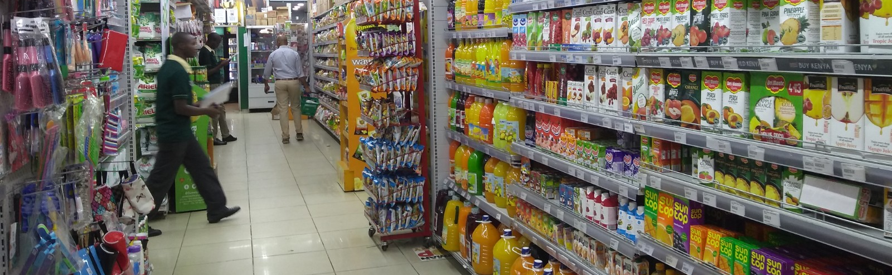
Notes:
However. so much in life now relies on steel, without which the quality of life and the population that can be supported would be greatly diminished. Every person in the UK accounts for 16 tonnes of steel during their lifetime, three times the global average.

Slide 3


Facts
Steel pollutes
cannot cope without Fe-C
50% reduction in emissions, 2030
(5 years left)
No time for research, development ......
hydrogen, electrolysis etc.
We use 2.5 billion tonnes/annum

Slide 4
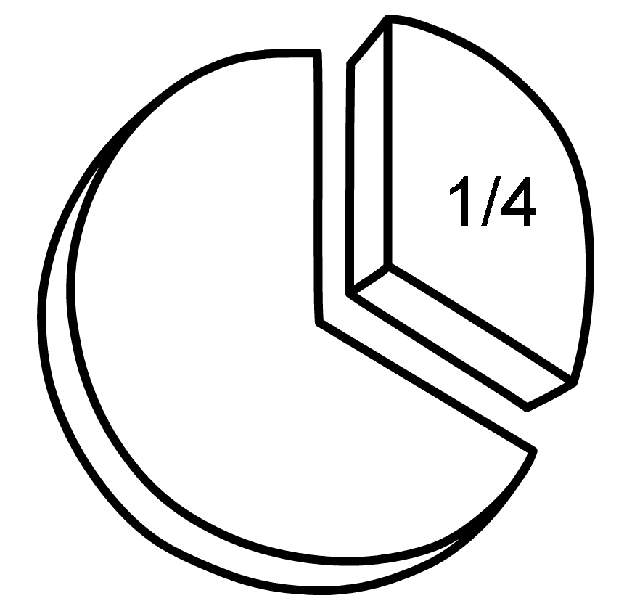

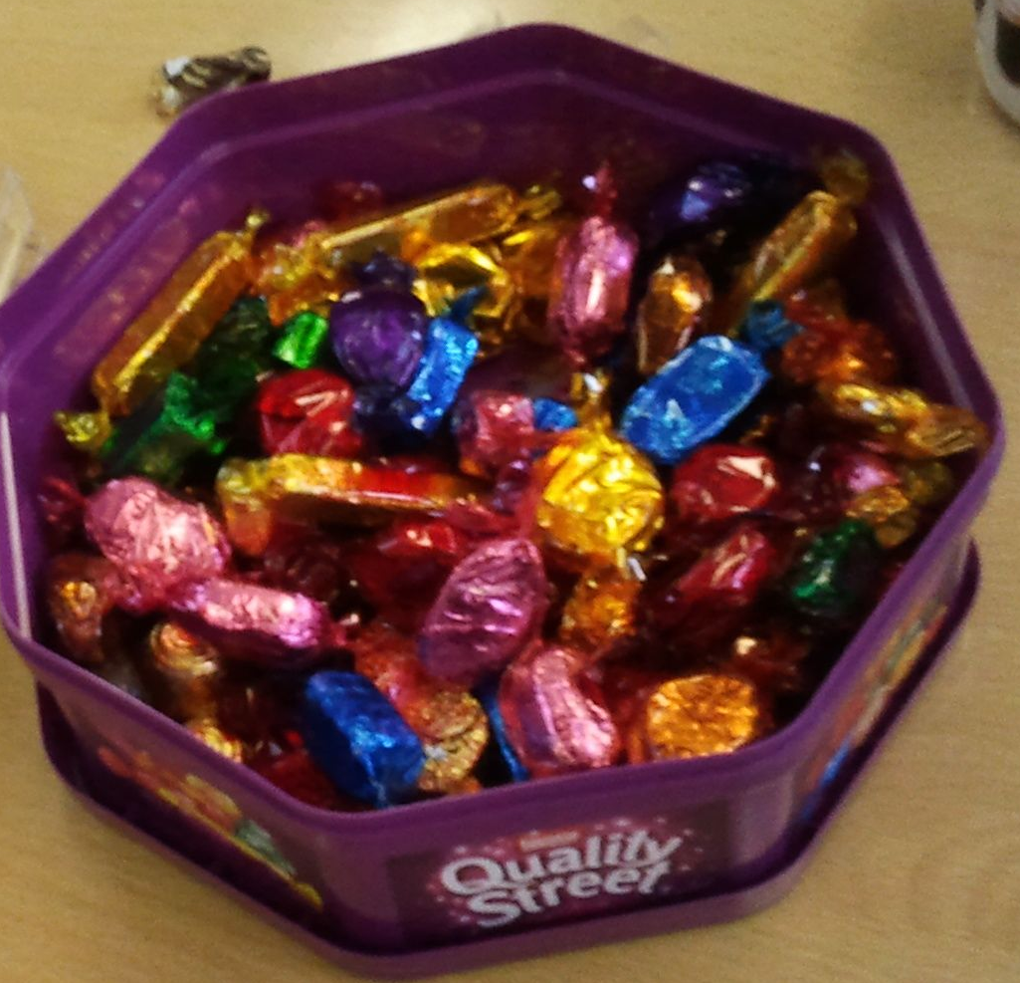

zero-cost solution
Reduce steel consumption by 25%
In four years
Without affecting quality of life
Without pain to industry

Slide 5
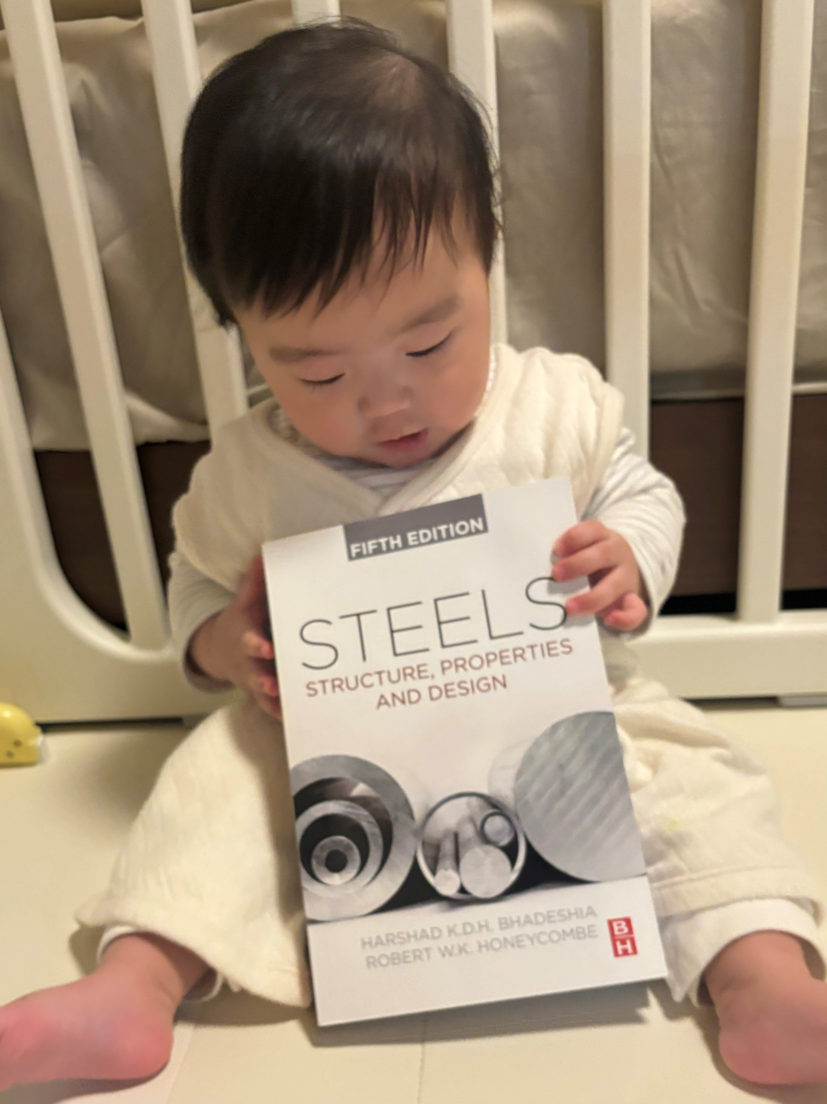
Real case studies
Buildings
Bridges
Ships
Rockets
Tools
Cars
etc .......

Slide 6
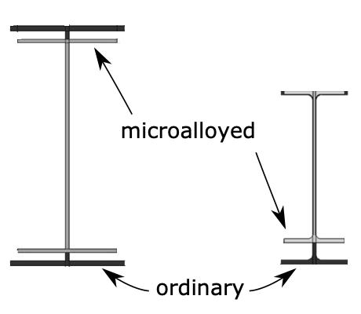
Half of all steel
used in bridges,
buildings, infrastructure

Slide 7
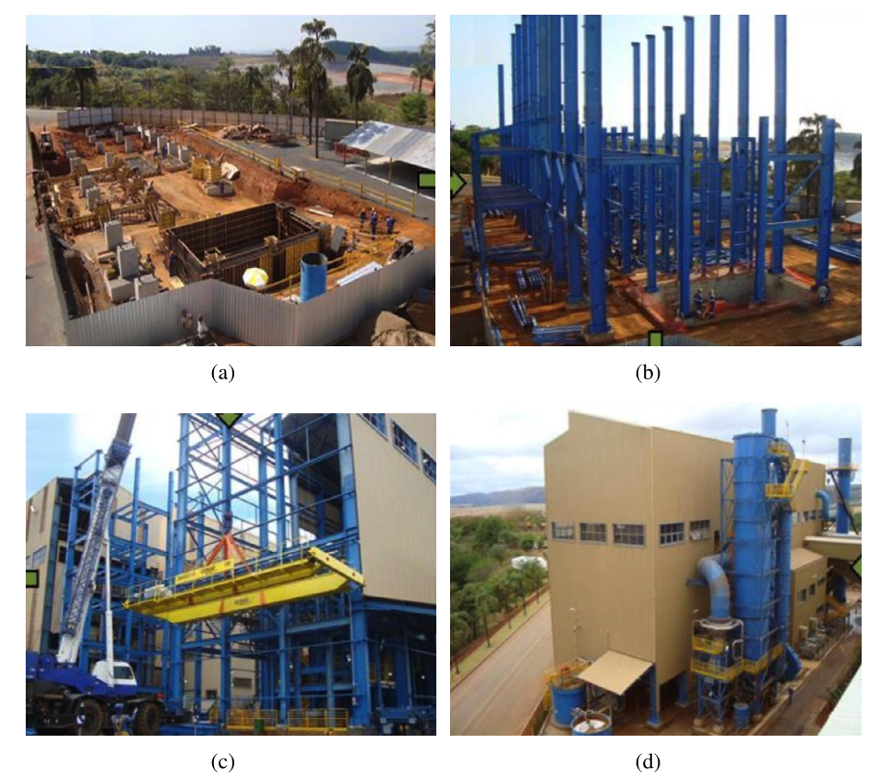
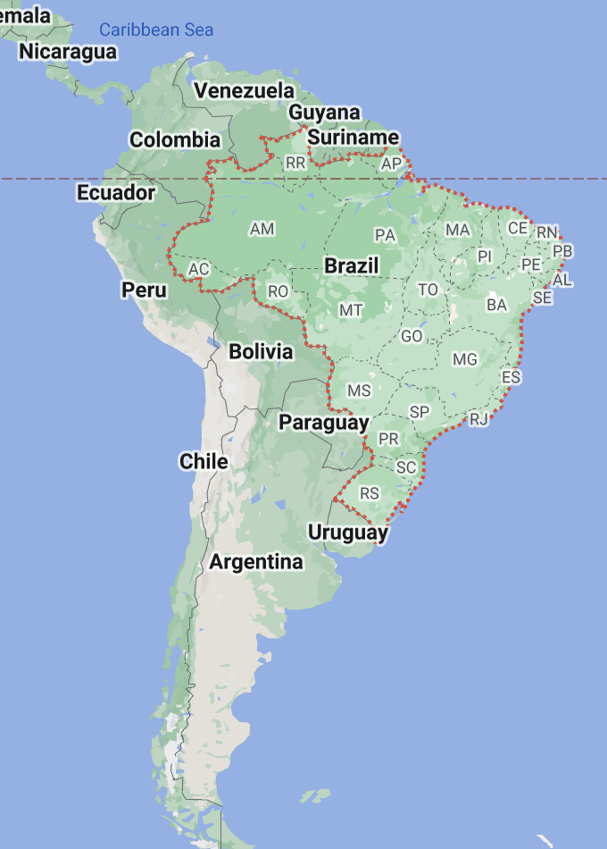
courtesy of CBMM, Brazil

Slide 8
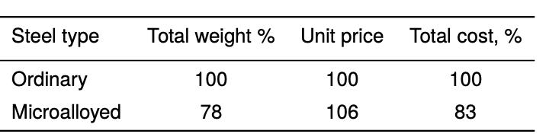
Ordinary steel: 363,000 kg required
Microalloyed steel: 284,000 kg required
130,000 kg less CO₂

Slide 9
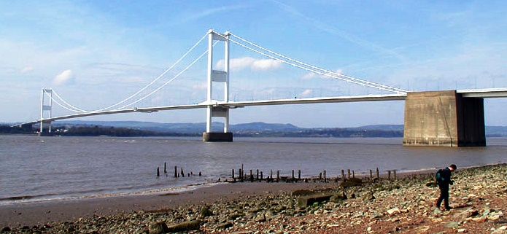
CO₂ cost ~190,000 tonnes, 85% in materials
David Collings, https://doi.org/10.1680/jcien.22.00178

Slide 10
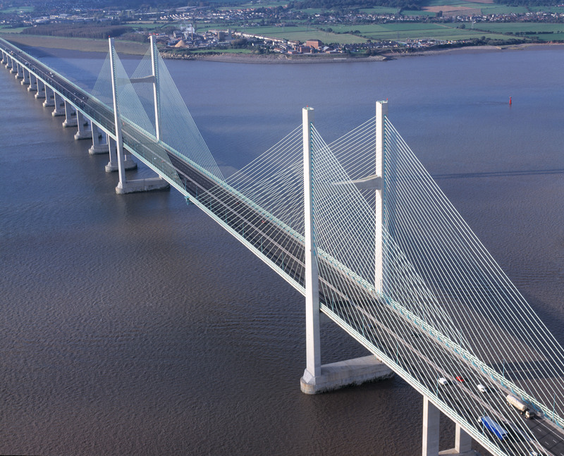
Prince of Wales Bridge
1996
smaller main span, much smaller
carbon footprint
David Collings,
Proc. Inst. Civil Engineers
2024
+ private communication

Slide 11
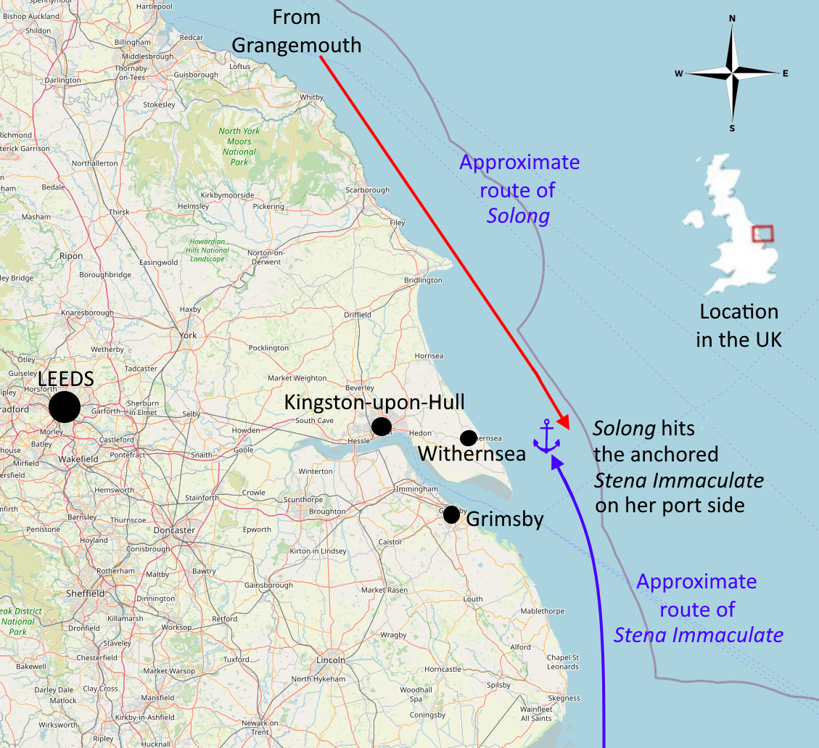
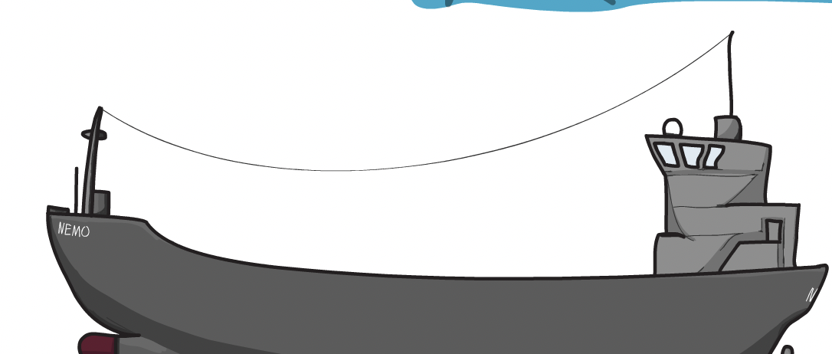
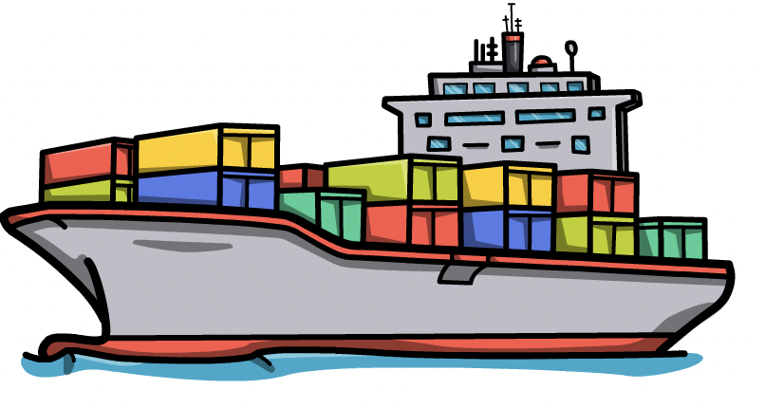
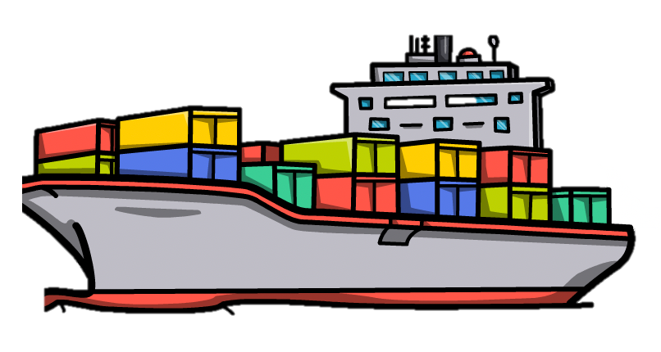
Solong 🔥 Stena Immaculate
10th March 2025
Creative Commons CC0 1.0 Universal Public Domain

Slide 12
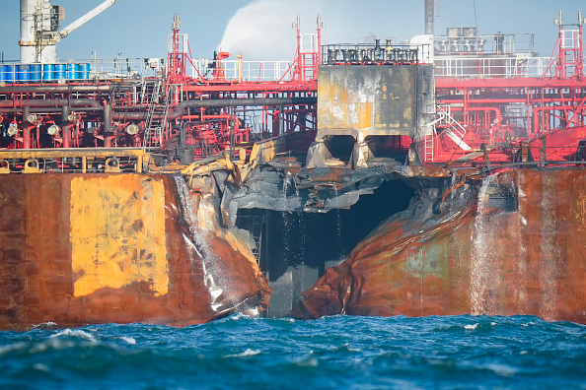
Licensed from Getty images

Slide 13
Rough calculation

Slide 14
Rough calculation

Slide 15
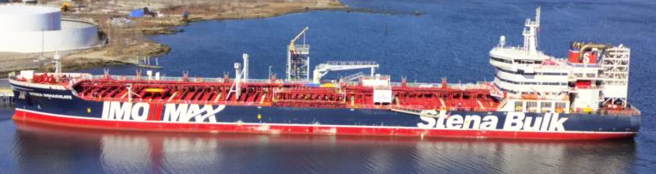
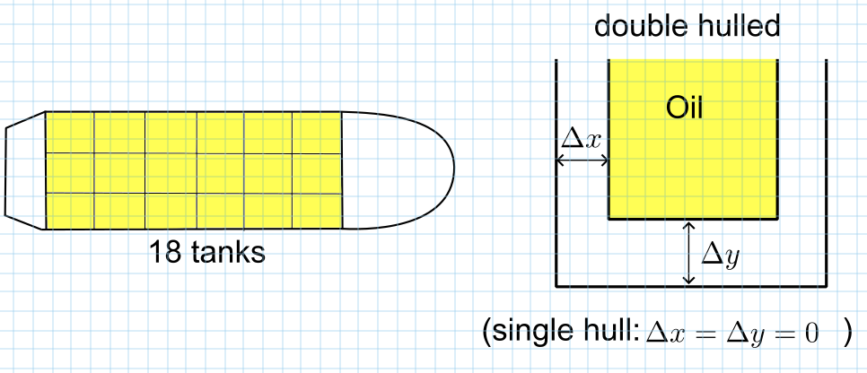
18 tanks, double hulled, 183 m in length
made in China, owned by Stena, operated by USA
VesselFinder.com

Slide 16
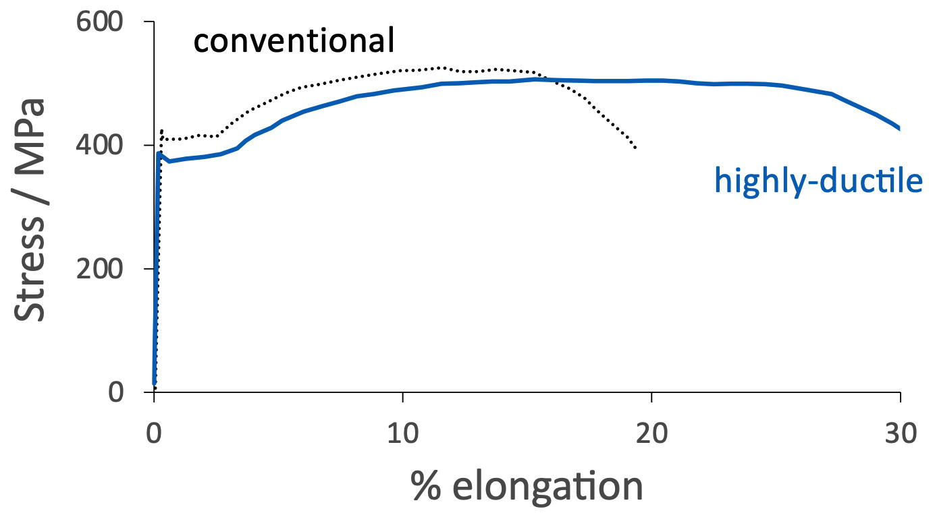
Okawa, Ichikawa, Yanagita, Shirahata, Inami, Iskhida, Yamada, Inai
Nippon Steel & Sumitomo Metals (2015)

Slide 17



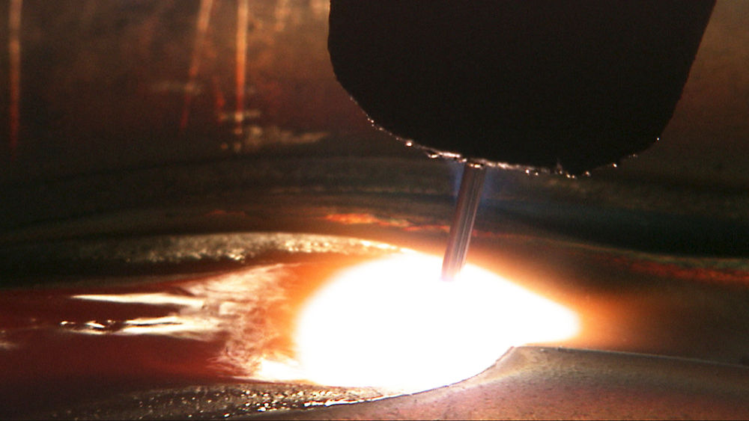
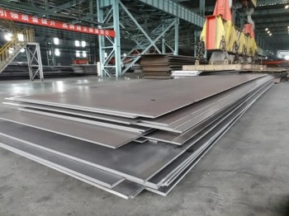
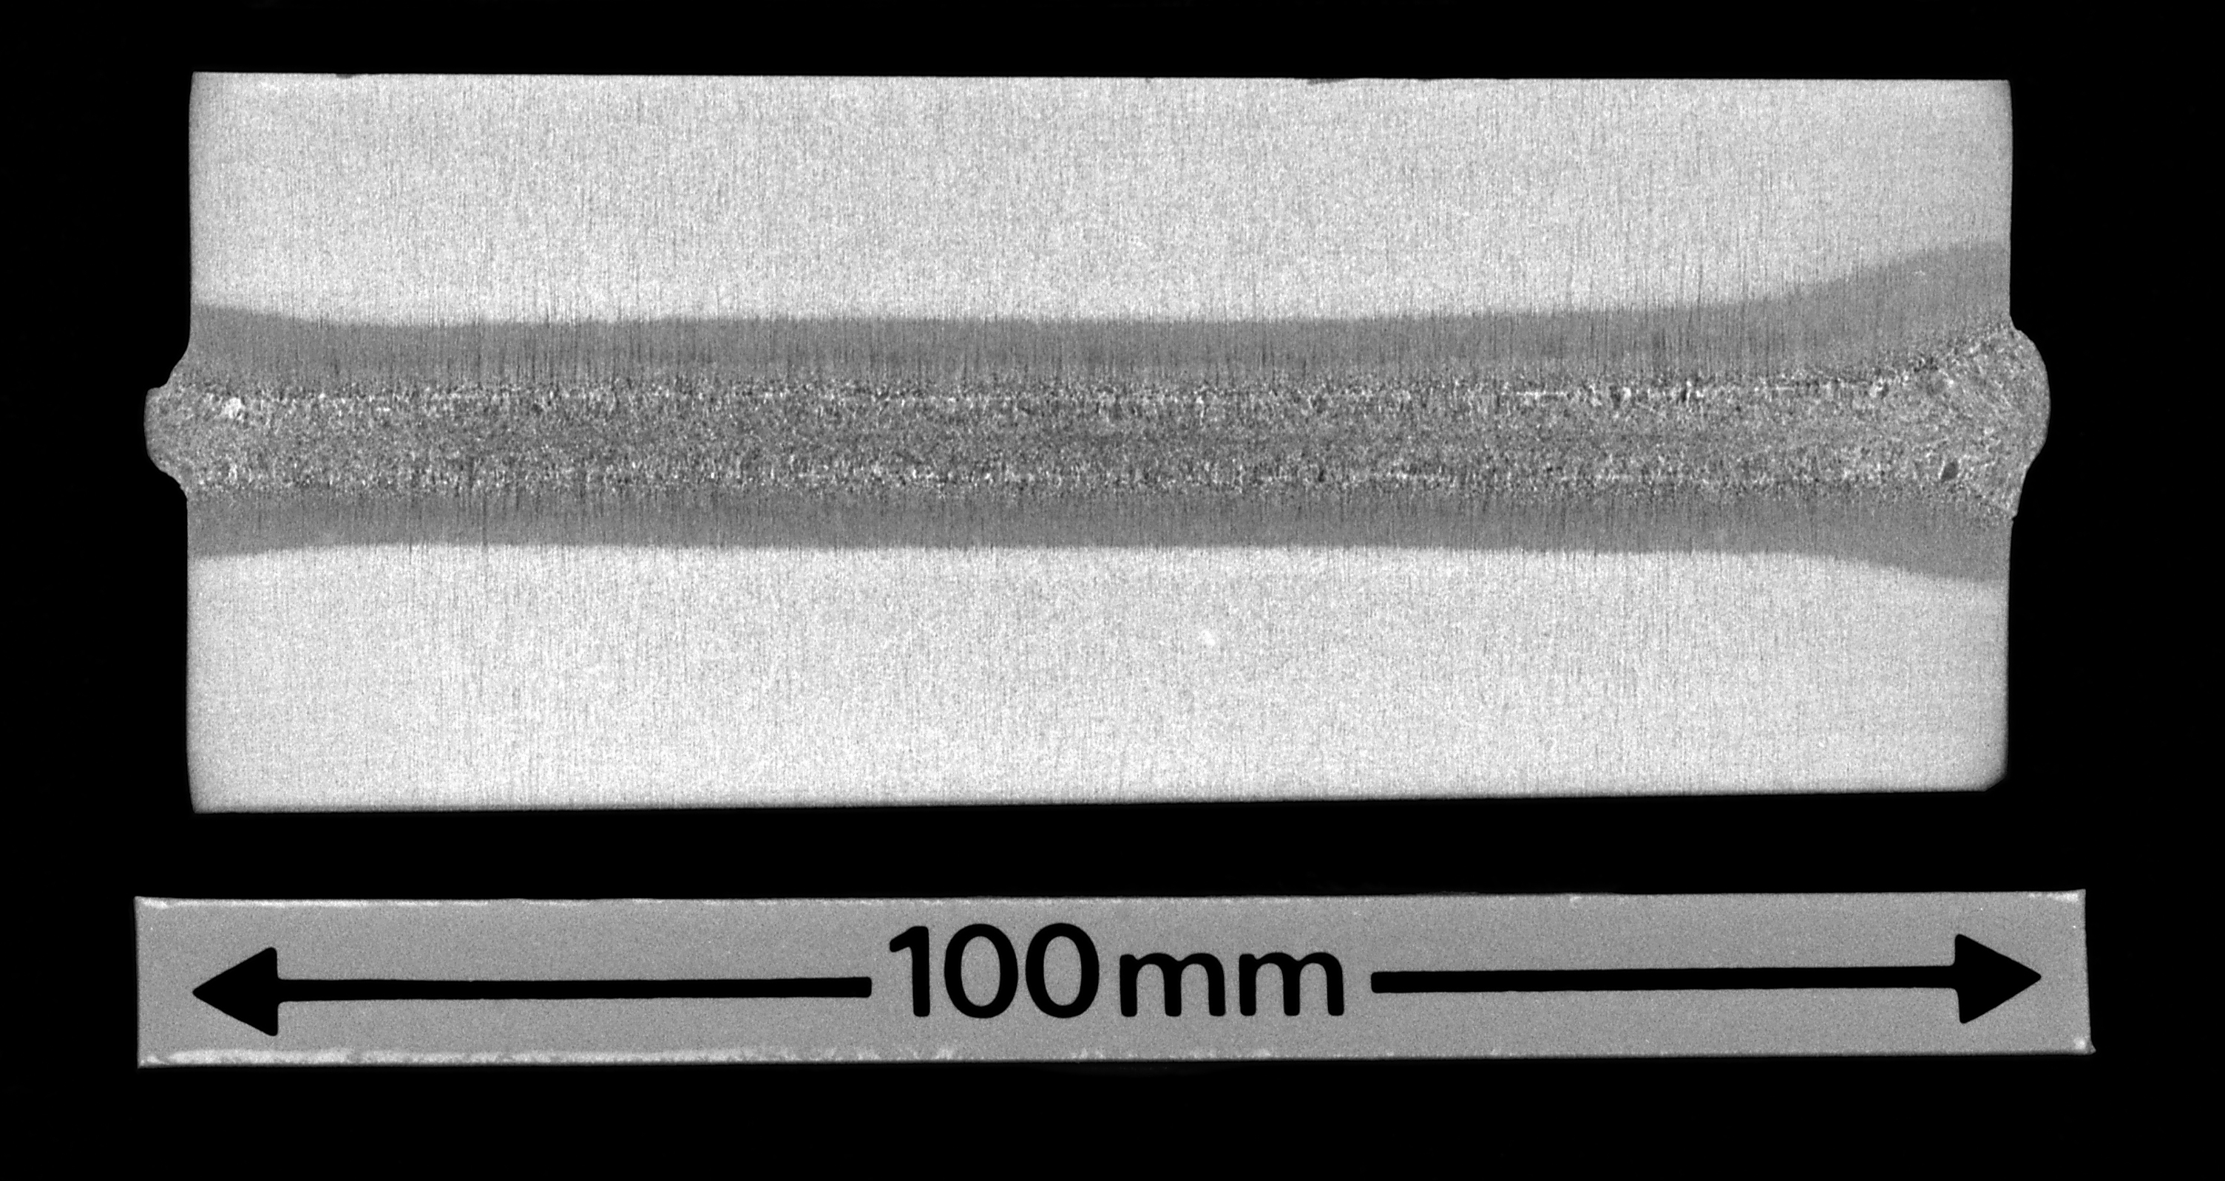
Toughness
K. Dalaei, ESAB AB
235-460 MPa
C. Johnston, TWI

Slide 18

Material standards, certification
Lloyd’s register (1760)
world’s leading classification society
Det Norske Veritas – Germanischer
American Bureau of Shipping

Slide 19
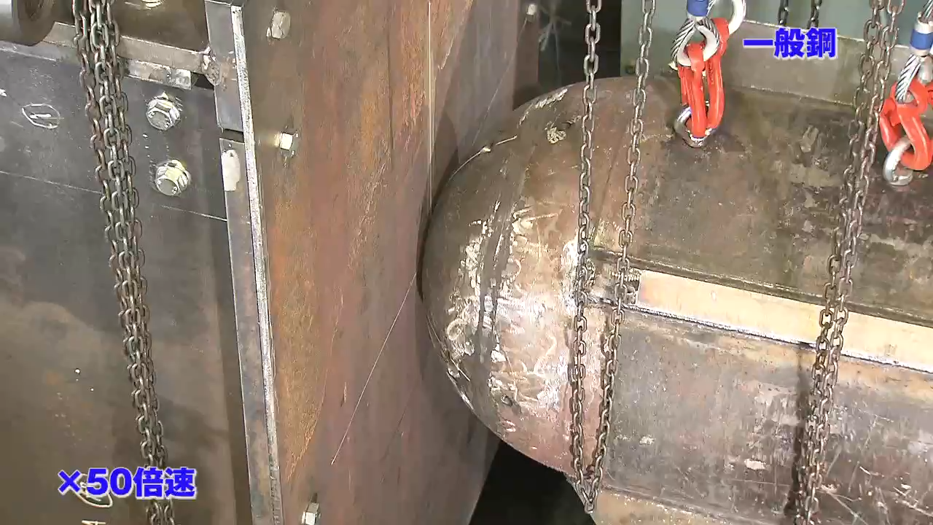
Courtesy Kazutoshi Ichikawa, Nippon Steel

Slide 20
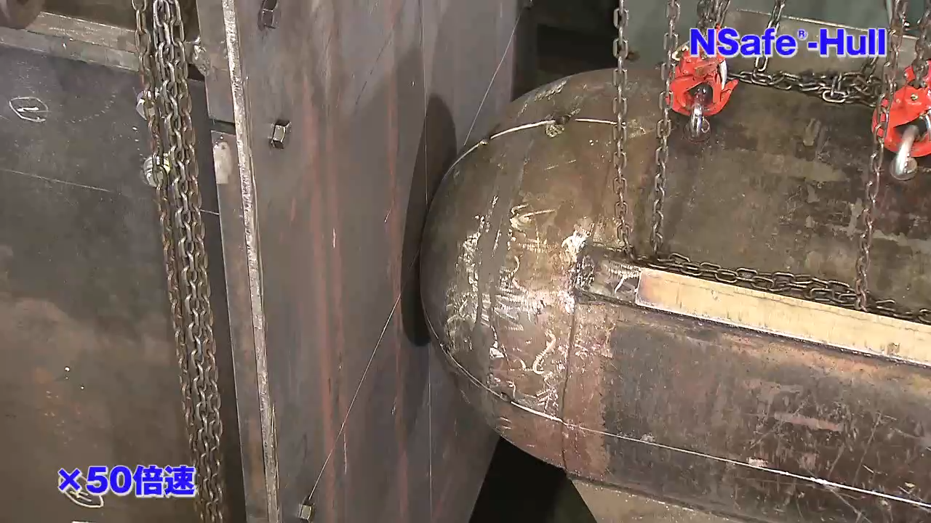
Courtesy Kazutoshi Ichikawa, Nippon Steel

Slide 21
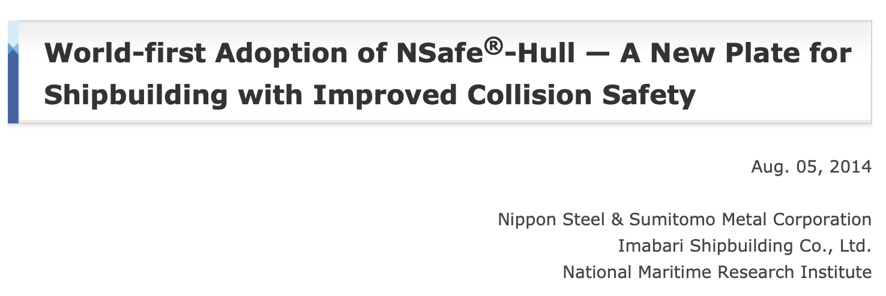
Deadweight: 206,600 tons
Size: Length overall:299.94 m;
Breadth: 50.00 m;
Depth: 24.70 m
Built by Saijo Shipyard of Imabari Shipbuilding Co., Ltd.
Shipping company: Mitsui O.S.K. Lines, Ltd.
Launched on August 2, 2014

Slide 22
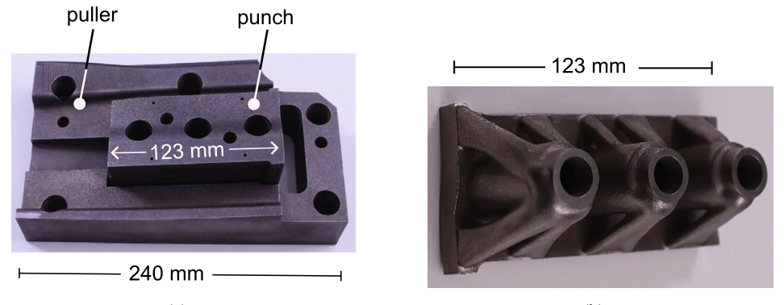
CC BY 4.0
70% reduction in weight,
better engineering

Slide 23
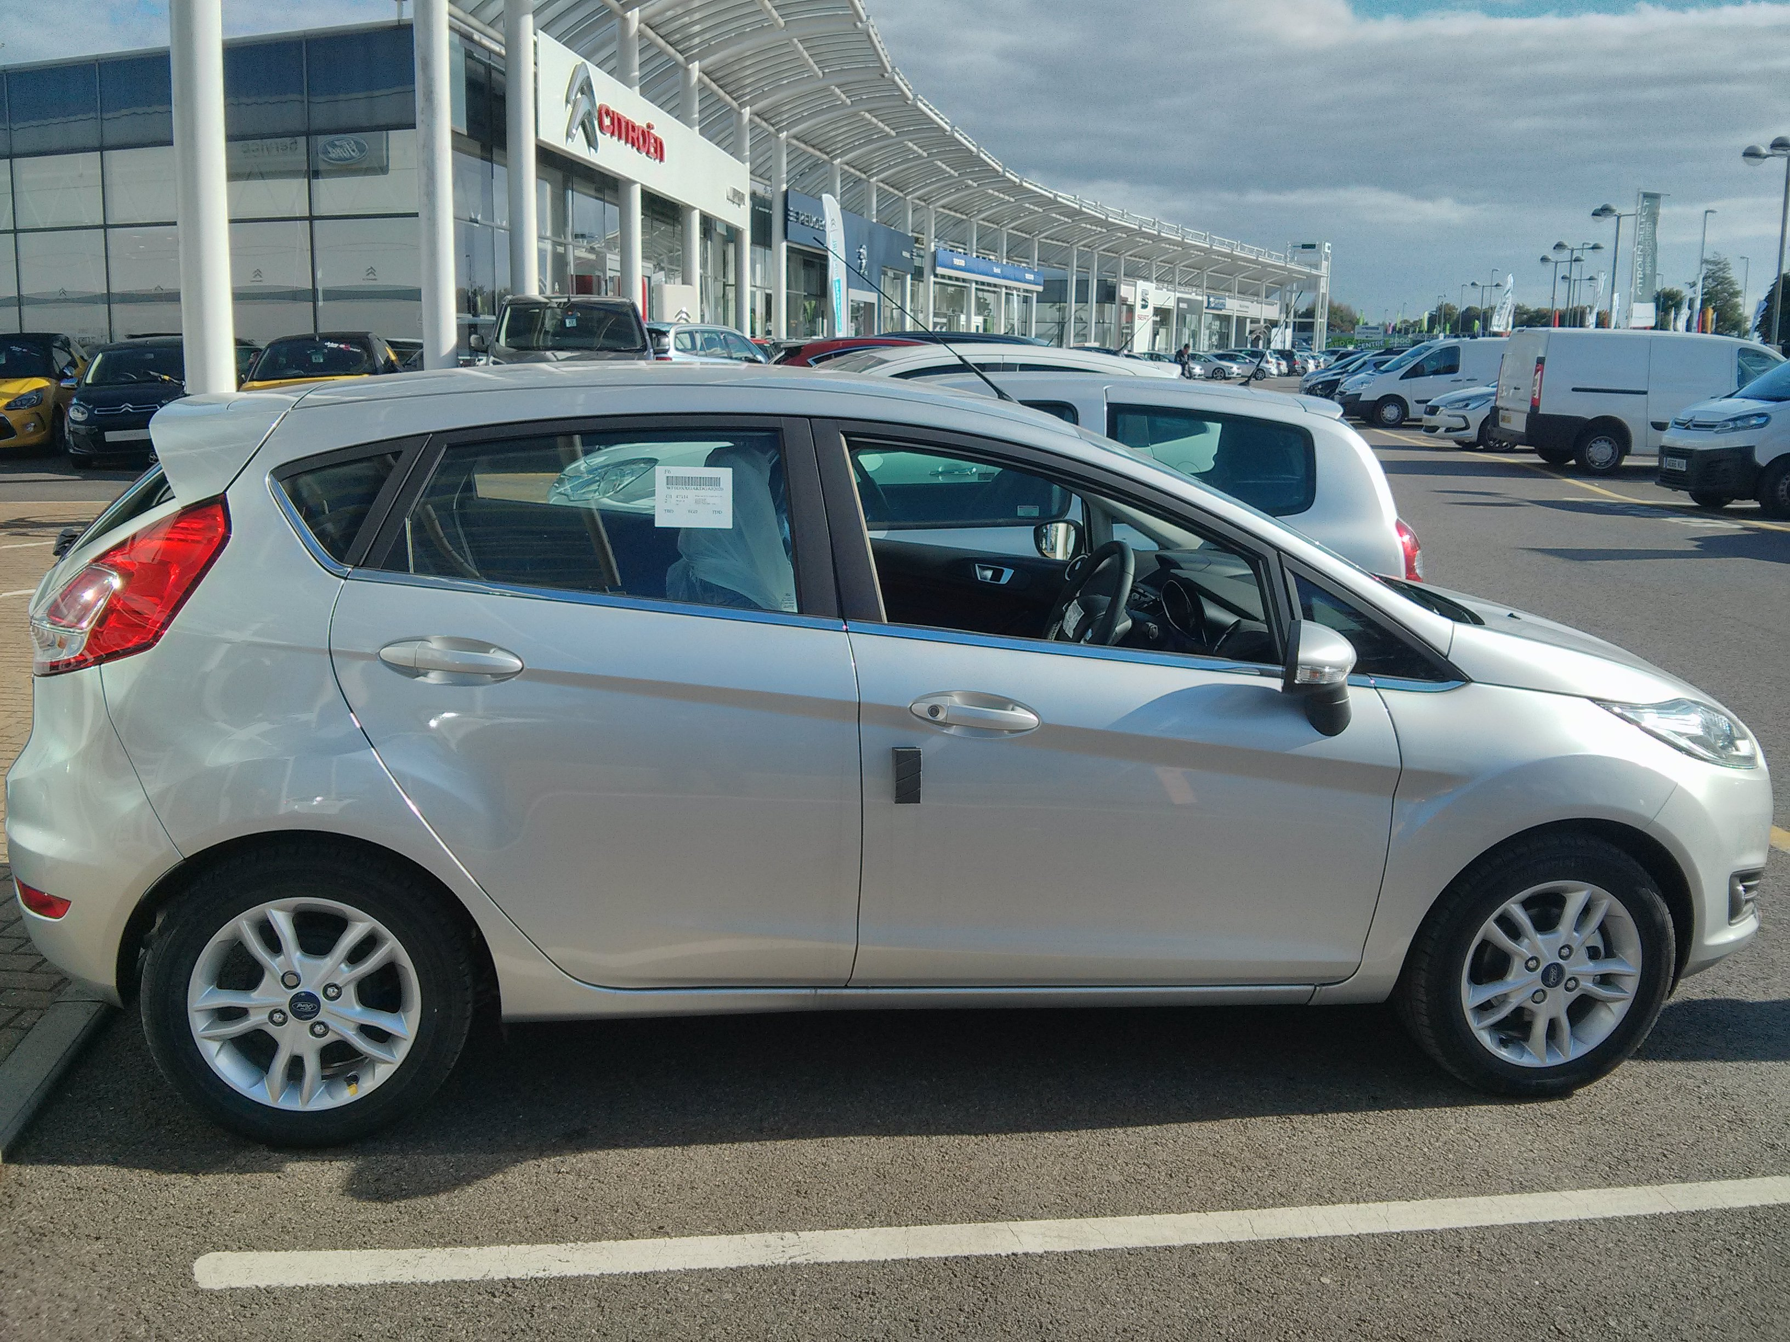
CO₂ / g km⁻¹
Tesla Roadster (France) 26
Tesla Roadster (USA) 141
Ford Fiesta Eco (petrol) 95
Tesla data from Energy Environ. Sci., 2010, 3, 1825–1832

Slide 24


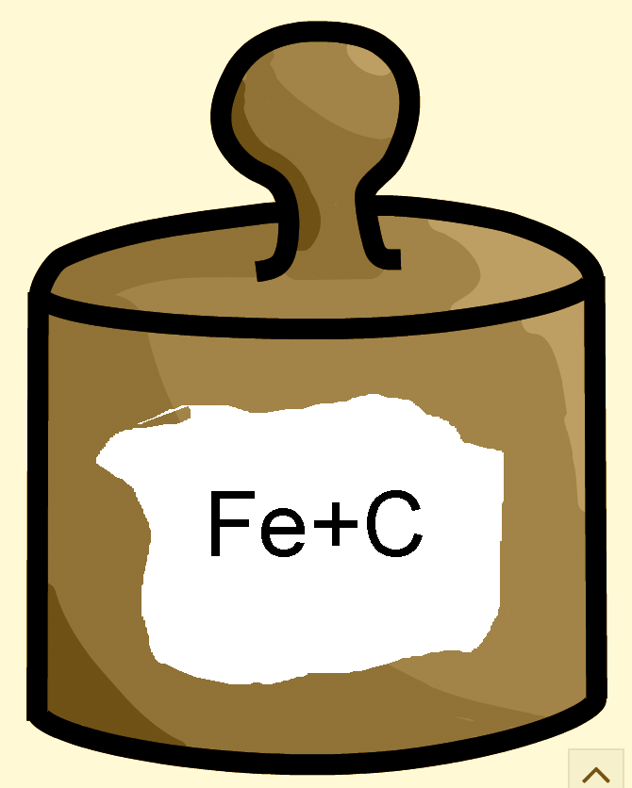
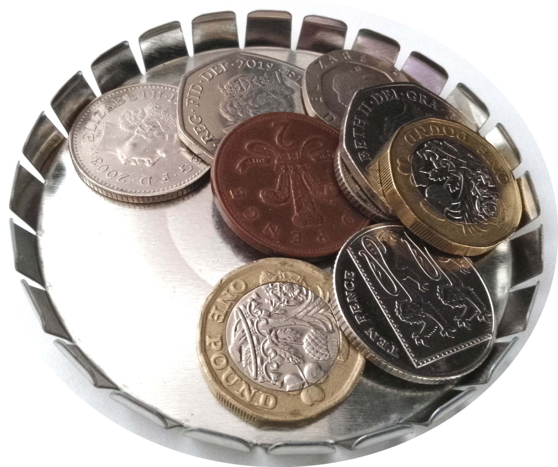
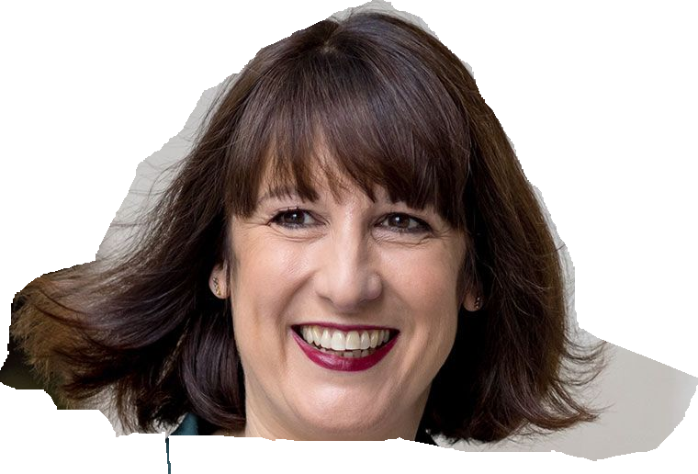
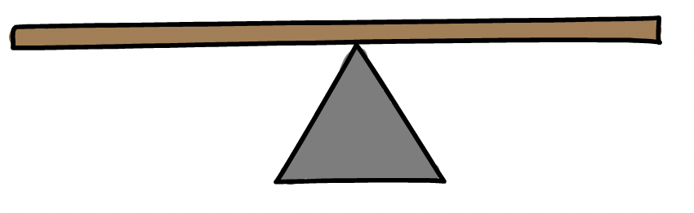
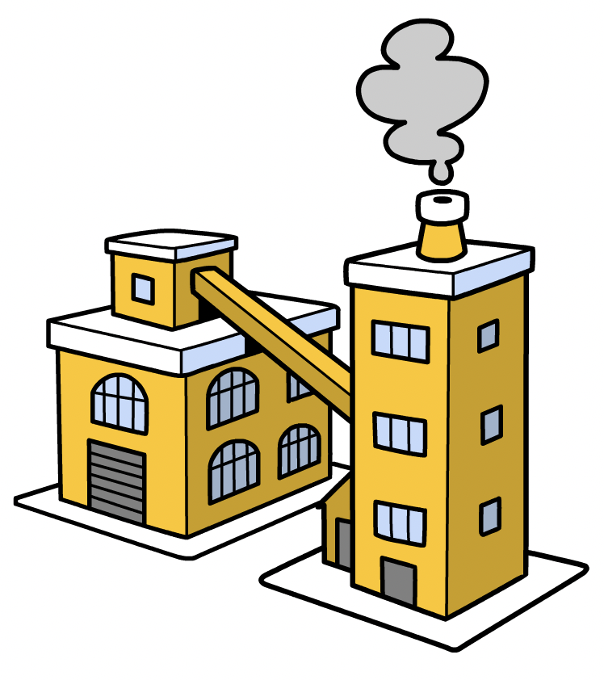
Quick solution to CO₂ burden of steel
steel needs to be more expensive, better design
legislation
tax ∝ steel content
local+imports
local industry

Slide 25
weak experiment in progress, USA, over next 3-4 years
25% tariffs on steel imports (not steel products)
∴ increase in cost of steel in USA
∴ decrease in consumption?
(cost may increase only a few % ?)
Notes:
US companies producing from ore at 74% capacity, manufacturing suffers in uncertain environment so demand may decline, need to see a movement that is greater than normal noise.

Slide 26
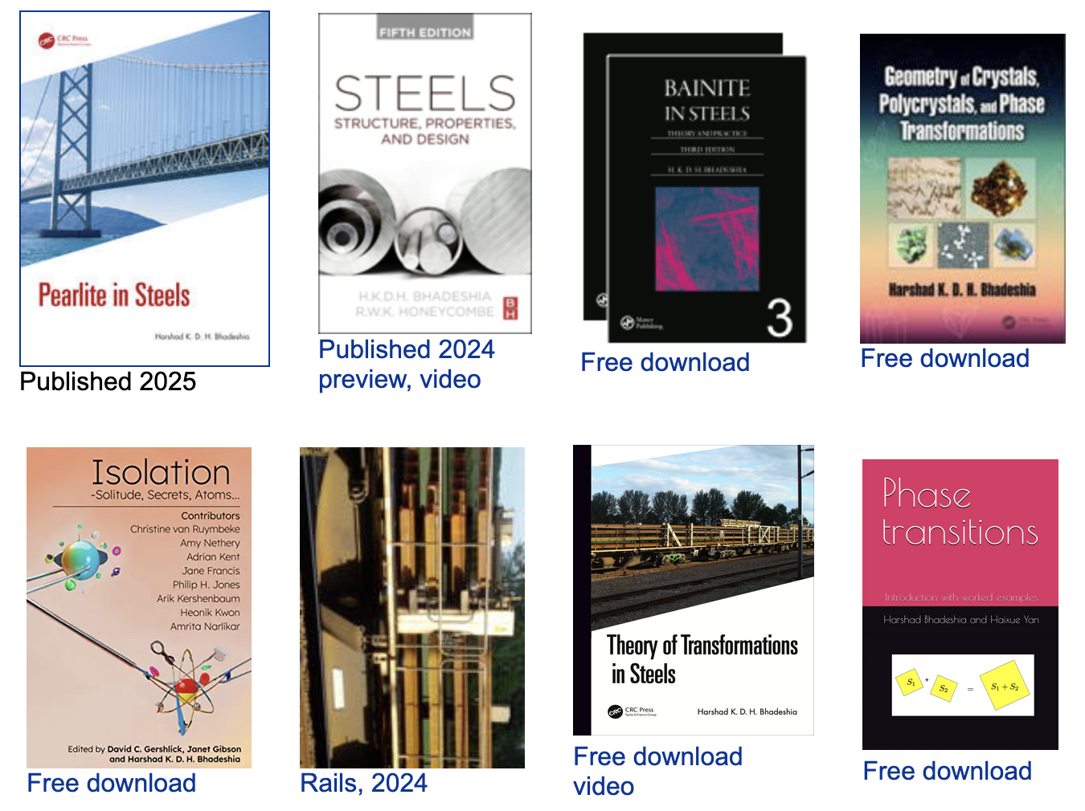
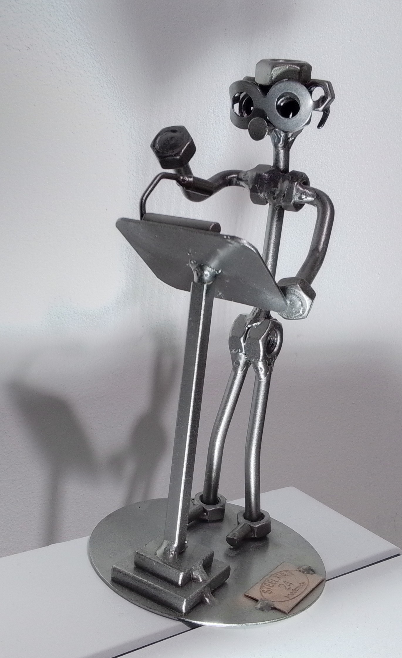
www.phase-trans.msm.cam.ac.uk

