Slide 1
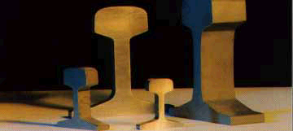

Niobium microalloyed rail steels
www.msm.cam.ac.uk/phase-trans
CBMM Brazil
L. M. Silvestre and M. Stuart
A. Ray and H. K. D. H. Bhadeshia

Slide 2
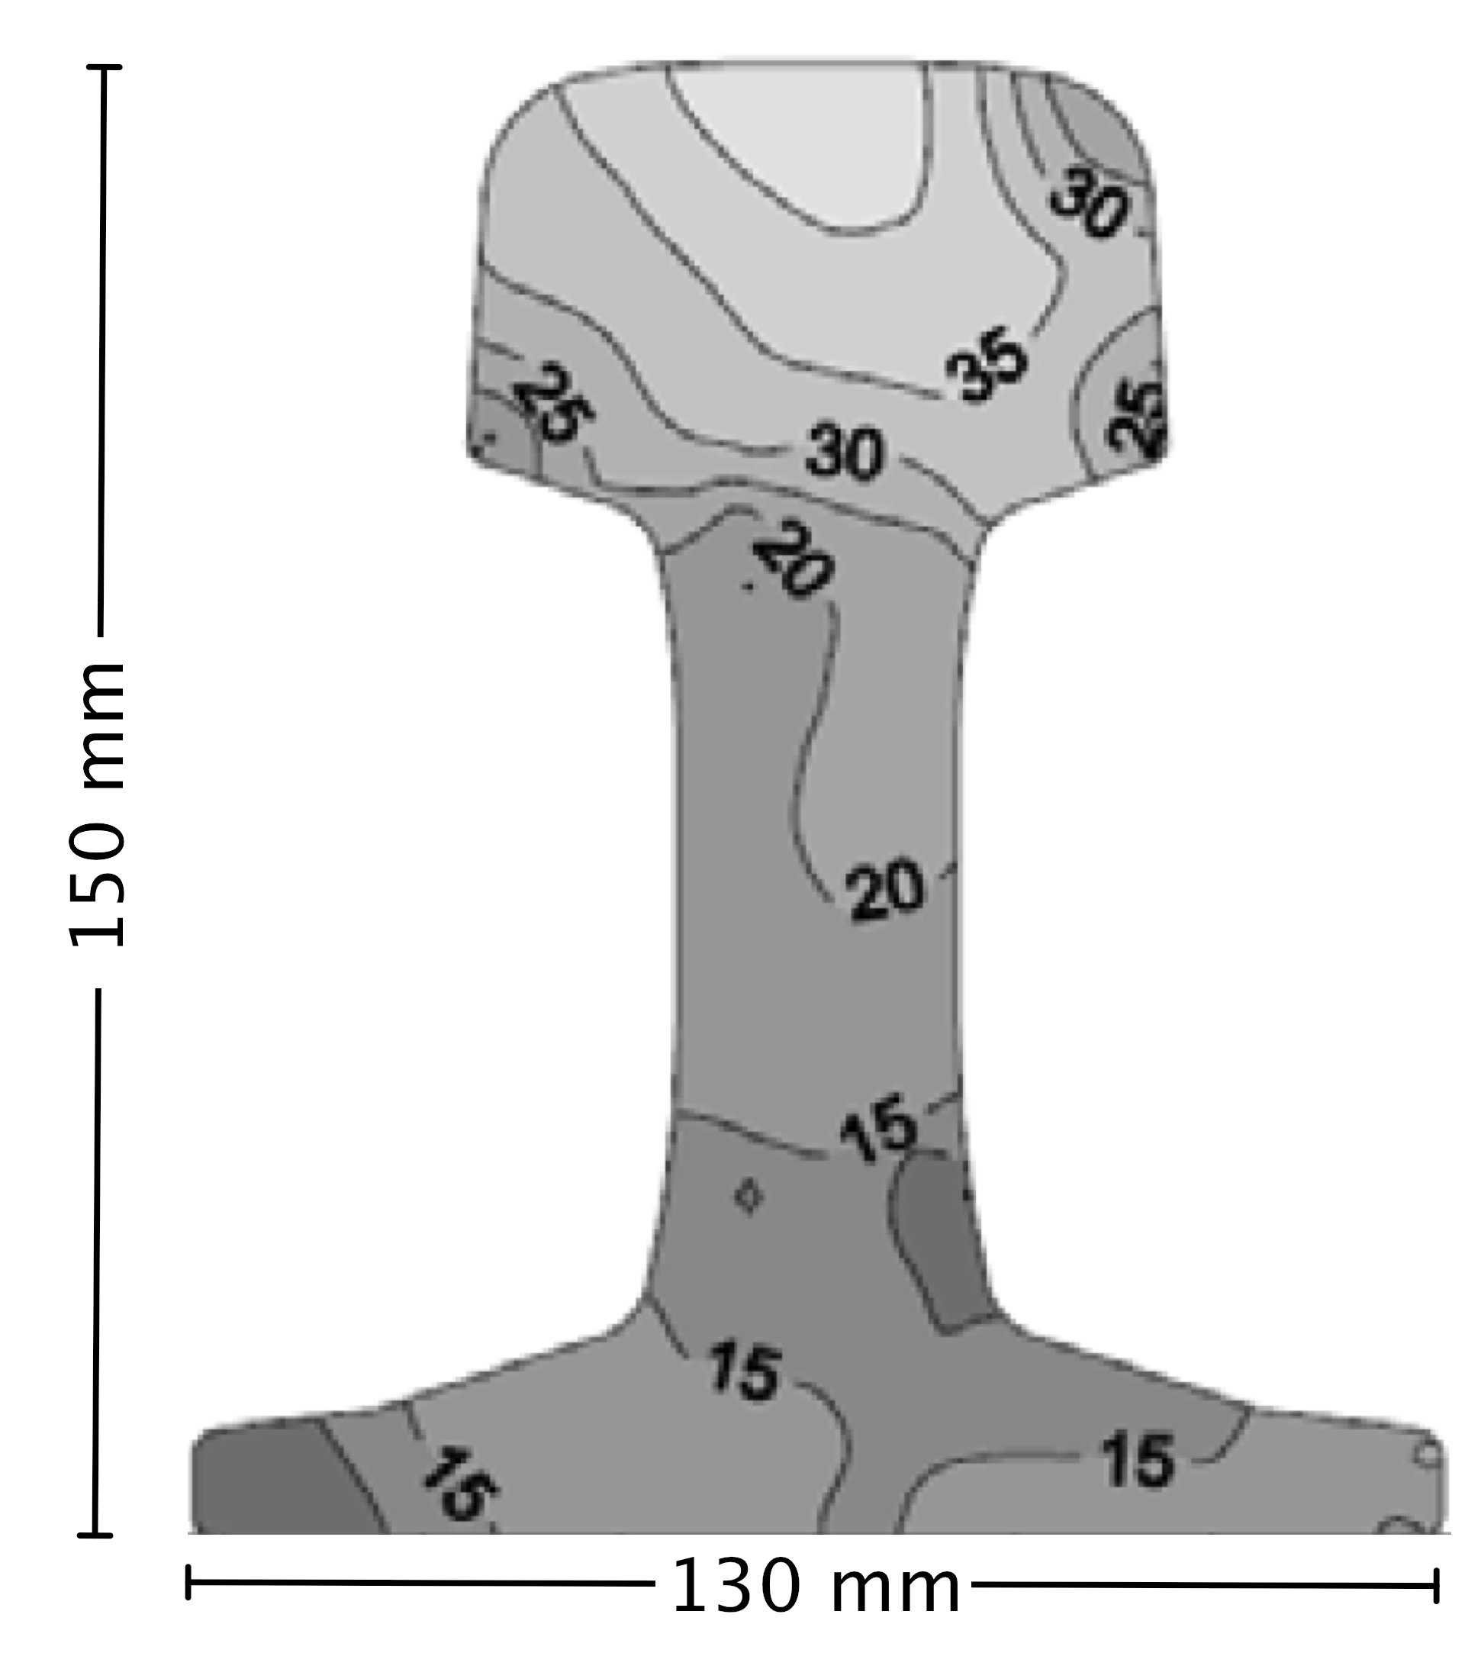

Smyk, 2014
Austenite grain size / µm

Slide 3


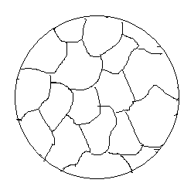


Slide 4
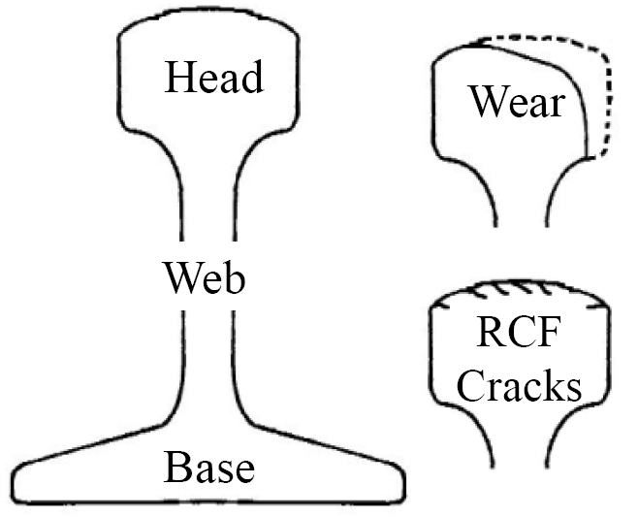
Properties required
Wear resistance
Rolling contact fatigue resistance
Toughness
Uniformity
Ability to manufacture
on large scale

Slide 5
Niobium in high-C steel may segregate during solidification.
This may lead to bands of coarse NbC.
The reheating temperature must be capable of taking coarse carbides into solution.
NbC should precipitate during hot-rolling.

Slide 6
Zero-cementite rail
base composition:
0.4 C – 1.5 Si – 2.0 Mn – 1.0 Cr – 0.3 Mo wt%
structure is bainitic
silicon suppresses the precipitation of cementite
carbon partitions, stabilises austenite
molybdenum suppresses embrittlement due to phosphorus
manganese and chromium for avoiding pearlite or allotriomorphic ferrite

Slide 7
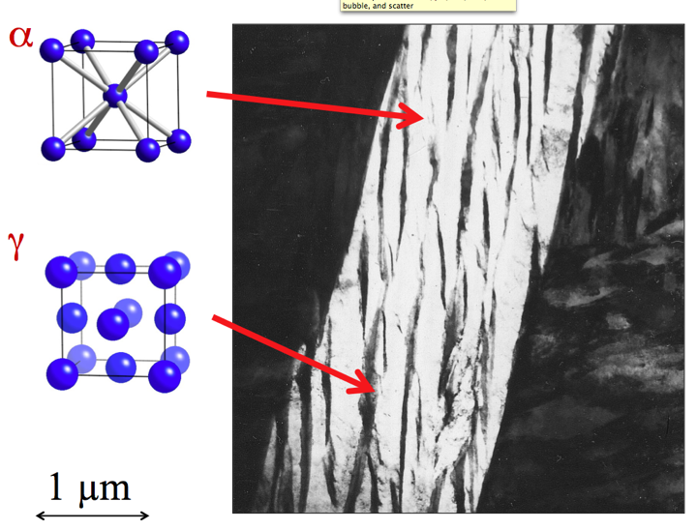
7

Slide 8
austenite

Slide 9
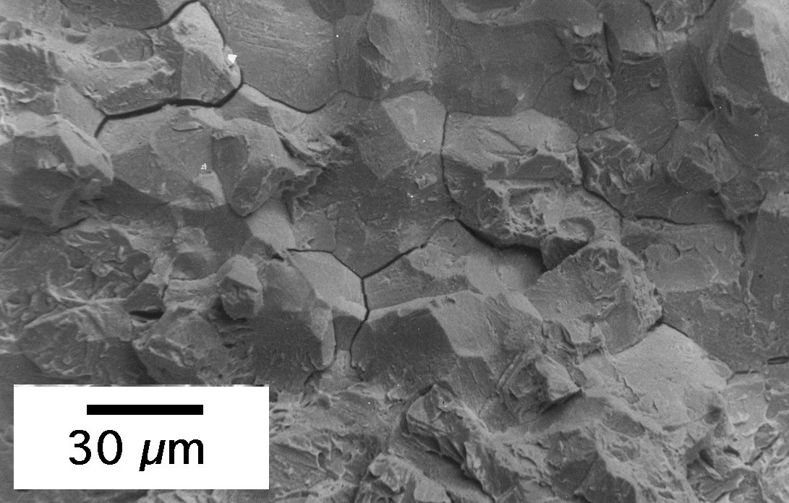
15 mm thick plate, without Mo
550°C for 5 h
Chang and Bhadeshia

Slide 10
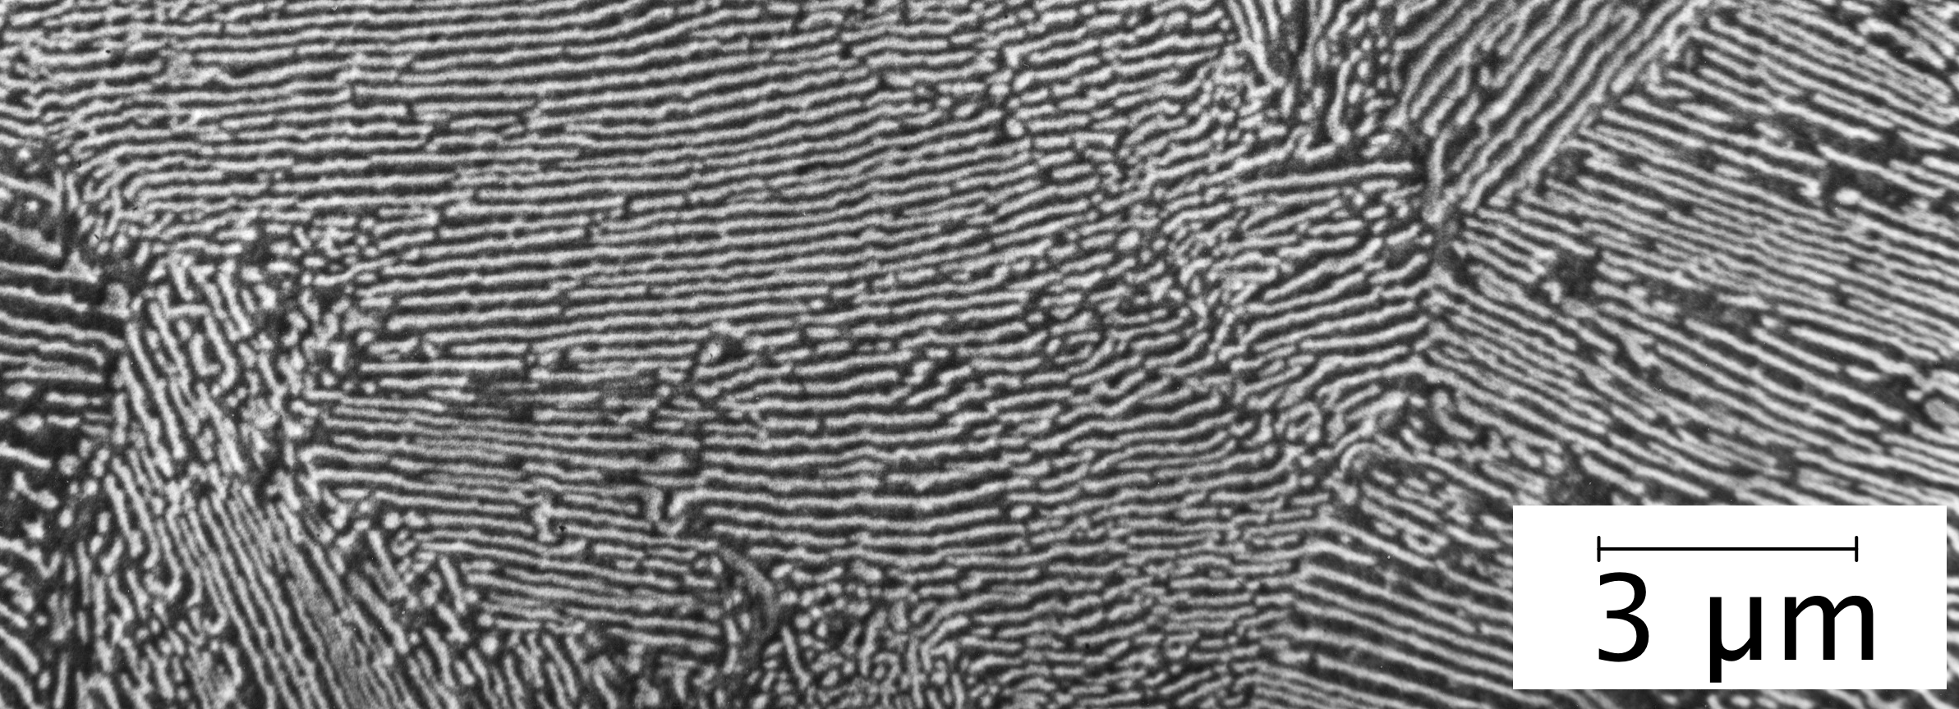
Pearlitic rail
base composition:
0.8 C – 0.4 Si – 1.0 Mn – 0.5 Cr wt%
structure is 100% pearlite
manganese and chromium help suppress pearlite transformation to lower temperatures, therefore, finer pearlite

Slide 11
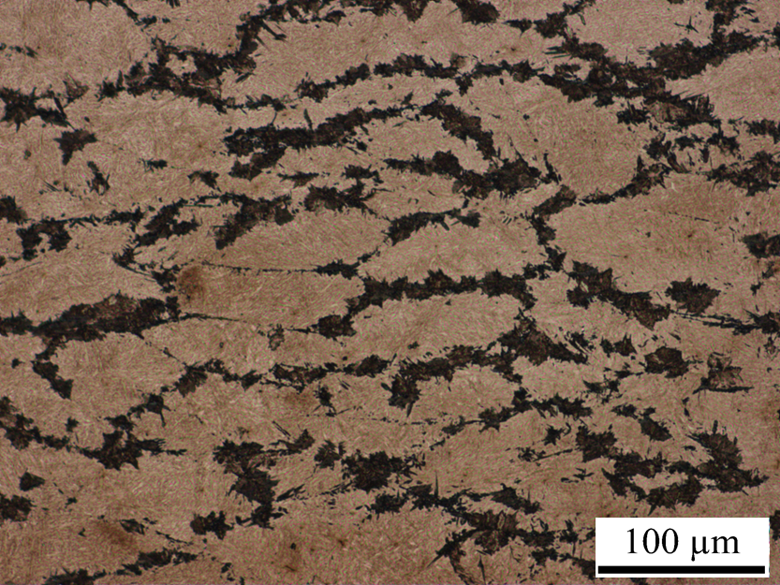
1200 ºC/ 50%/950ºC/ 50%
Pearlitic, 0.02 Nb wt%

Slide 12
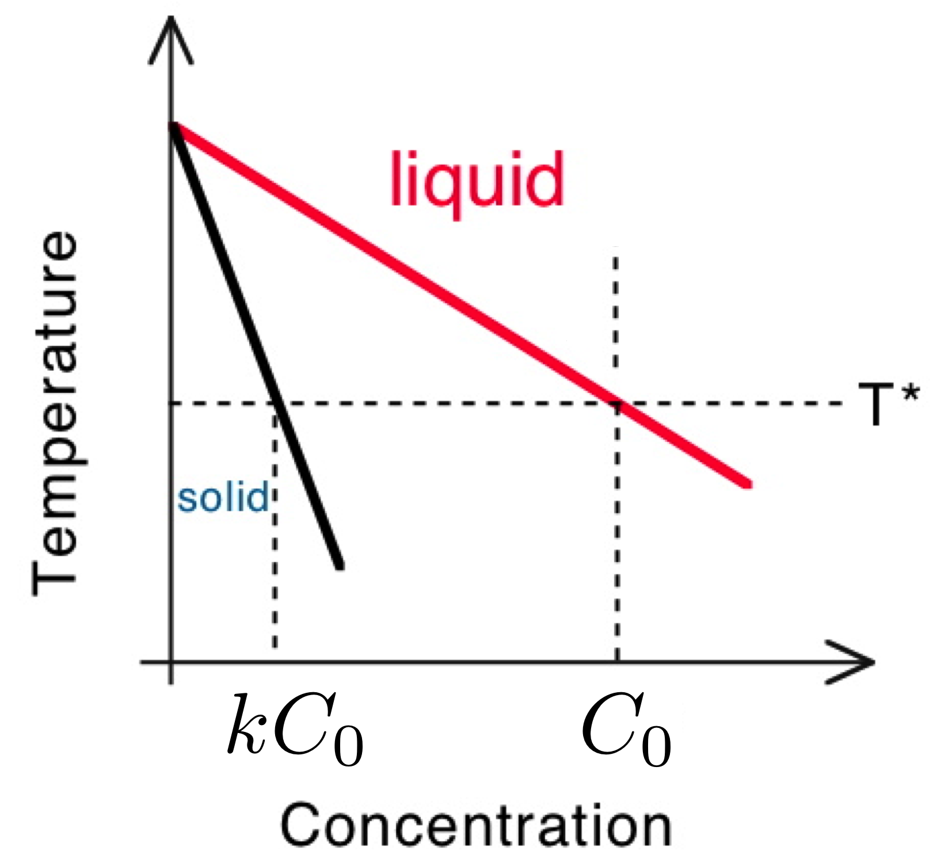

Slide 13
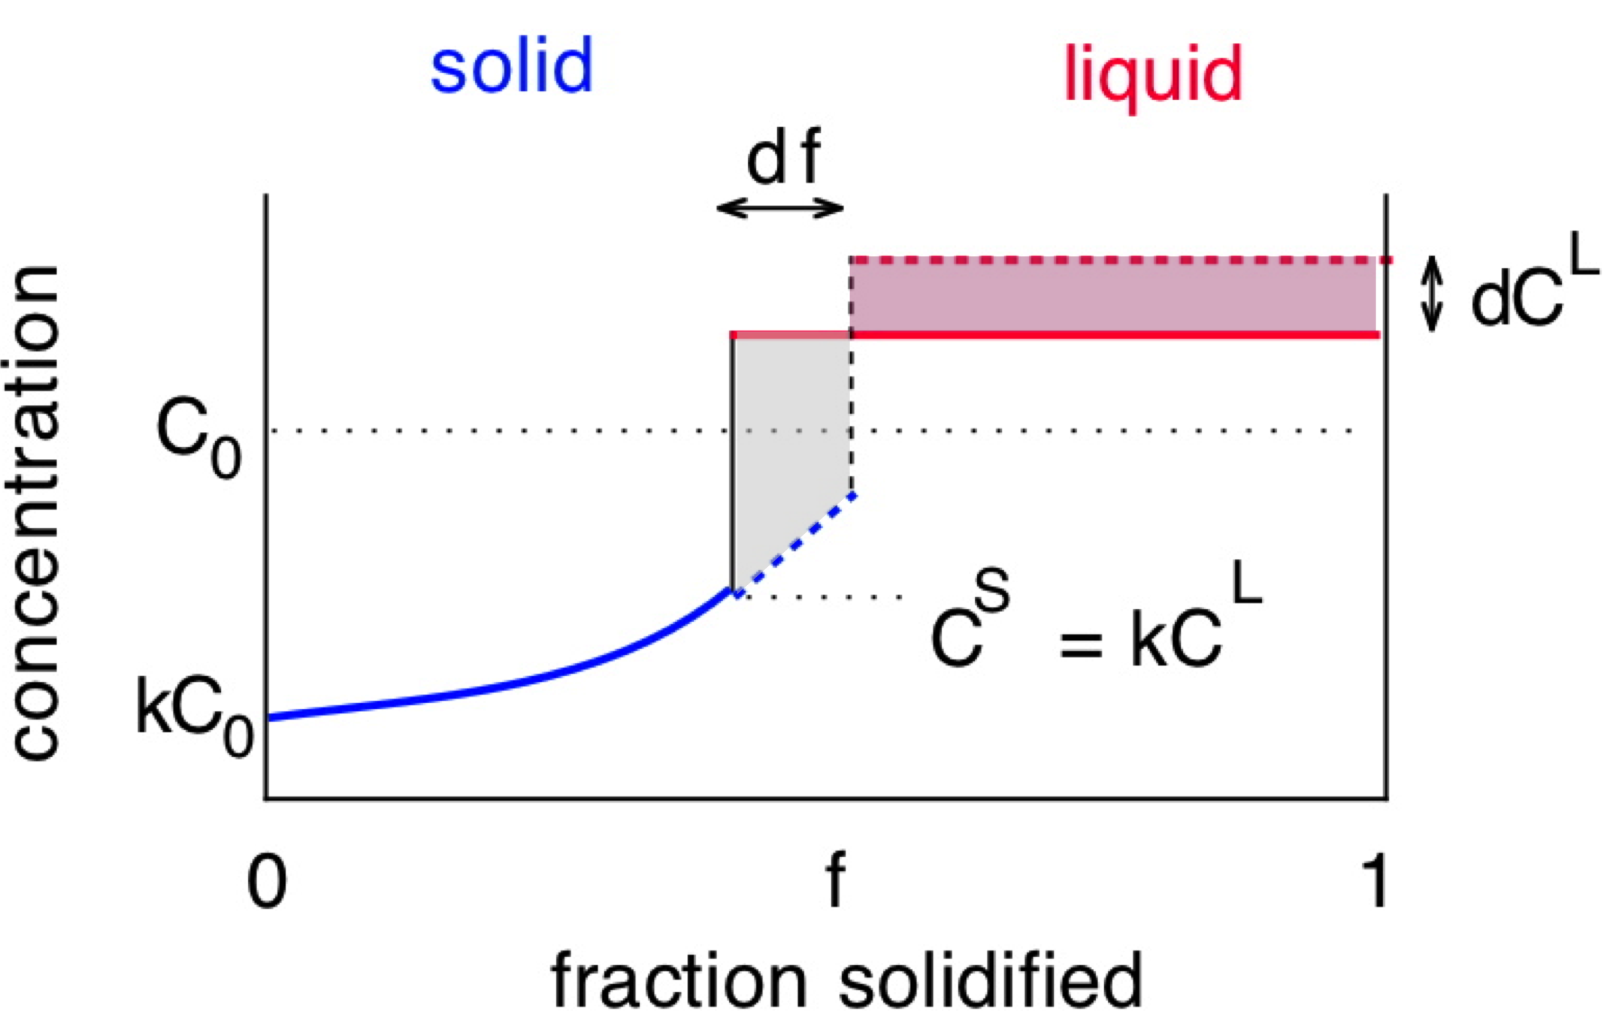

Slide 14
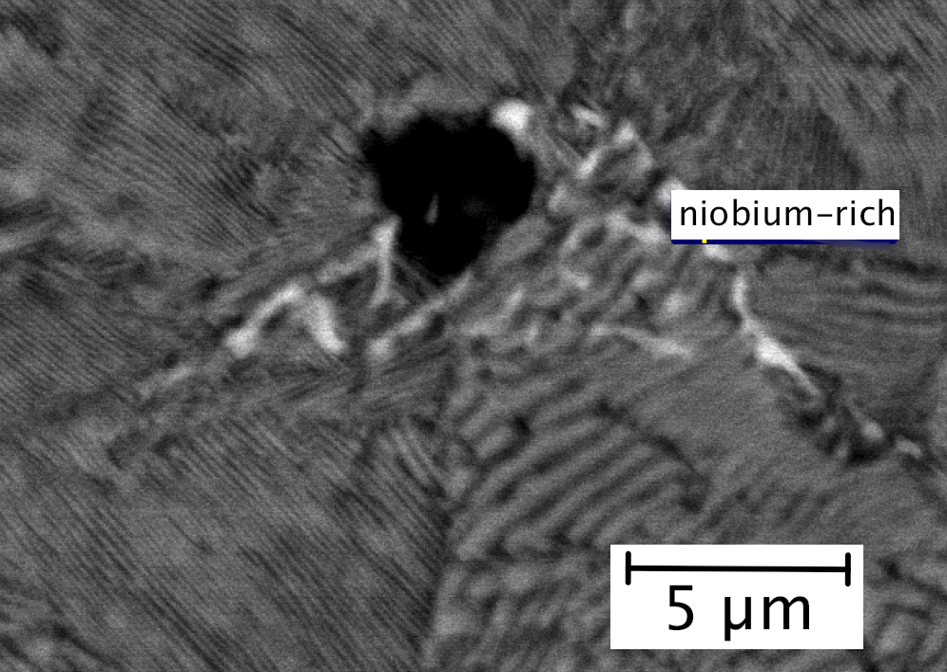
0.02 wt% Nb added to experimental rail steels: cast condition

Slide 15
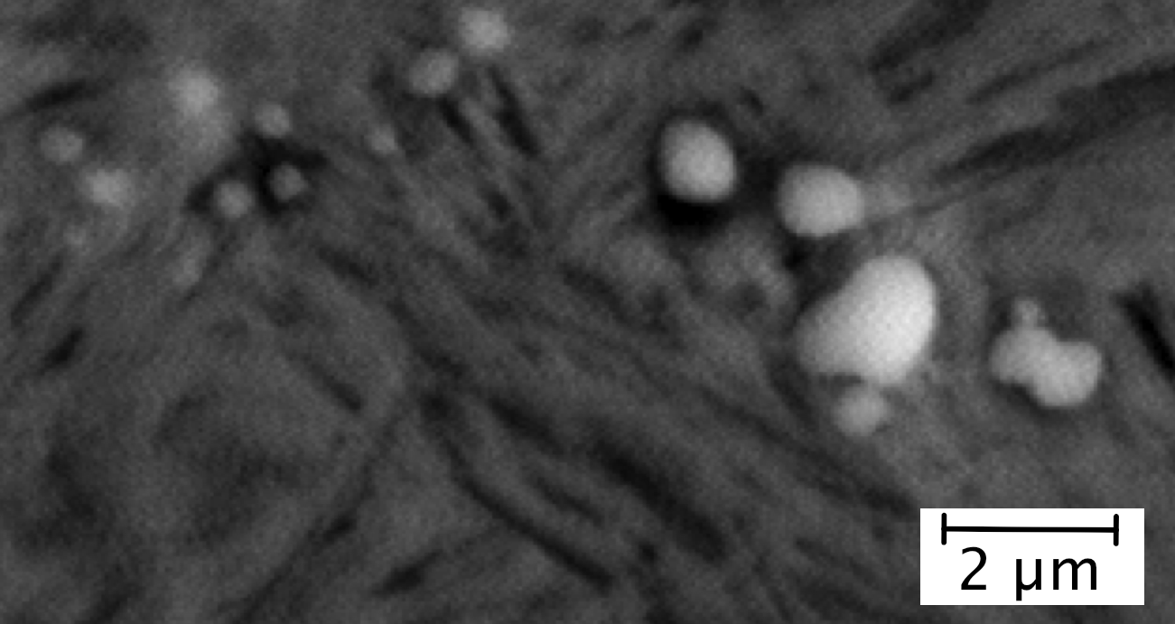
0.02 wt% Nb added to experimental rail steels: hot-rolled condition

Slide 16
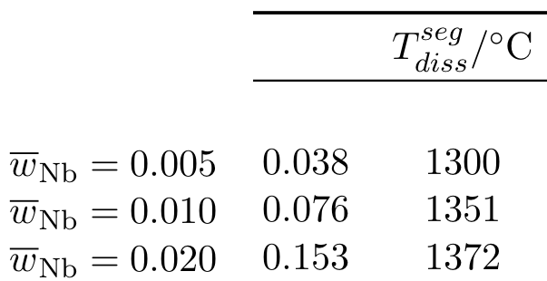
base composition of pearlitic rail:
0.8 C – 0.4 Si – 1.0 Mn – 0.5 Cr wt%
average Nb
Nb

Slide 17
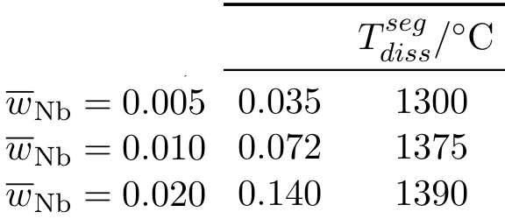
base composition of carbide-free bainite:
0.4 C – 1.5 Si – 2.0 Mn – 1.0 Cr – 0.3 Mo wt%
average Nb
Nb

Slide 18
Dissolution of NbC in pearlitic rail
Cast samples water quenched for scanning microscopy of NbC
Nb / wt% | Temperature / °C | Time / h | Precipitates in SEM
0.02 | 1300 | 2 | Observed
0.02 | 1300 | 4 | Not observed
0.02 | 1250 | 48 | Not observed
0.015 | 1250 | 2 | Not observed
0.015 | 1200 | 2 | Observed
0.01 | 1200 | 2 | Not observed

Slide 19
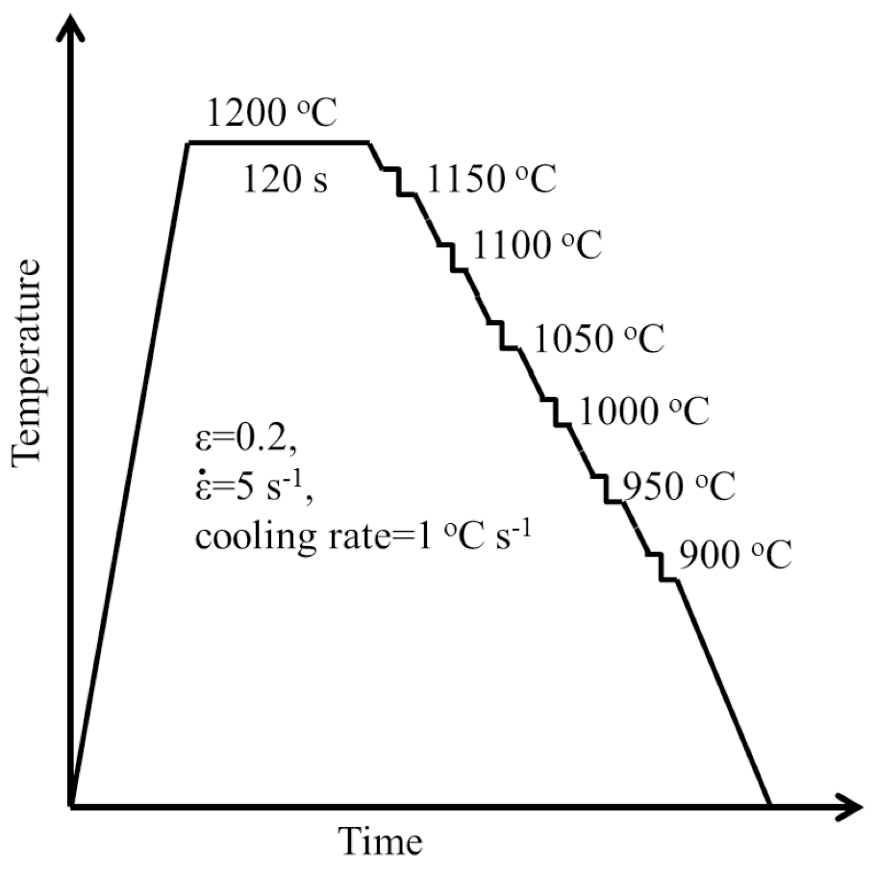

Slide 20
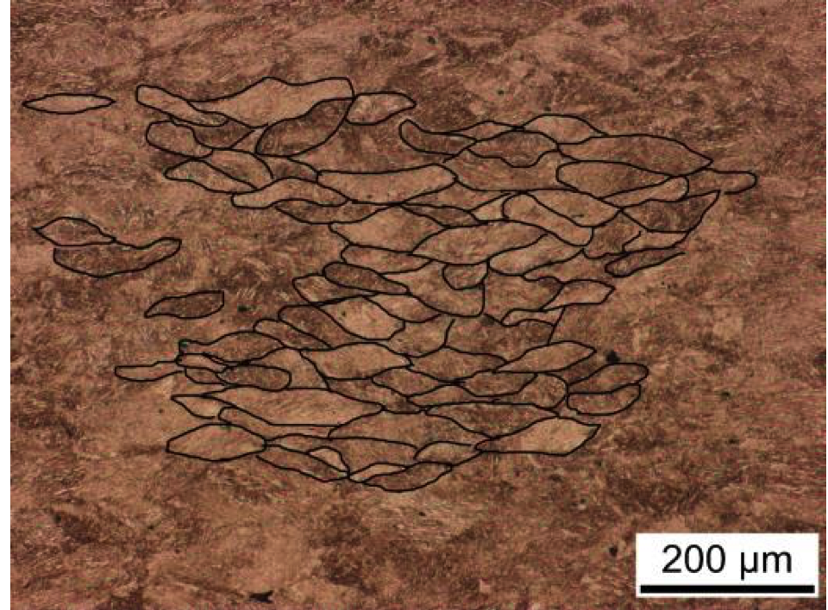
Pancaked austenite grains in 0.01 Nb bainitic rail steel

Slide 21
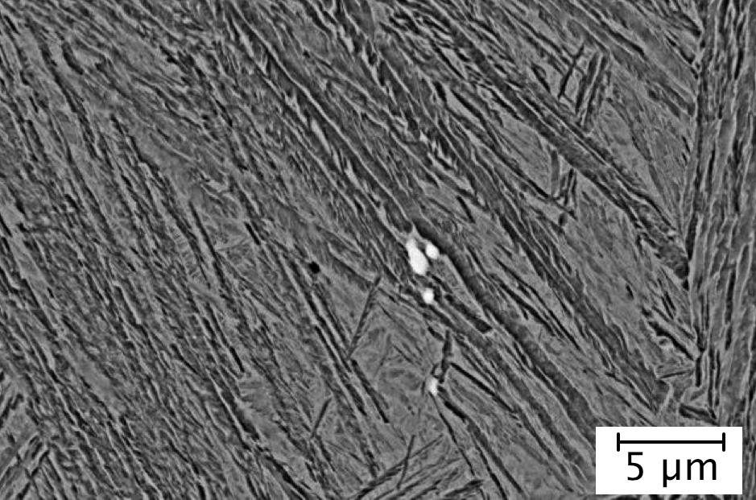

Slide 22
Outcomes
Generic strategy developed for niobium additions to high-carbon steels
Strategy consistent with rolling-start temperatures of 1300 or 1200°C
Work in progress to establish acceptable
un-dissolved carbide particle size

