Slide 1


Percolation of phases in interface dominated structures:
consequences on diffusion, properties
www.msm.cam.ac.uk/phase-trans

Slide 2
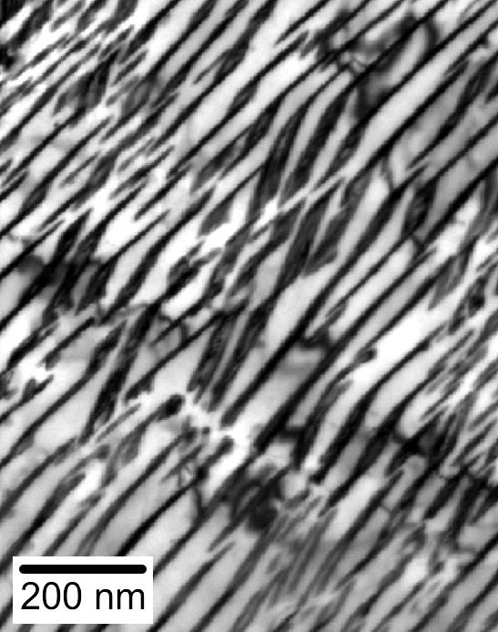
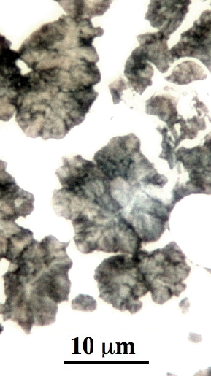
The Pearlite Reaction

Slide 3
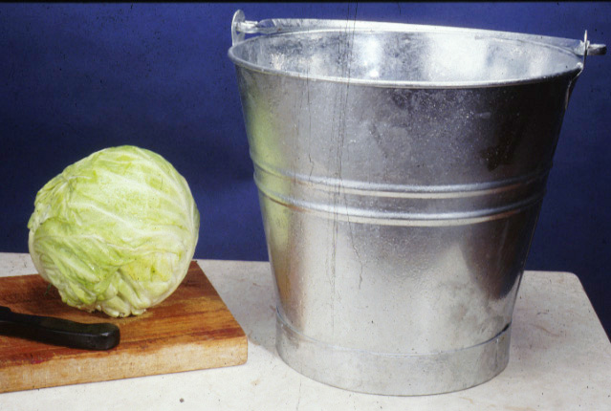

Slide 4
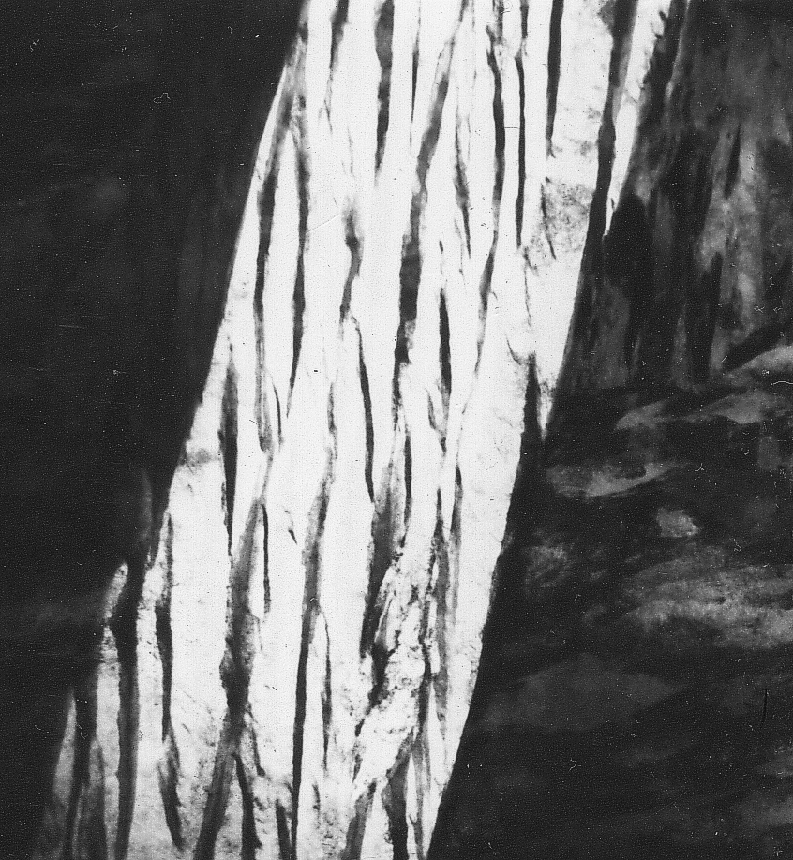
upper bainite
1 µm

Slide 5
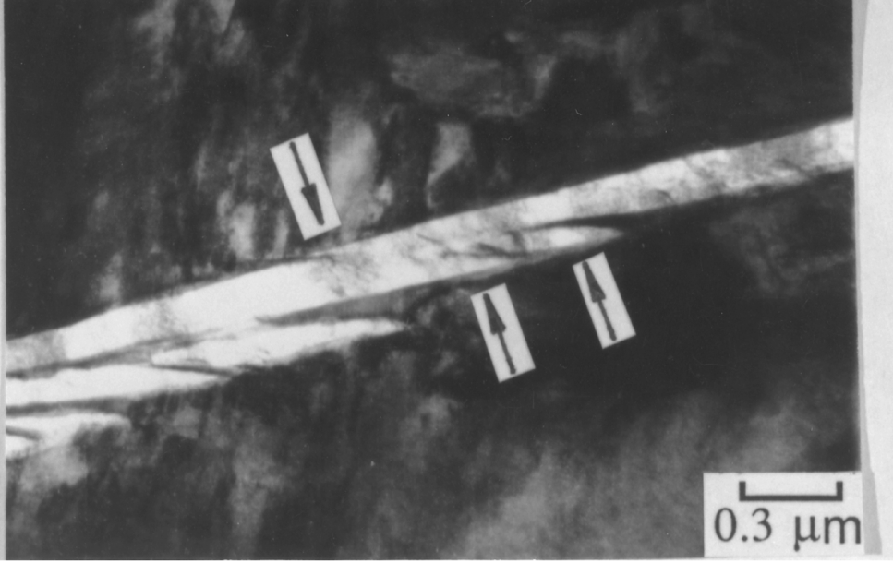

Slide 6
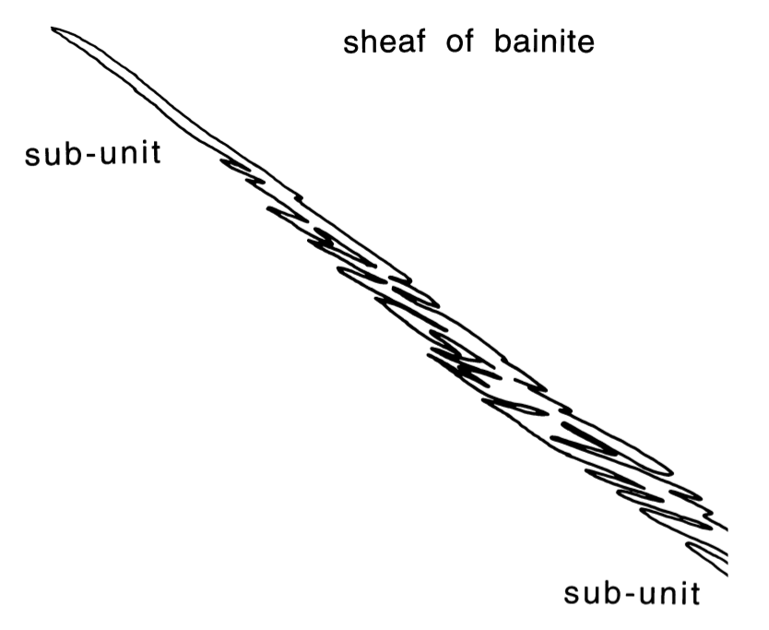

Sheaf is a rough object

Slide 7
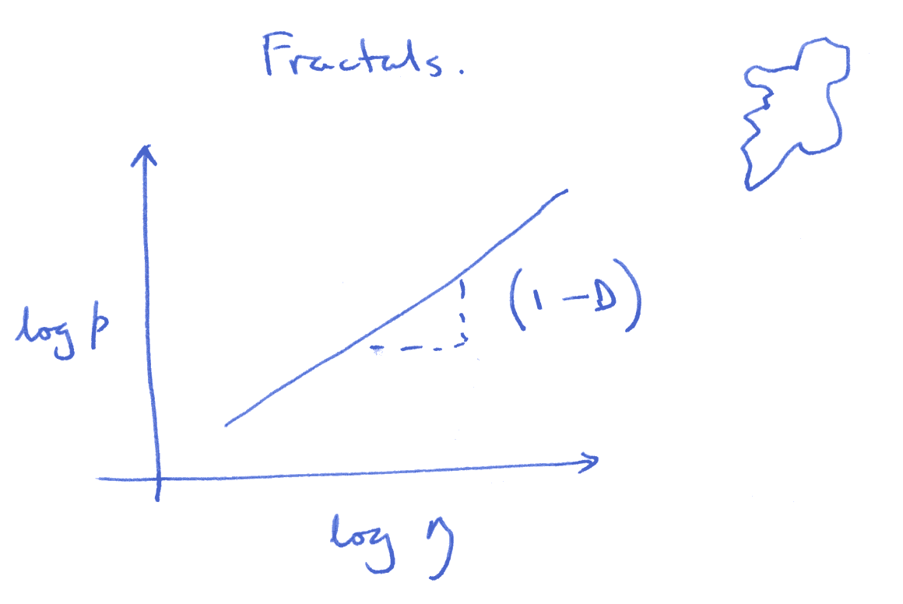
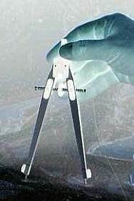

Slide 8


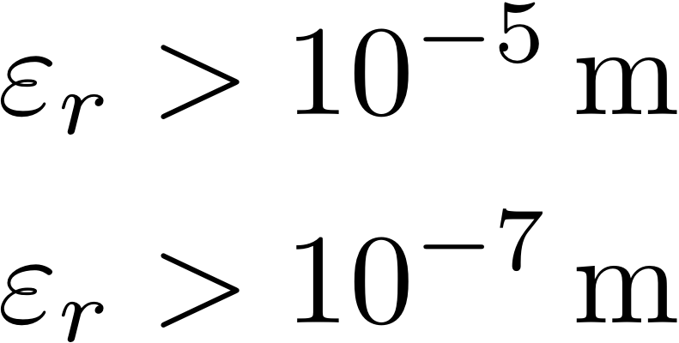
plastic zone
hydrogen

Slide 9
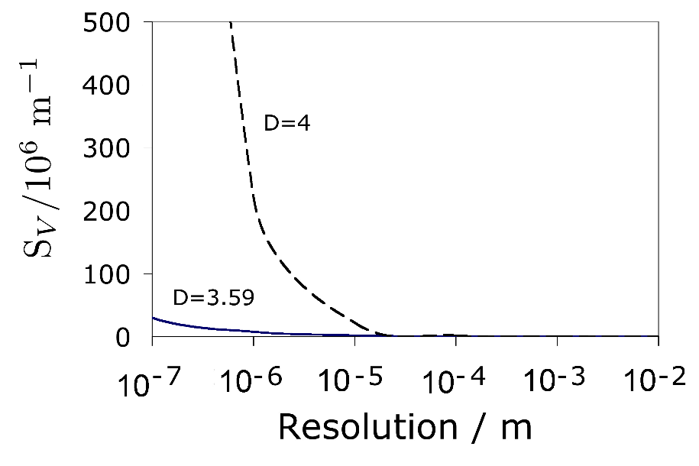

Slide 10
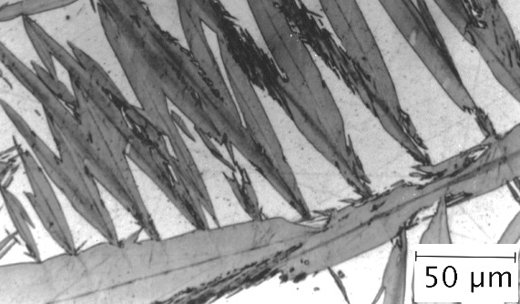
fragmentation of martensite

Slide 11
Greasy austenite
martensite is brittle
yet, dual phase steels etc are not
explained by austenite films that
lubricate deformation

Slide 12
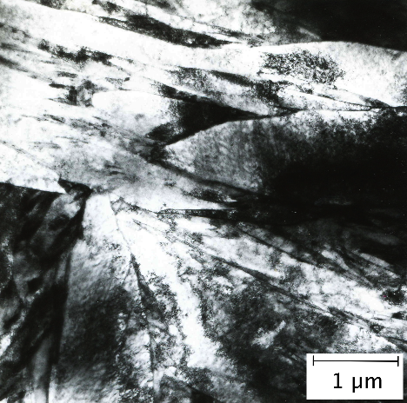
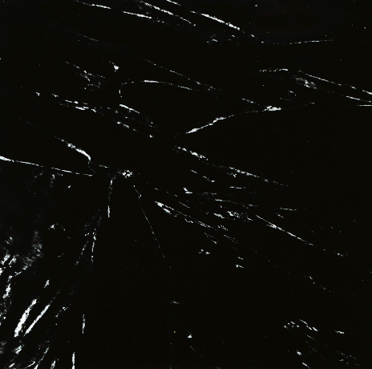
greasy austenite?

Slide 13
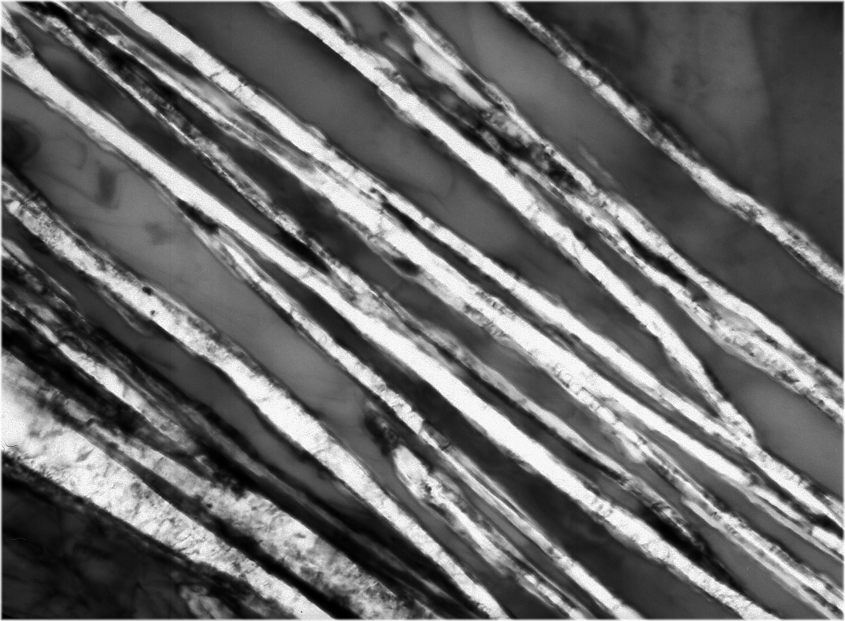
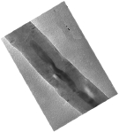
γ
γ
α
α
α
Caballero, Mateo, Bhadeshia
200 Å

Slide 14
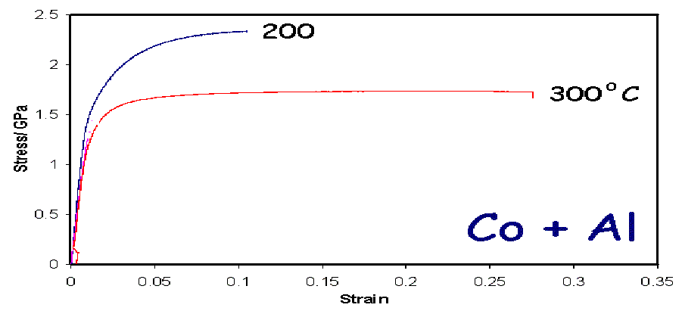

Slide 15
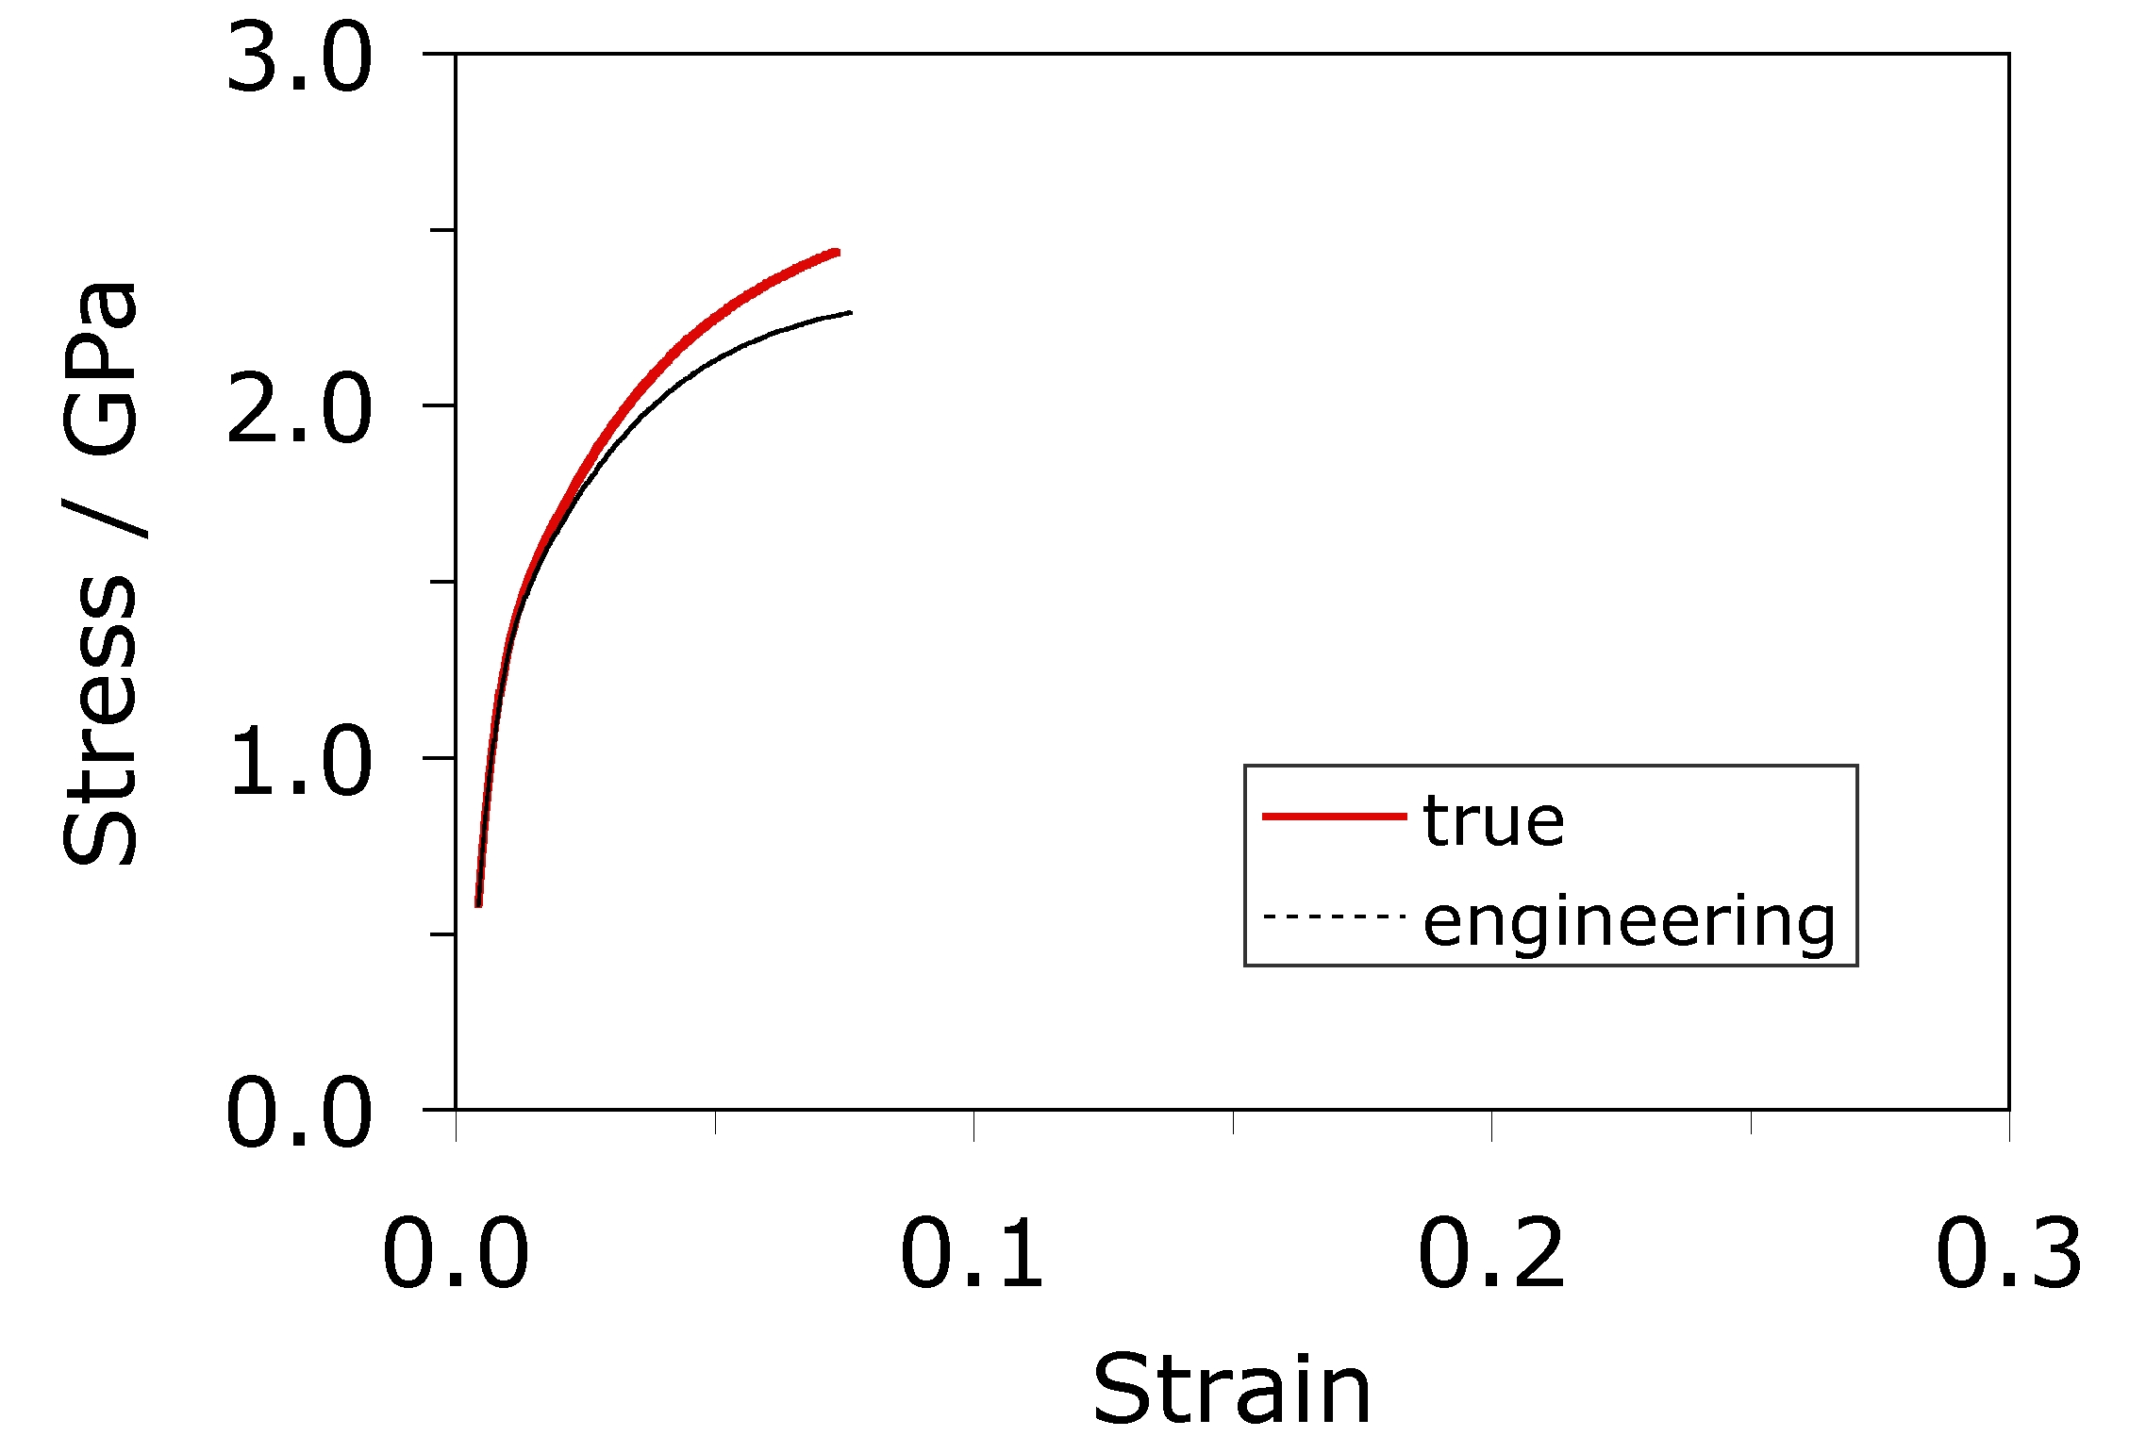
Caballero, Mateo, Bhadeshia

Slide 16
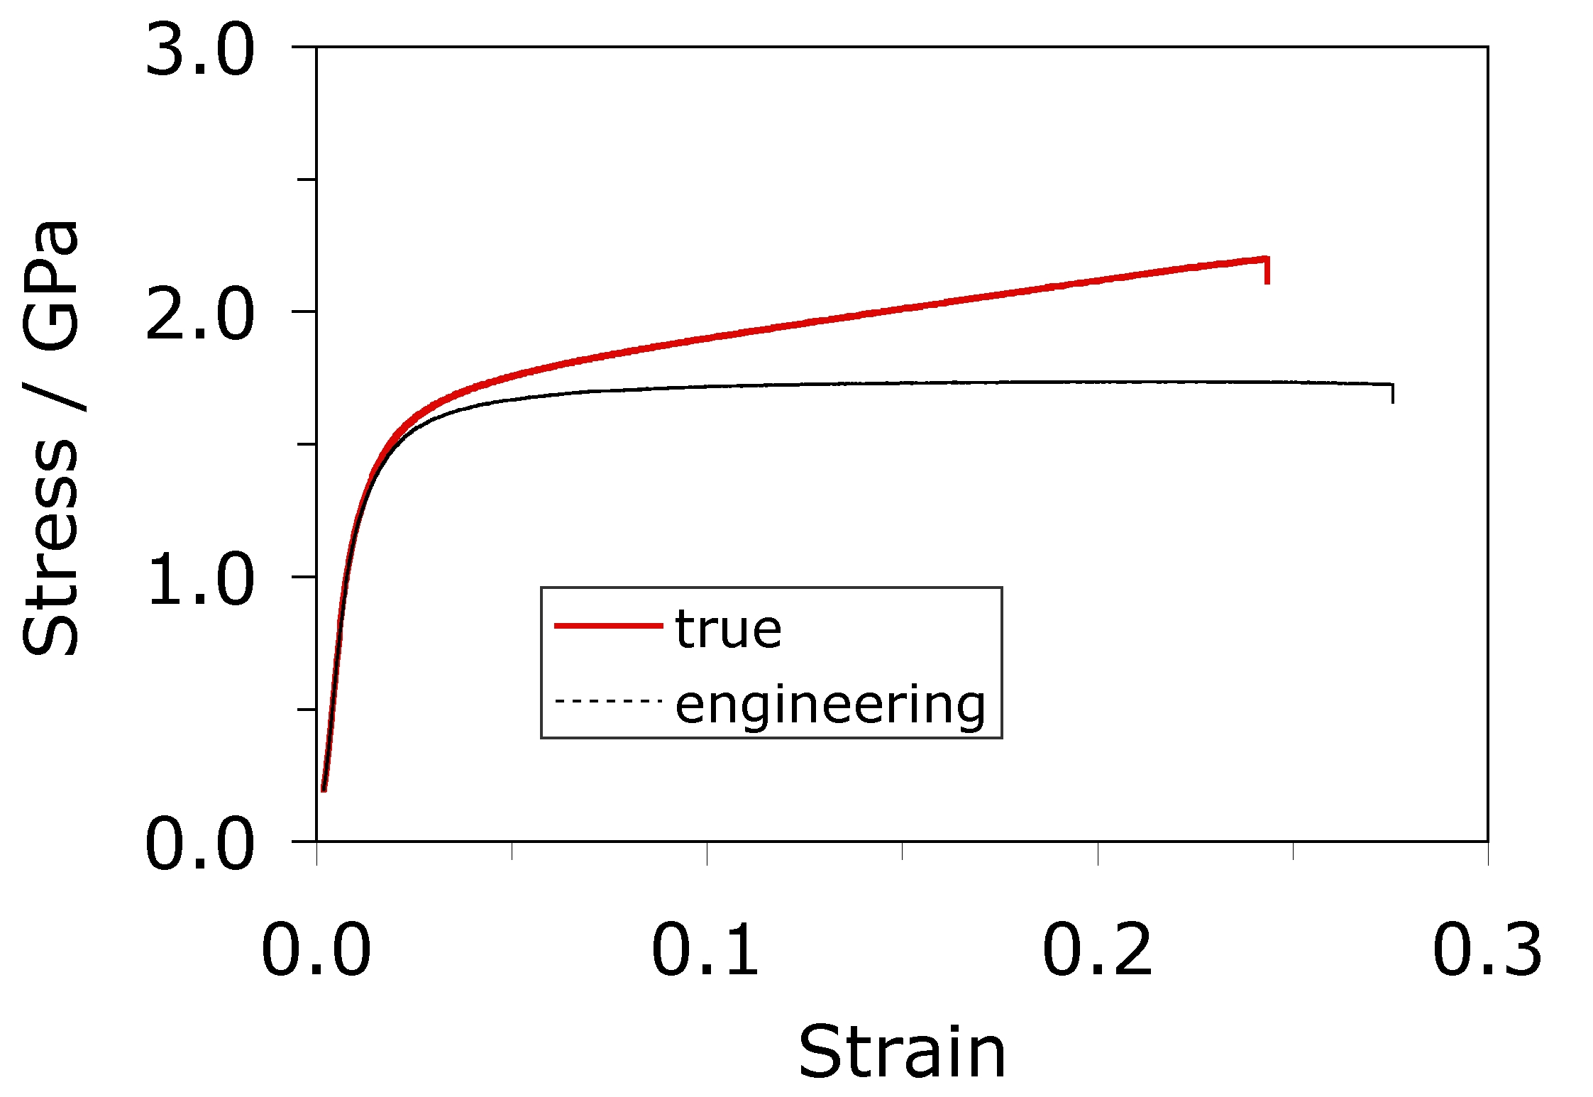
Caballero, Mateo, Bhadeshia

Slide 17
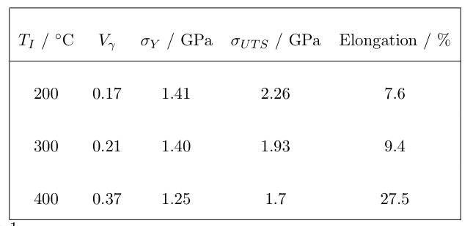

Slide 18
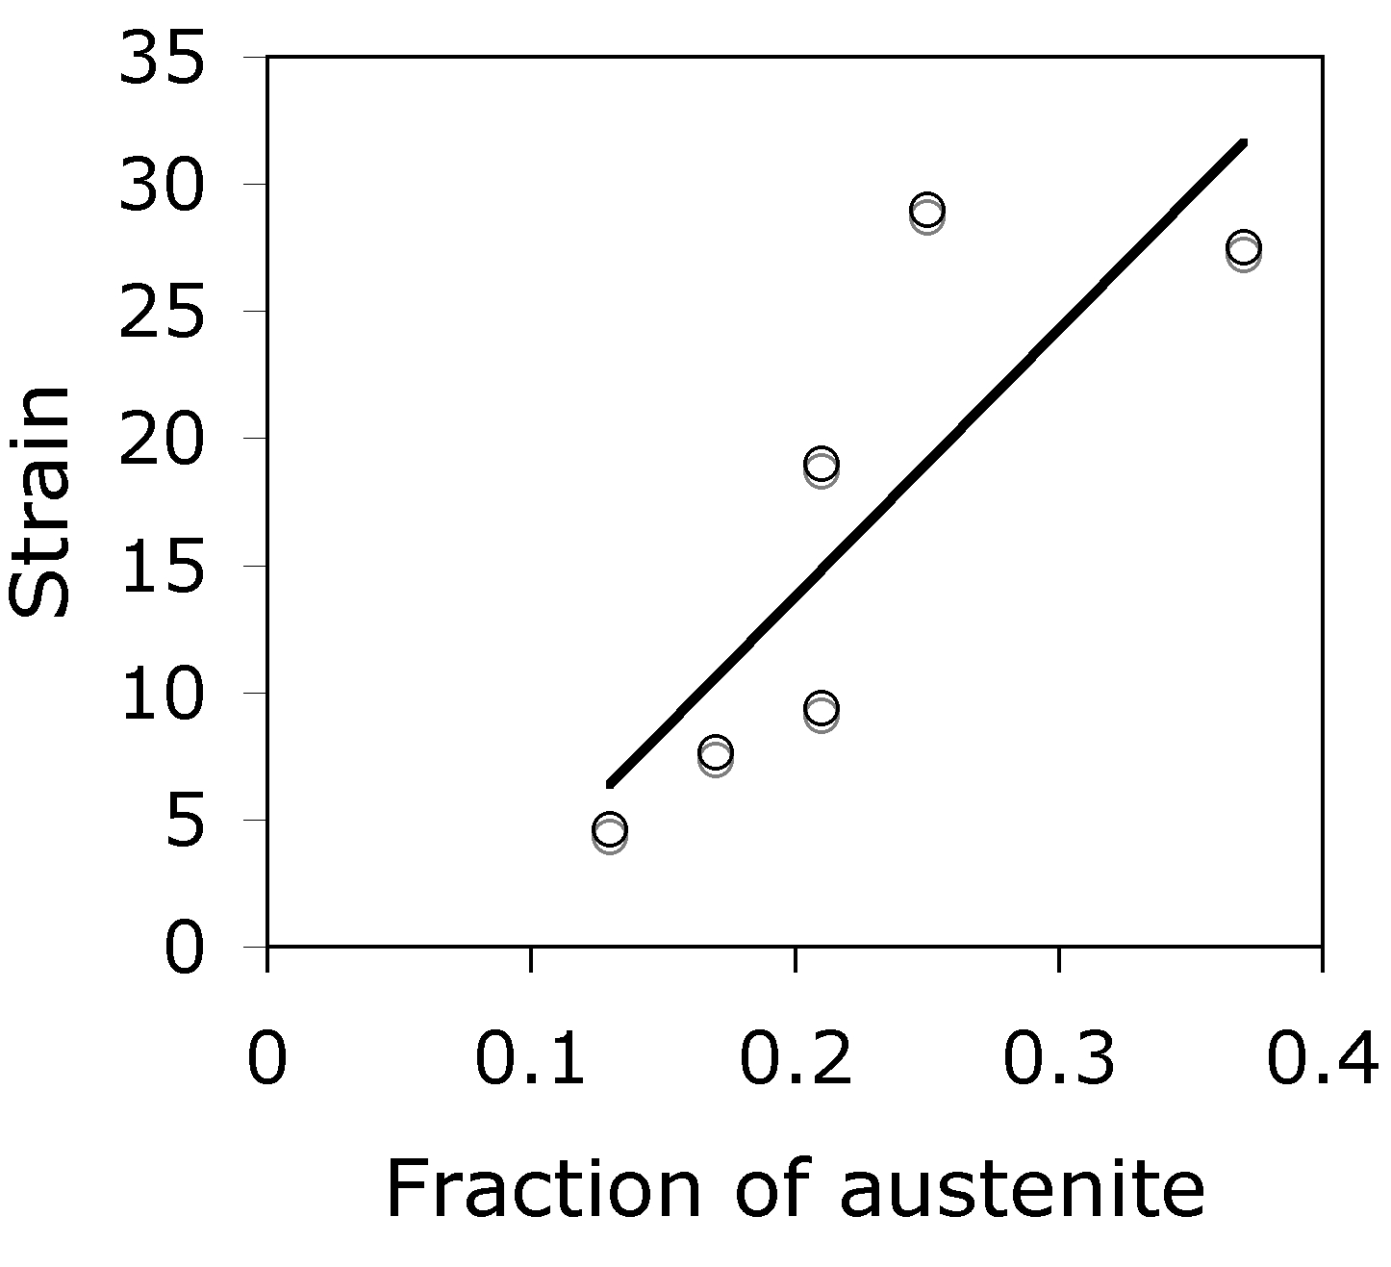

Slide 19
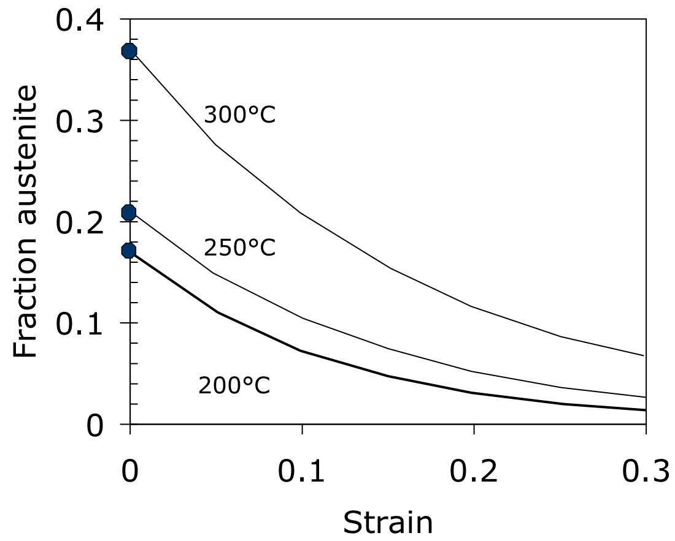

Slide 20
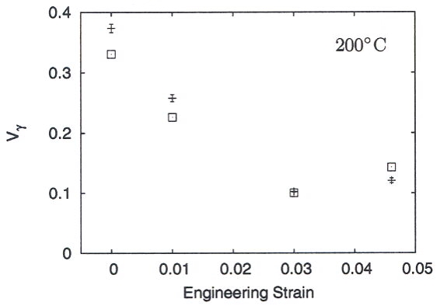
Sherif, 2005, Ph.D. thesis, Cambridge

Slide 21
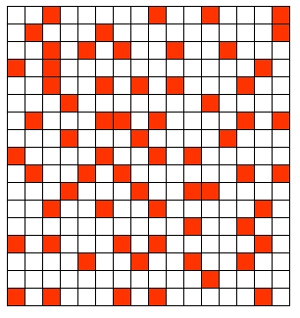
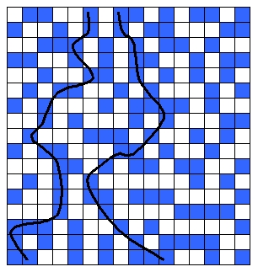
Above percolation threshold
Below percolation threshold

Slide 22
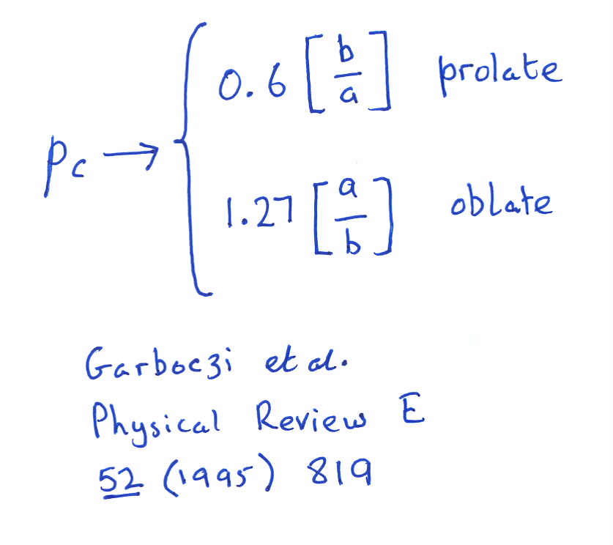
Geometrical percolation threshold of overlapping ellipsoids

Slide 23
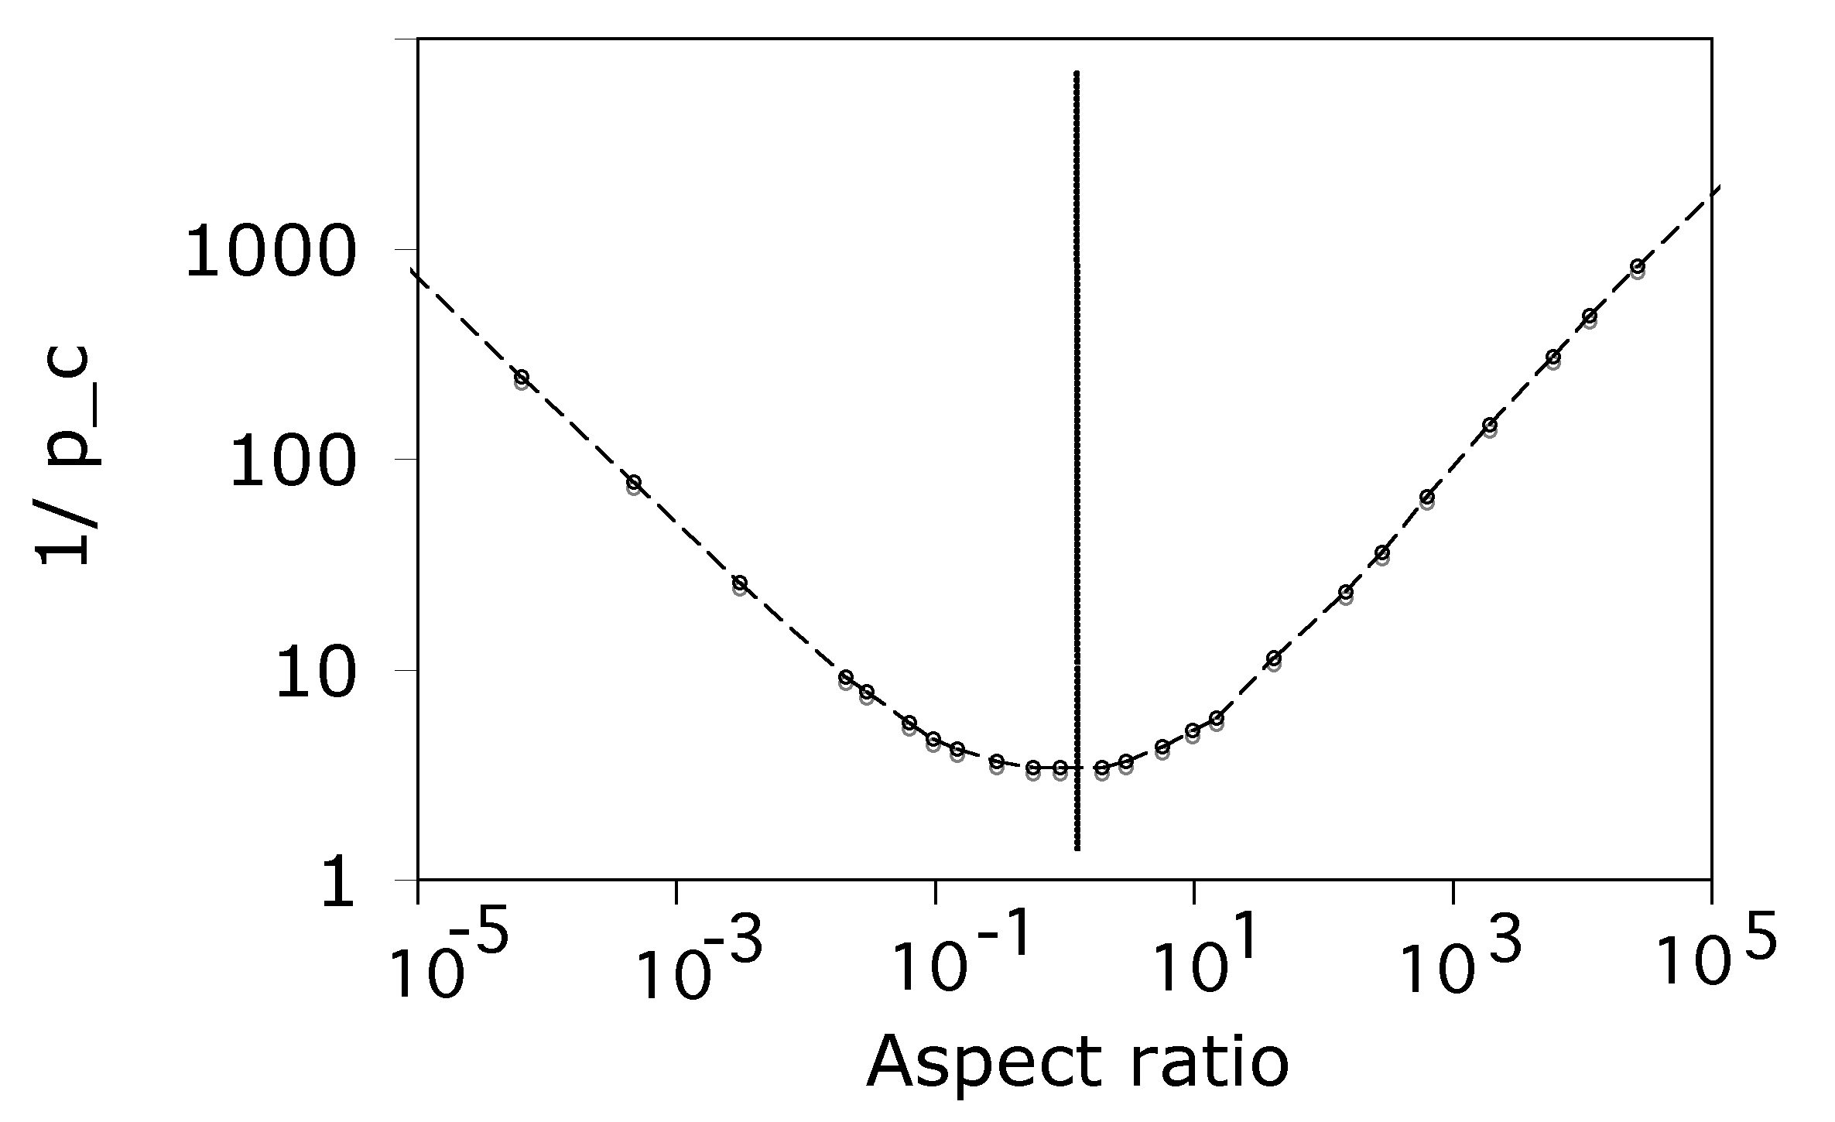

Slide 24
Hydrogen probing
of austenite percolation

Slide 25
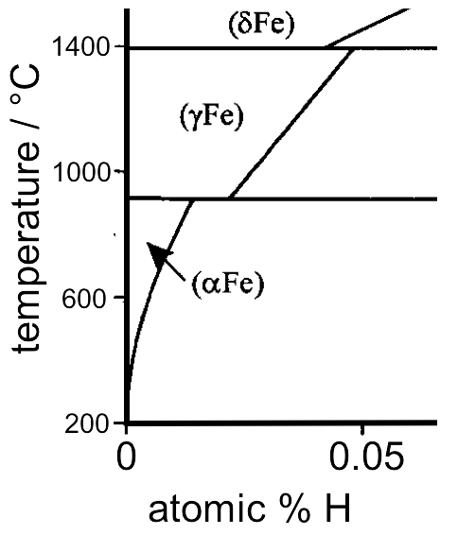
Hydrogen dissolves in ferrite, austenite
Okamoto:2004

Slide 26
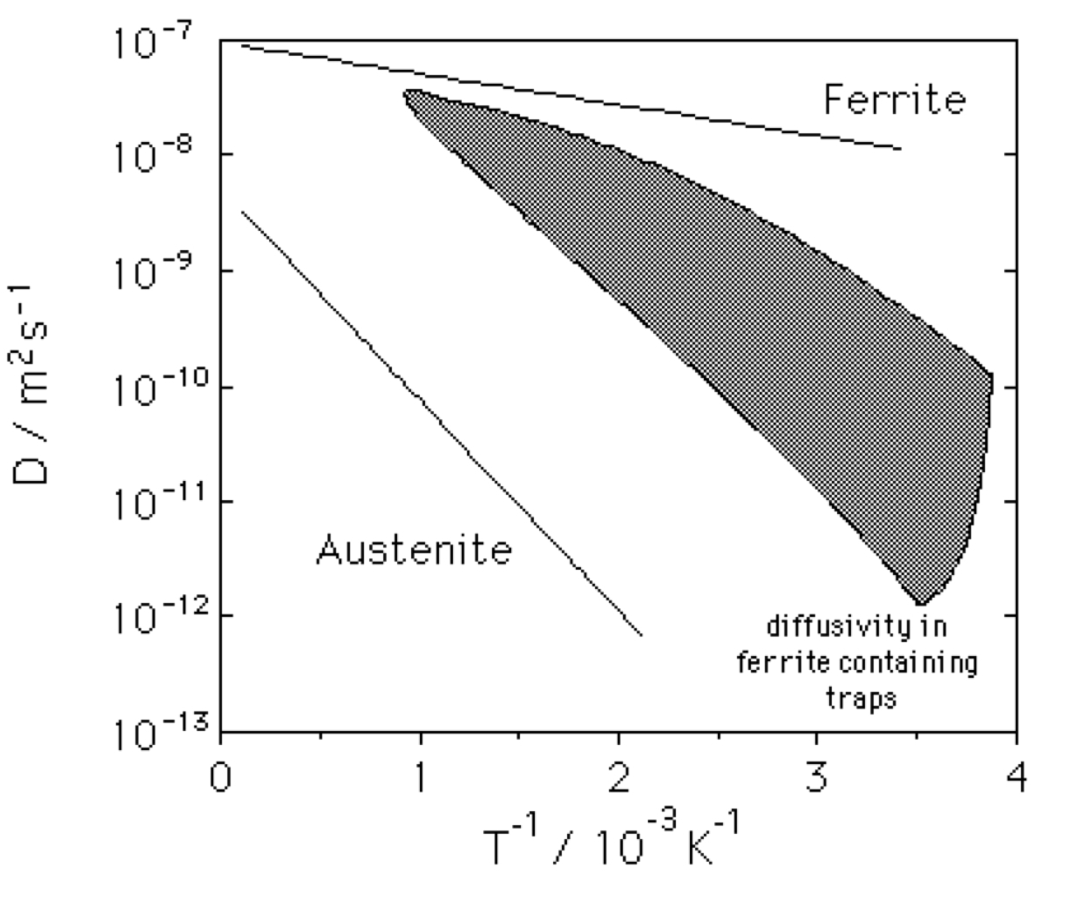
Coe, 1973
hydrogen diffuses faster in ferrite, but there are complications

Slide 27
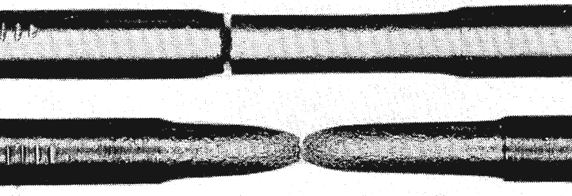
W. H. Johnson: ‘On some remarkable changes produced in iron and steel by the action of hydrogen and acids’, Proceedings of the Royal Society of London, 1875, 23, 168–179.
normal
pickled
Pfeil 1926
Hydrogen embrittles iron
both single and polycrystalline forms

Slide 28
W. H. Johnson: ‘On some remarkable changes produced in iron and steel by the action of hydrogen and acids’, Proceedings of the Royal Society of London, 1875, 23, 168–179.
It is diffusible hydrogen that embrittles
it is atomic hydrogen that embrittles
submerging H-containing steel causes frothing
stronger steel more susceptible

Slide 29
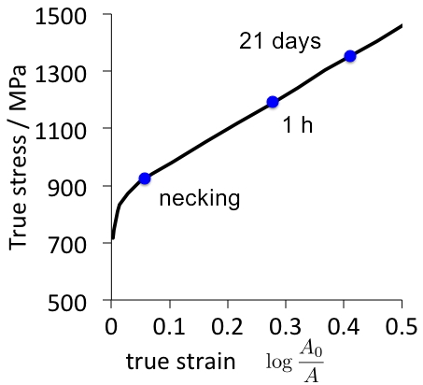
Hobson, 1951

Slide 30
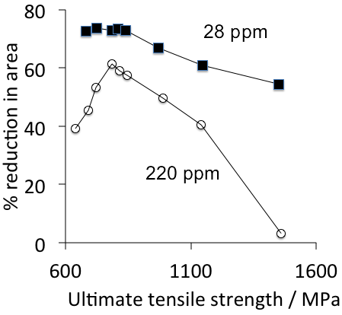
Hobson & Sykes, 1951
Tendency to embrittle scales with strength
or does it in fact scale with ductility in the absence of hydrogen?

Slide 31
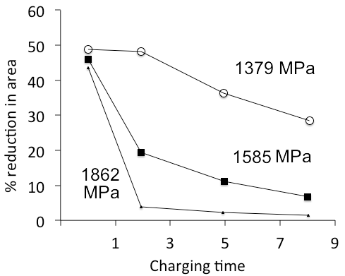
Frohmberg, 1954

Slide 32
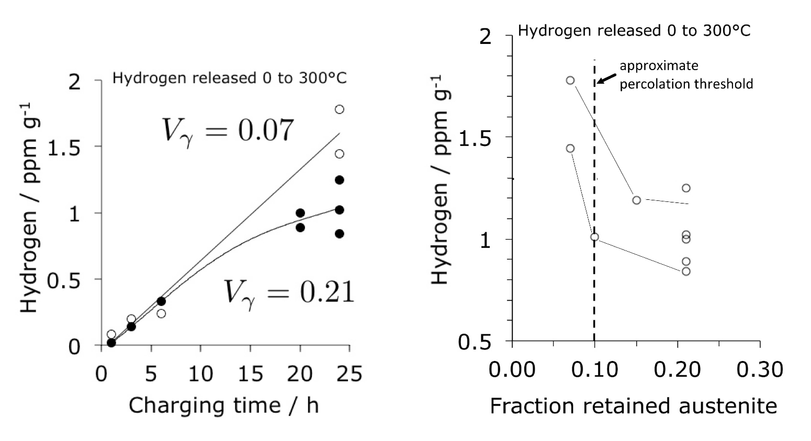
Fielding, Song, Bhadeshia, Suh, unpublished

Slide 33
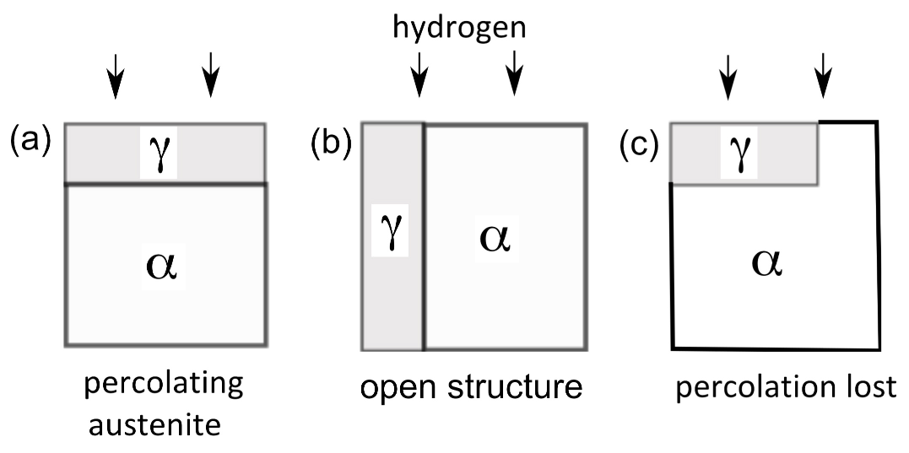
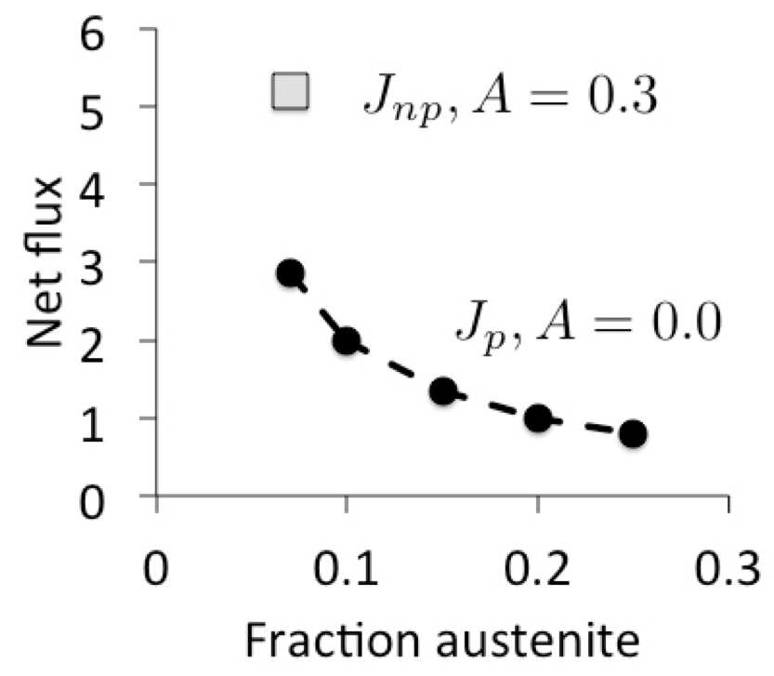

Slide 34
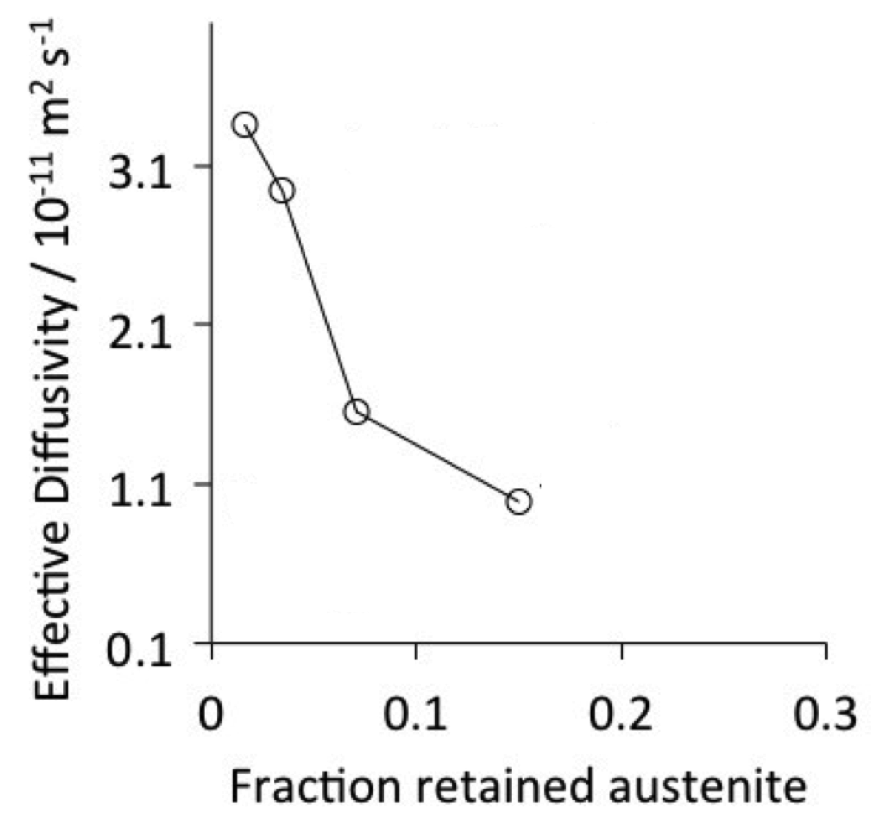
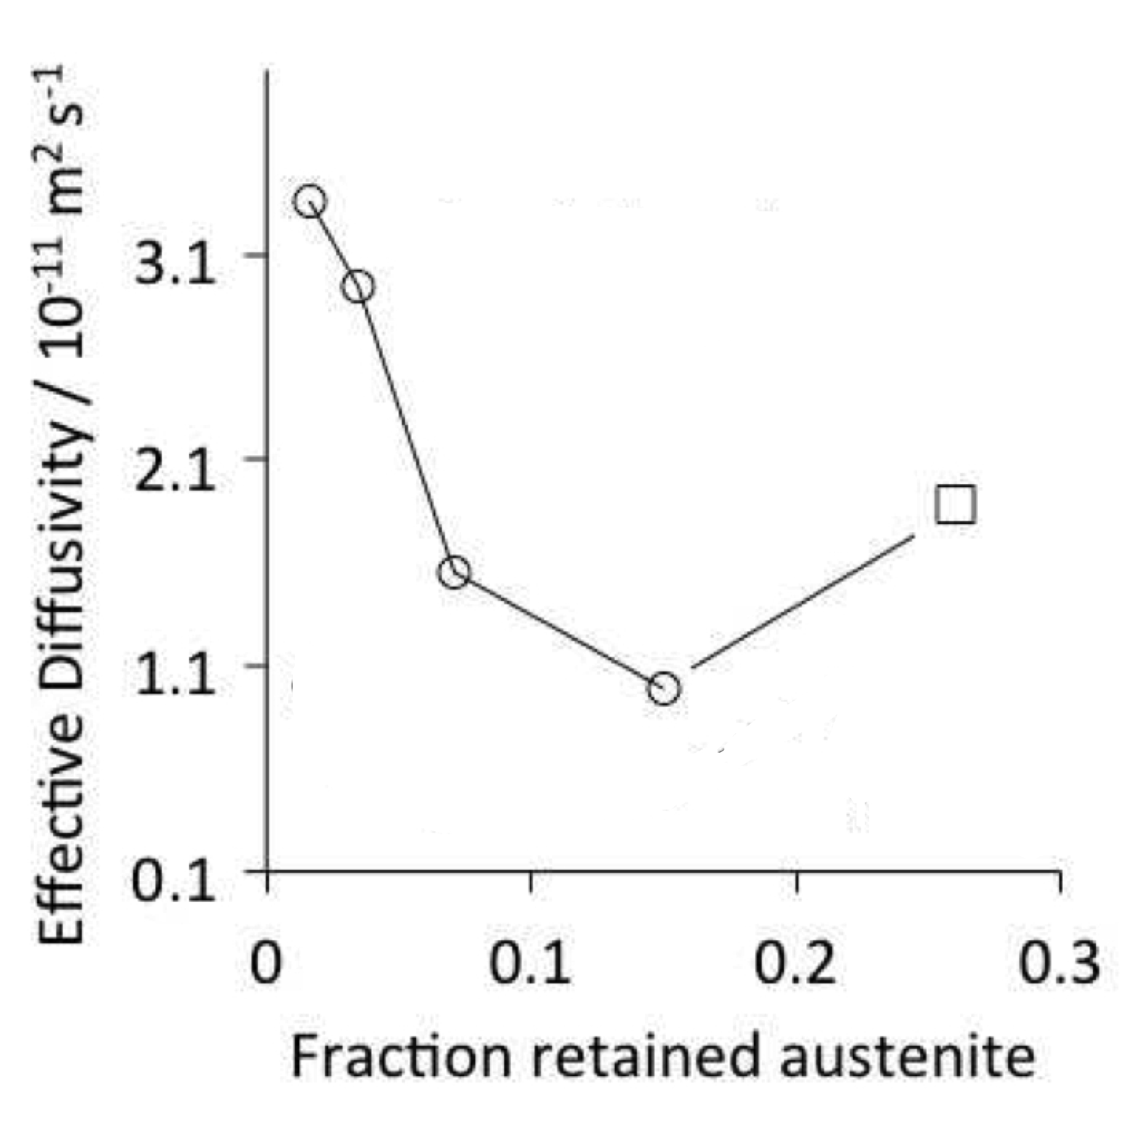
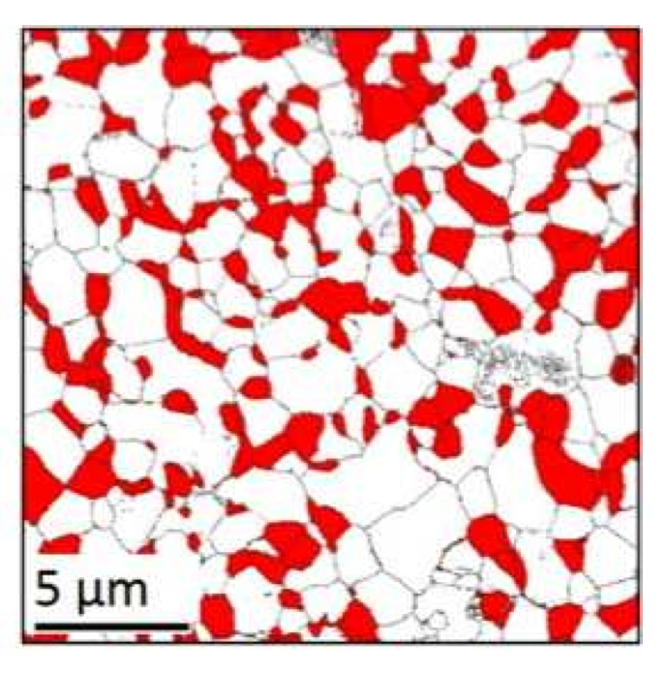

Fielding, Song, Han, Bhadeshia, Suh, Proc. Roy. Soc. A, 2014

Slide 35
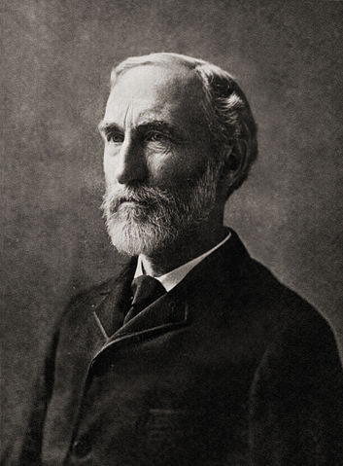

Why is Gibbs energy free?

Slide 36
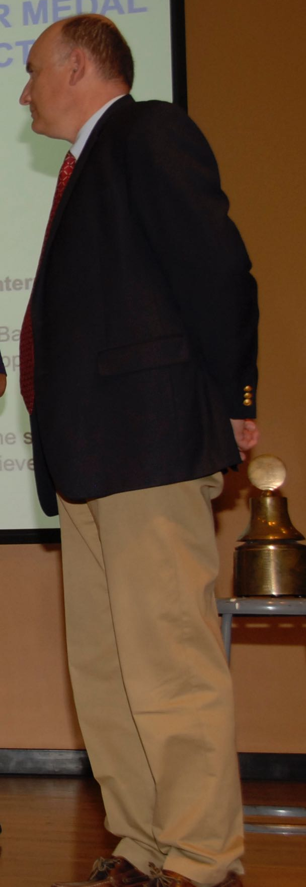
John Speer
Which medal? Helmholtz or Gibbs
Helmholtz is at constant volume
Gibbs at constant pressure

Slide 37

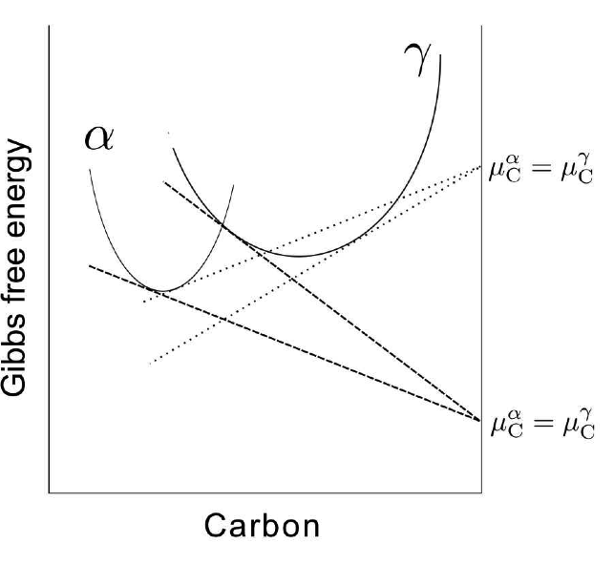

Slide 38
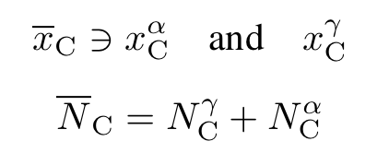
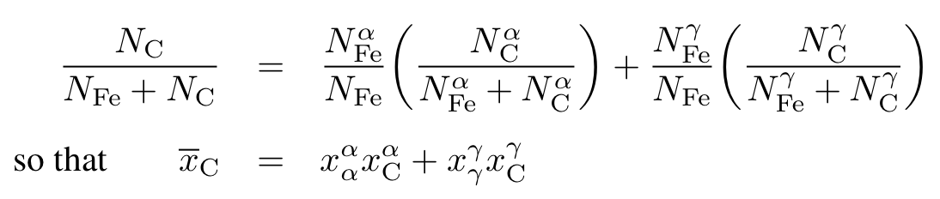

Slide 39
