Slide 1
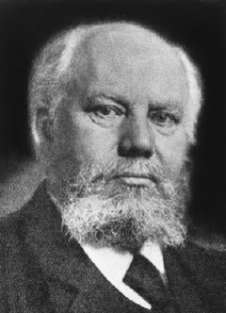

Complete theory for martensitic transformations
www.msm.cam.ac.uk/phase-trans
Adolf Martens
memorial lecture

Slide 2
Bain, Toriano, Wechsler, Liebermann,
Reed, Bowles, MacKenzie, Nishiyama,
Tamura, Shimizu, Kurdjumov,
Roitburd, Khandros, Cohen, Patel,
Krauss, Olson, Wayman, Zackay,
Wasserman, Christian, Bilby,
Hornbogen, Speich, Magee,
Koistinen, Marburger, Loretto, Ko

Slide 3
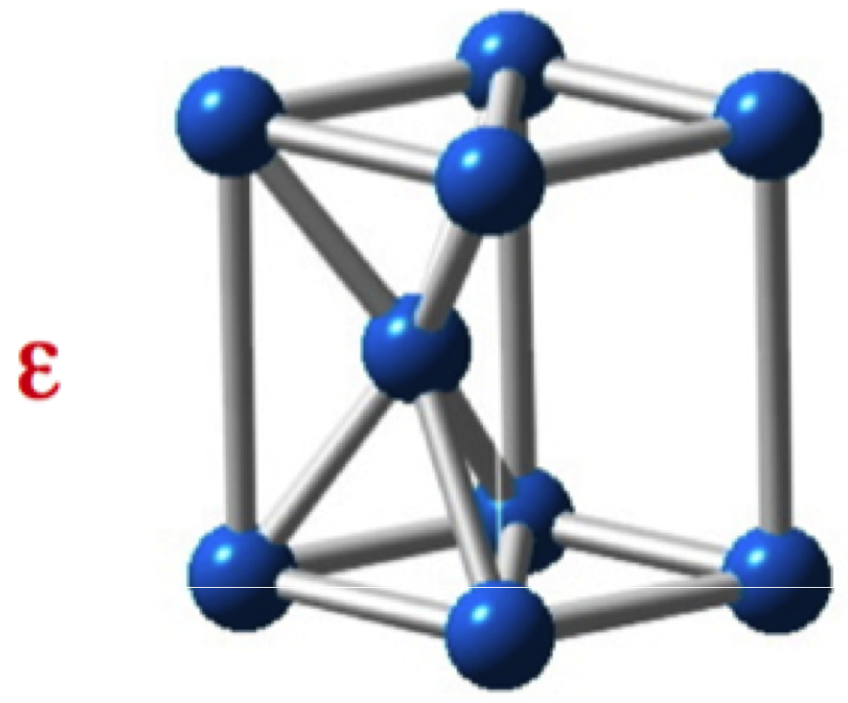
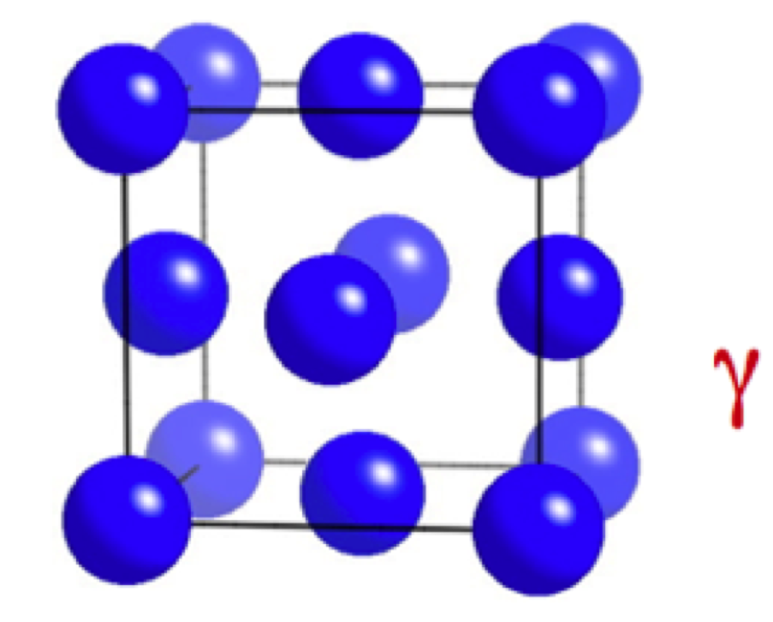
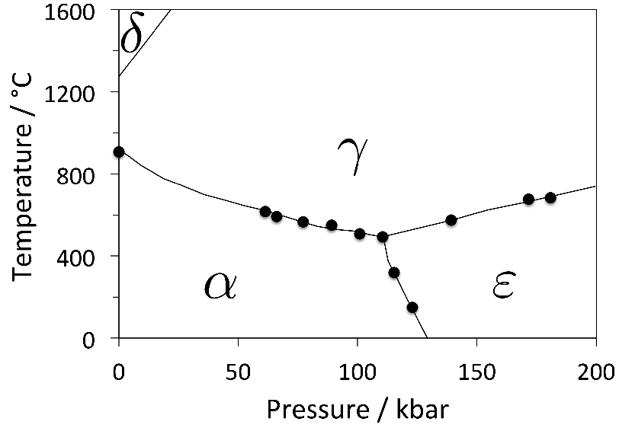
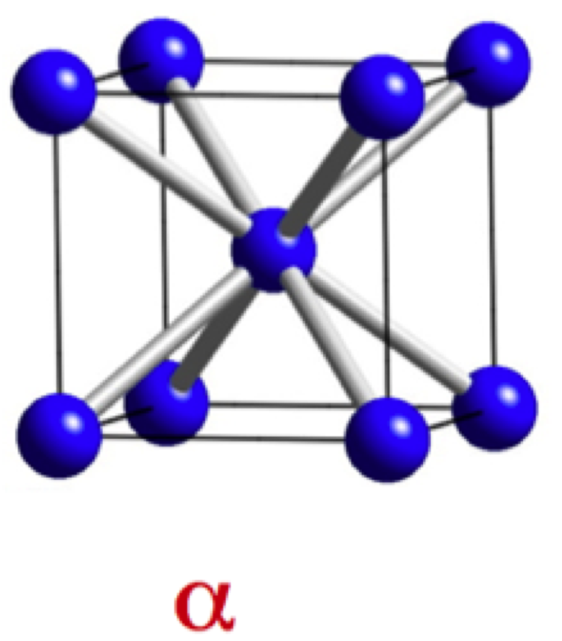

Slide 4
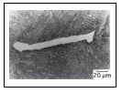
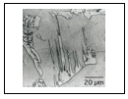

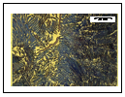
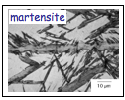

Slide 5
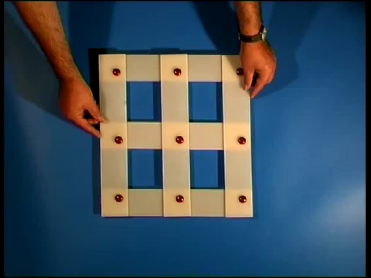

Slide 6
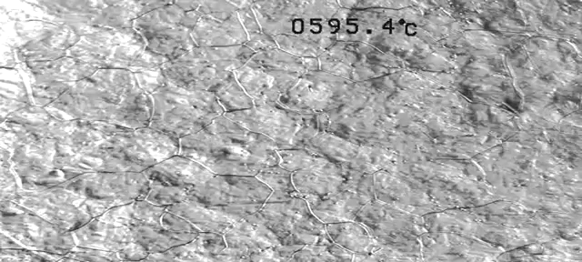

Slide 7
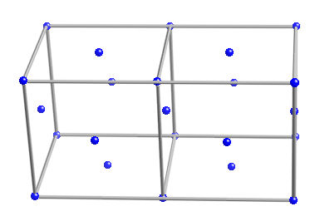
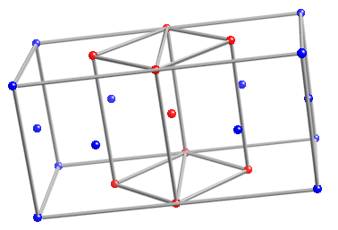
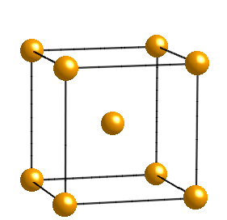

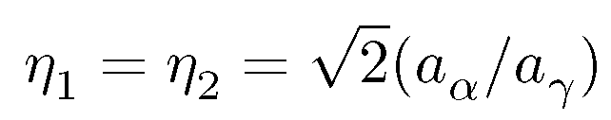
The Bain strain

Slide 8
[001]
b
b'
o
[100]
a'
a
b
(a)
o
b'
(b)
a,a'

Slide 9
RB
z
w
w
z
w
z
P
Observed
P
Austenite
1
shape,
2
Martensite
wrong
(wrong
y
structure
shape)
x
x
y
x
y
(a)
(b)
(c)
LATTICE
-INVARIANT
DEFORMATION
Twin
w
z
w
z
Boundary
x
y
x
y
Twinned
Slipped
Martensite
Martensite
Correct macroscopic shape, correct structure

Slide 10

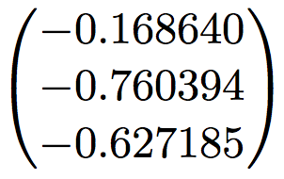

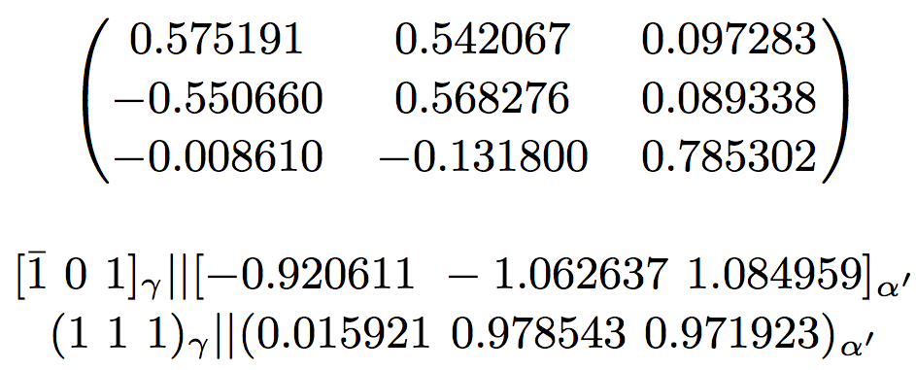
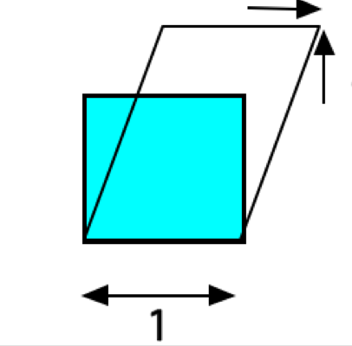

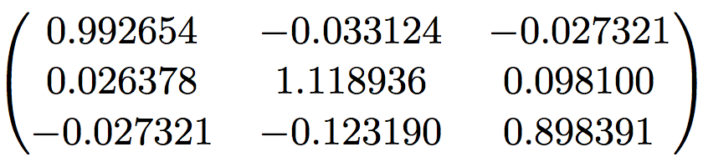

Slide 11
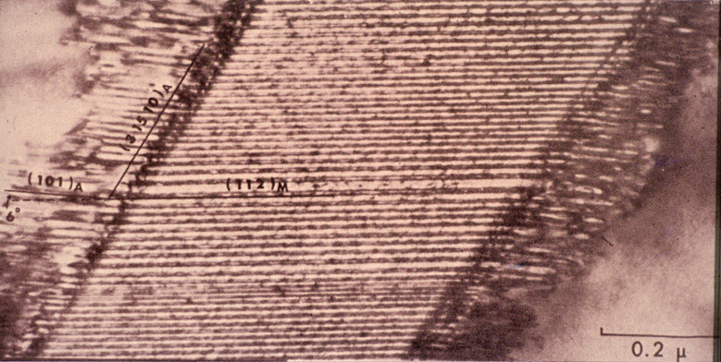
transformation twins (Wayman)

Slide 12
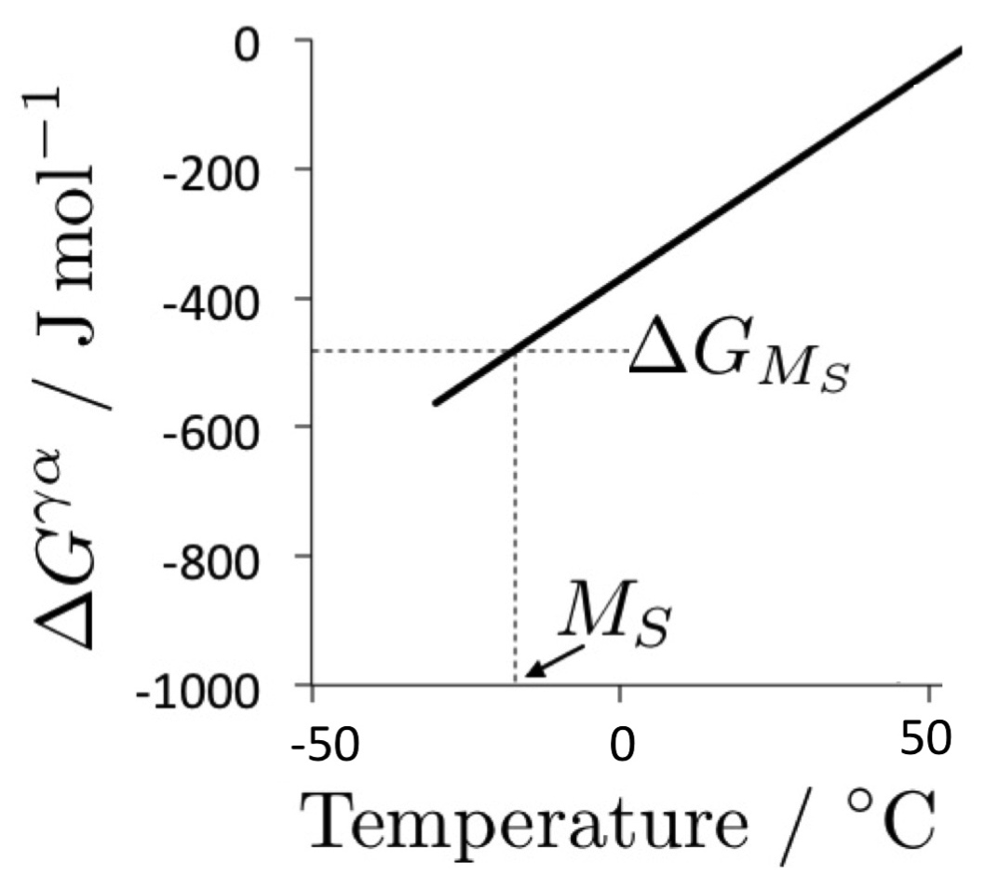
Martensite start temperature
Notes:
12

Slide 13
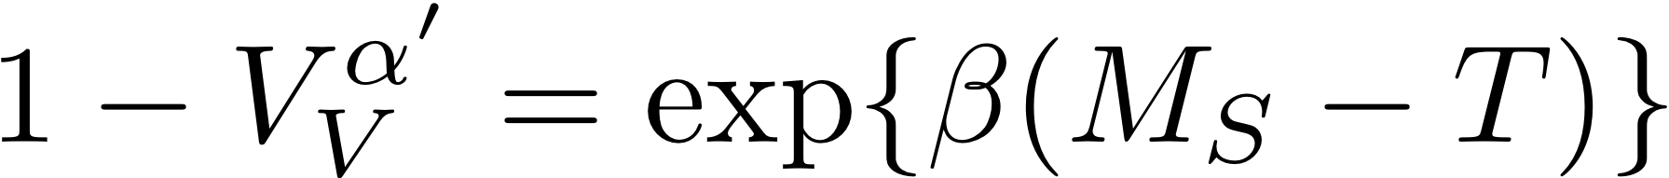
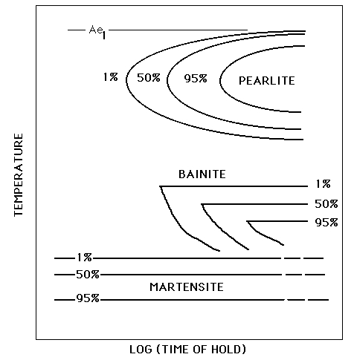
athermal transformation

Slide 14
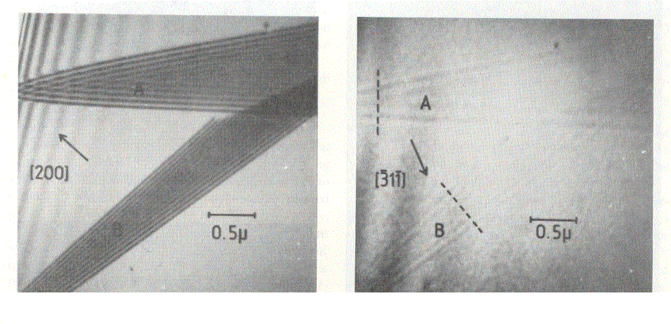
Brooks, Loretto and Smallman, 1979

Slide 15
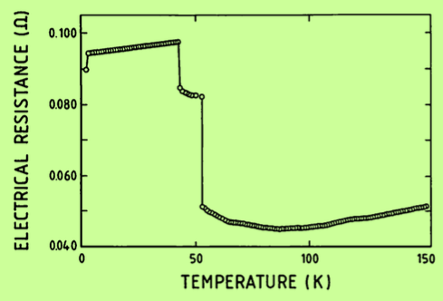
However, martensitic transformation can be suppressed by rapid cooling to 4 K
Ullako et al.
1990

Slide 16
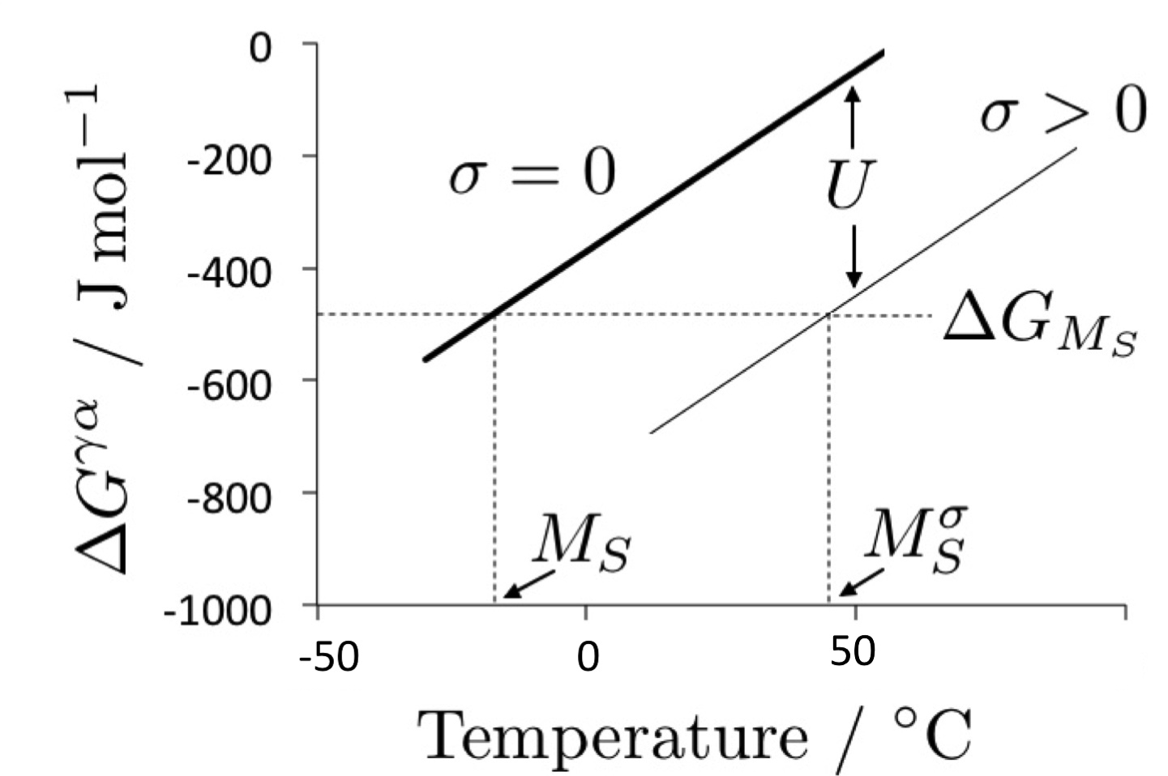

Slide 17
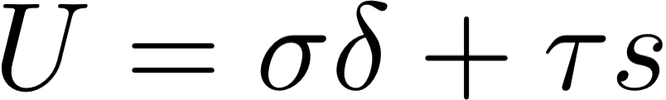
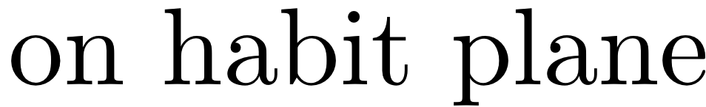
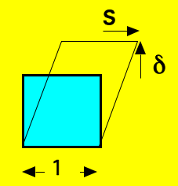

Slide 18
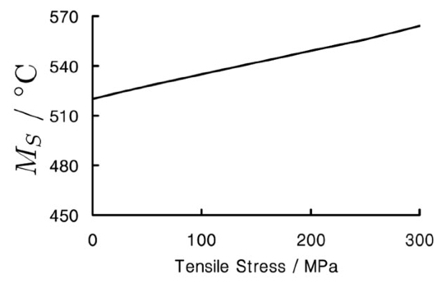
Fe-0.1C wt%
Influence of tensile stress

Slide 19
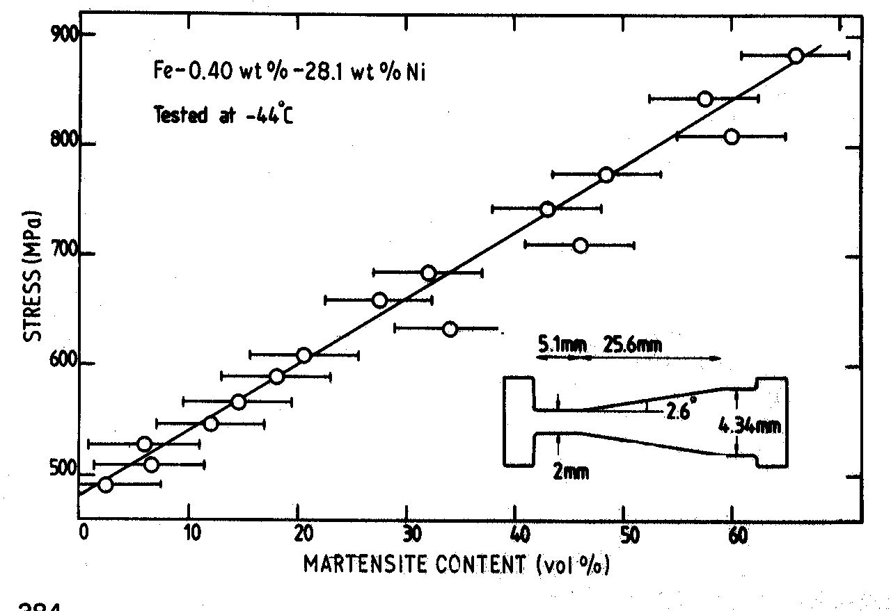
Bhadeshia, 1982

Slide 20
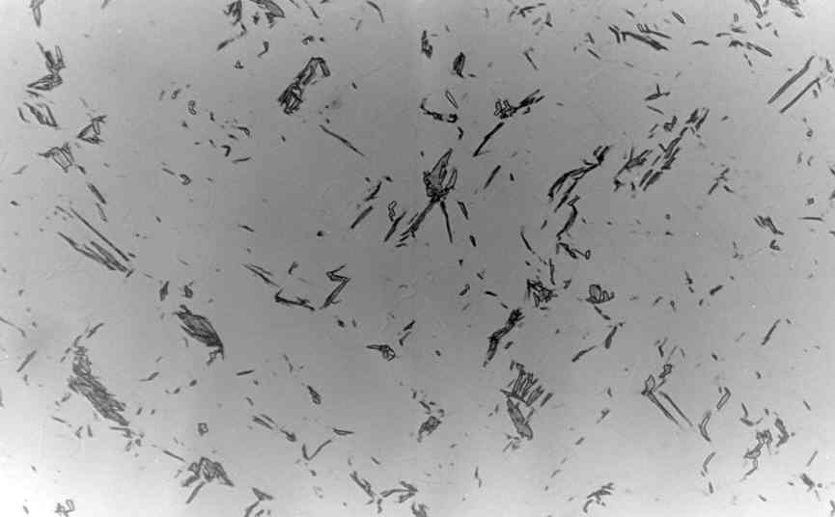
polycrystalline austenite
σ
50 μm
Bhadeshia, 1982

Slide 21
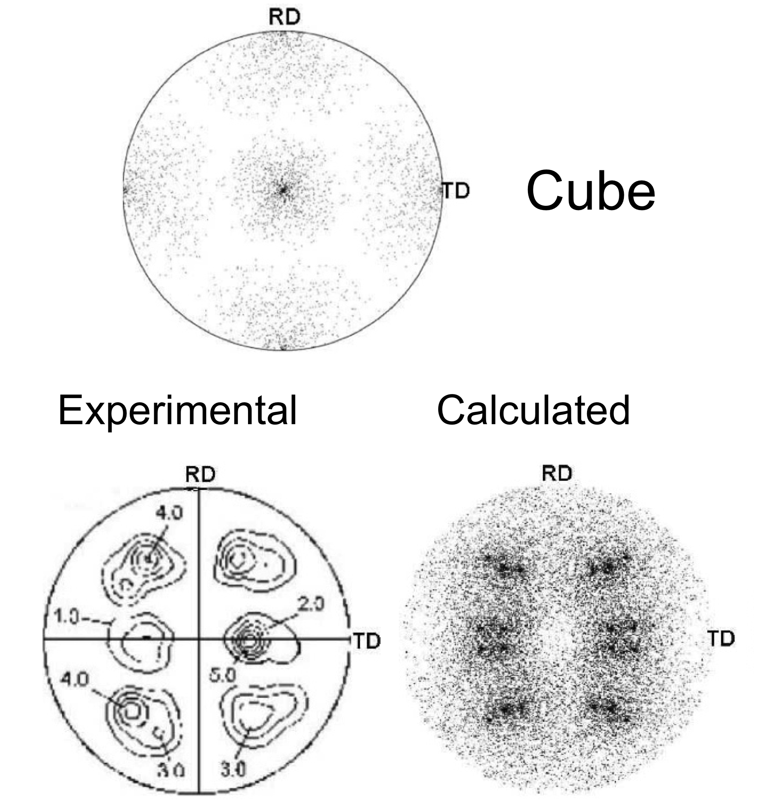
Texture prediction

Slide 22
No method calculates INTENSITY, only POSITIONS of poles

Slide 23
TRIP steels that are fully austenitic are expensive
How do we produce cheap austenite?

Slide 24
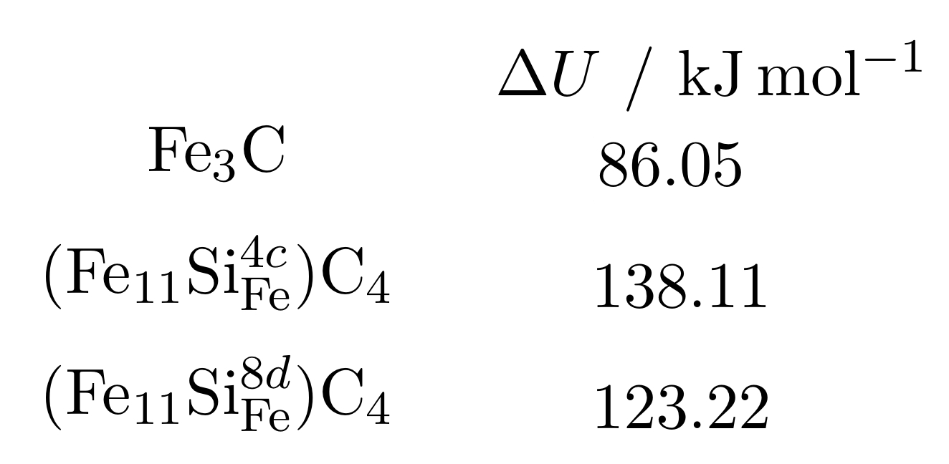
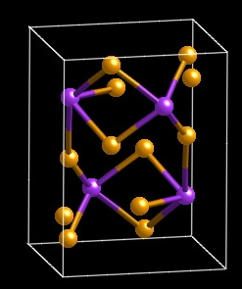
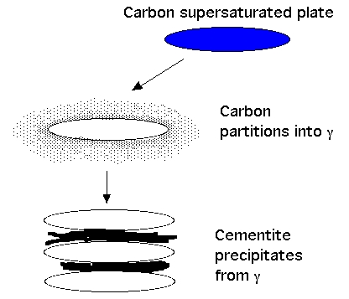
TRIP-Assisted Steels
austenite is expensive
carbon can be cheap
too much carbon is bad
Jae Hoon Jang, In Gee Kim
Notes:
24

Slide 25
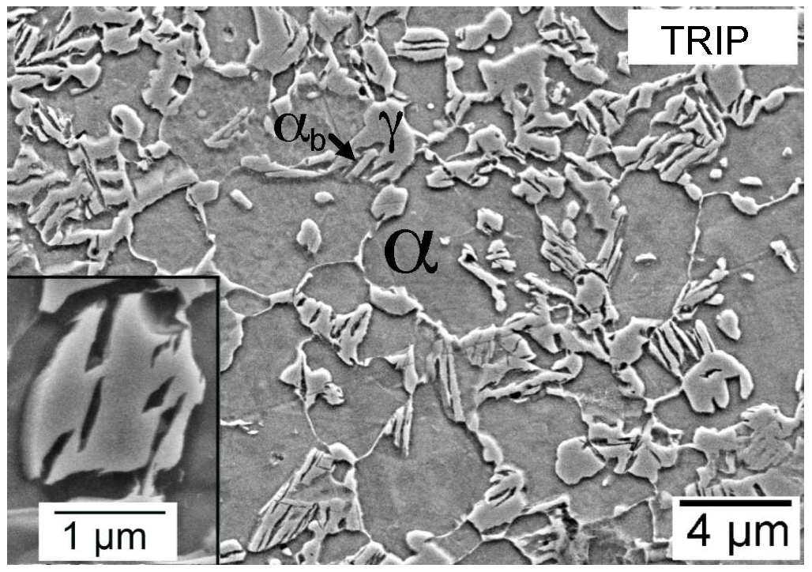
Typical composition Fe-0.15C-1.5Si-1.5Mn wt%

Slide 26
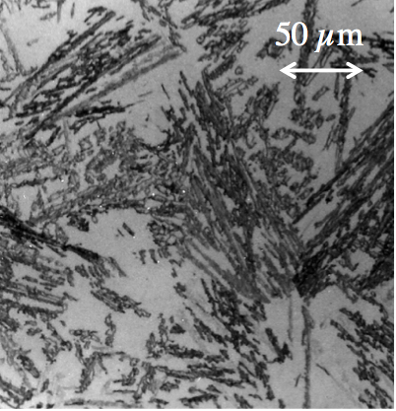
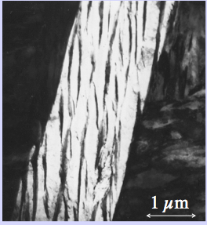

Slide 27
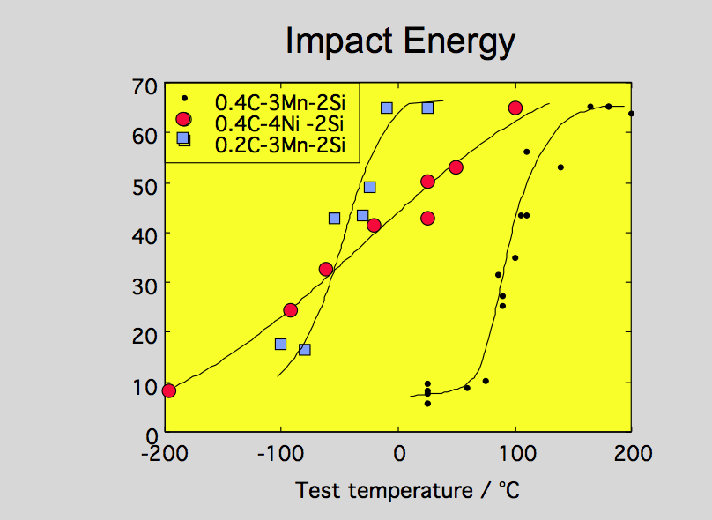

Slide 28
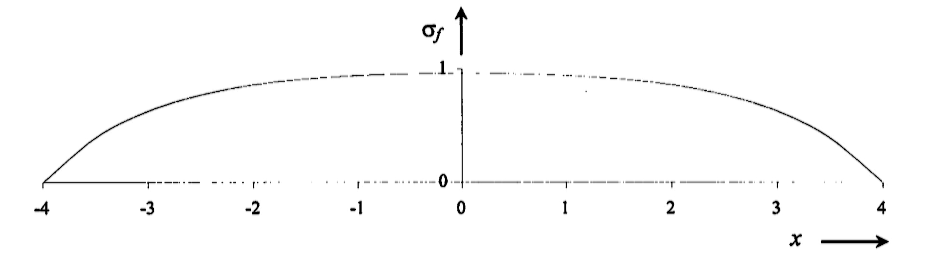
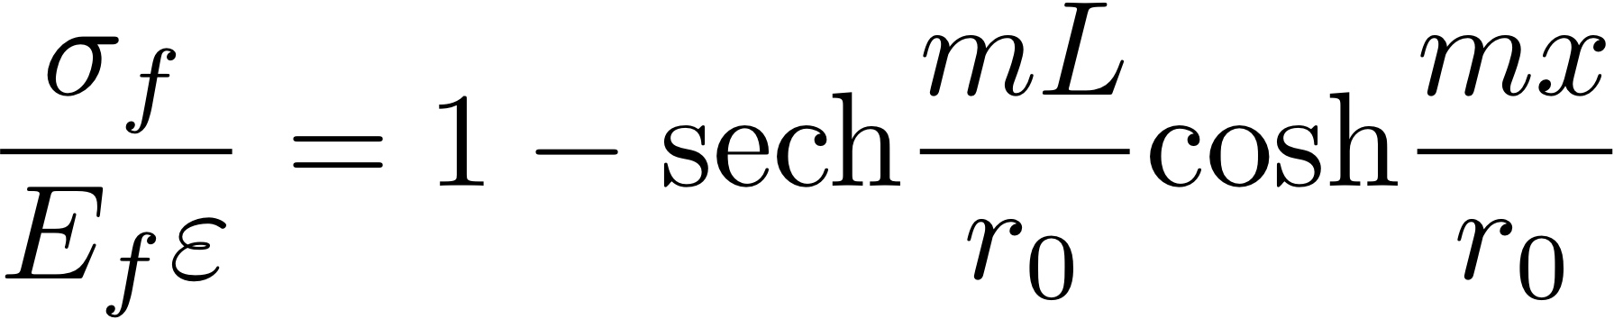
Cracking of brittle martensite
tensile stress in fibre enclosed by matrix

Slide 29
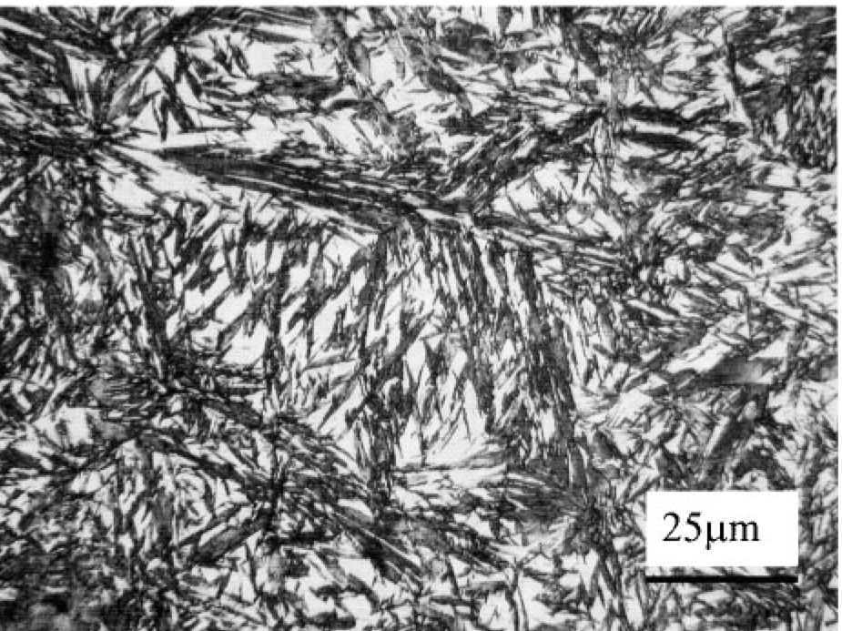
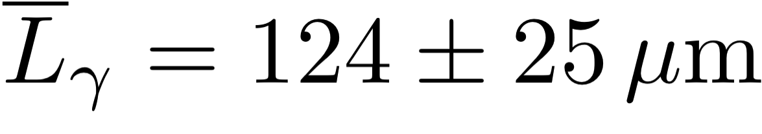
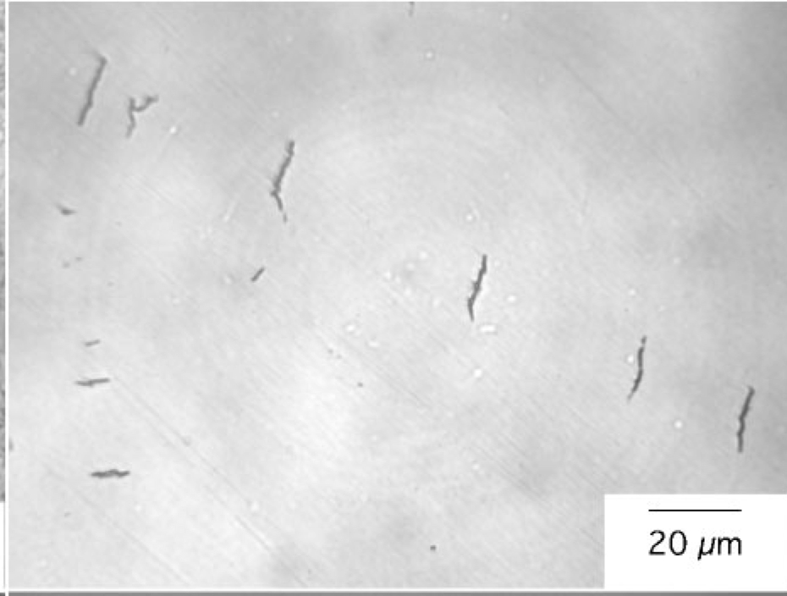
Chatterjee & Bhadeshia, 2006

Slide 30
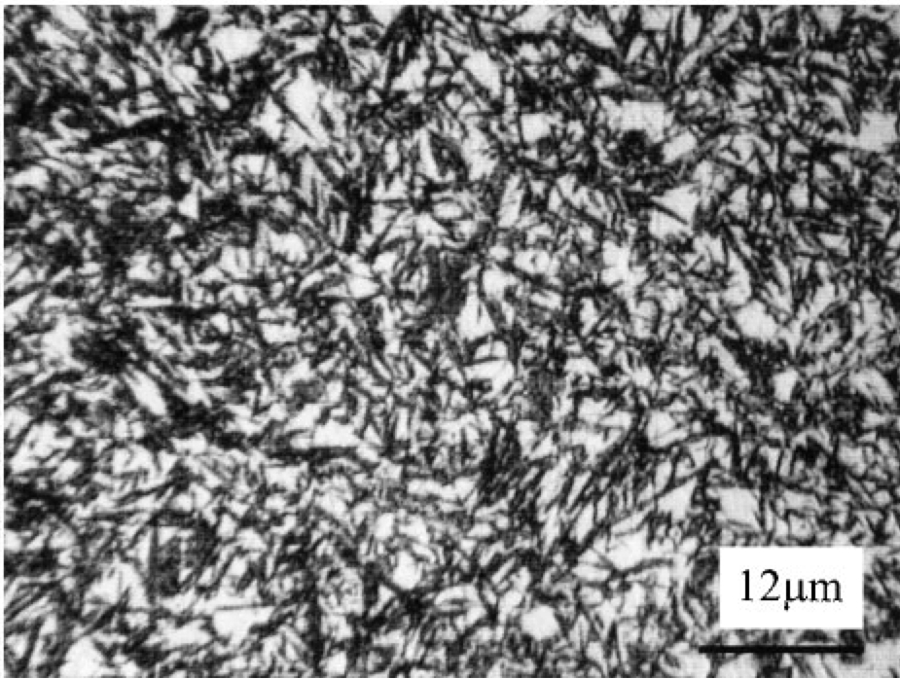
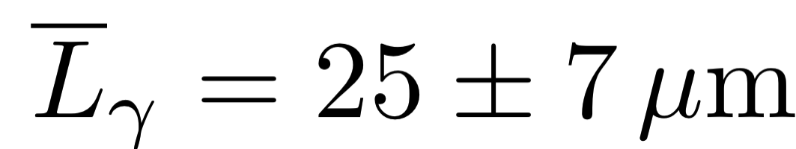
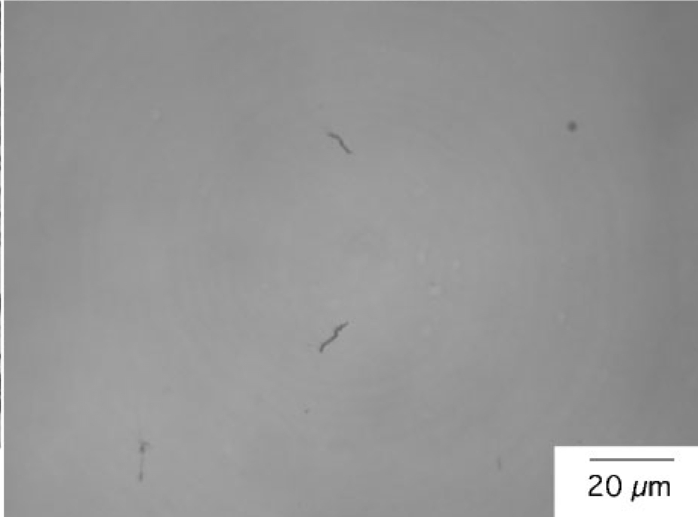
plates become finer than stress-transfer length, and hence do not crack

Slide 31
Austenite grain size effects
plates stopped by austenite grain boundary
total volume transformed reduced when grain size small
detection limit leads to reduction in start temperature

Slide 32
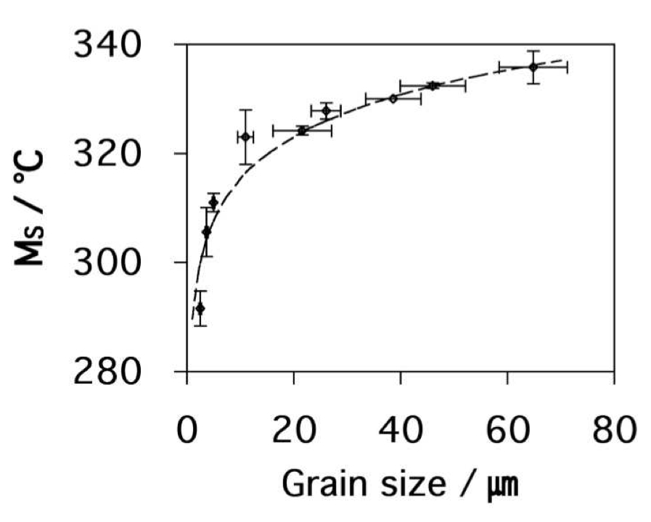
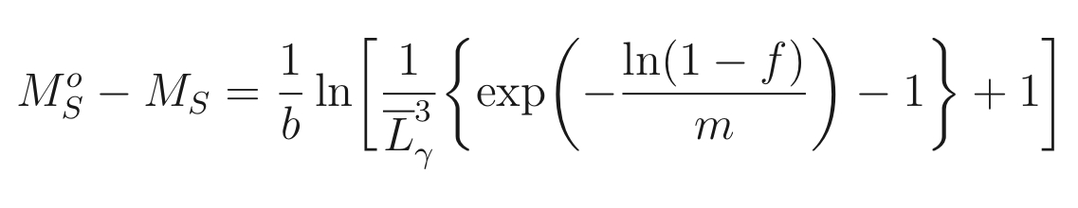
Yang & Bhadeshia, 2009

Slide 33



Plastic strain: grain shape

Slide 34

Plastic strain: stabilisation
Shipway & Bhadeshia 1995

Slide 35


Plastic strain: stabilisation
Chatterjee & Bhadeshia

Slide 36

Classic TRIP-assisted steel stress or strain-induced?

Slide 37

Classic TRIP-assisted steel calculations of austenite stability

Slide 38
Crystallography
Interfacial structure
Atomic structure
Chemical composition
Texture
Thermodynamics
Magnetic
Stress
Kinetics
Plastic strain
Critical mechanical properties

Slide 39



Slide 40


Standard thermodynamic databases fail for epsilon martensite

Slide 41


analysis limited to cases where

Slide 42




Pure iron
CALPHAD
First principles
Fe-5Mn-2-Si-2Cr
First principles

Slide 43


Slide 44


…………
empirical
method

Slide 45

non-linear: neural networks

