Slide 1


Multiple, simultaneous, martensitic transformations transformation texture intensities
www.msm.cam.ac.uk/phase-trans

Slide 2
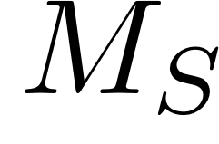
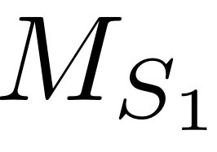
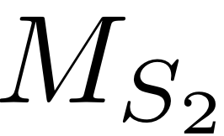
single start-temperature
Causes:
stress-affected
strain-affected
external fields
multiple start-temperatures

Slide 3
Multitude of start temperatures
How does the overall volume fraction evolve?
Definition of variant: unique start temperature
How does the fraction of each variant evolve?
How does texture intensity depend on this?
Mixture of alpha and epsilon martensite?

Slide 4
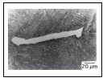
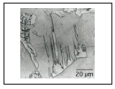

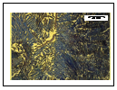
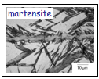

Slide 5
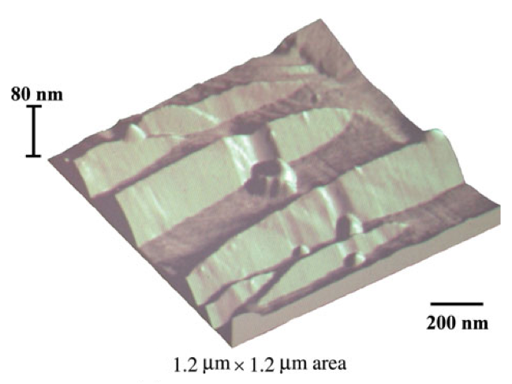

Slide 6
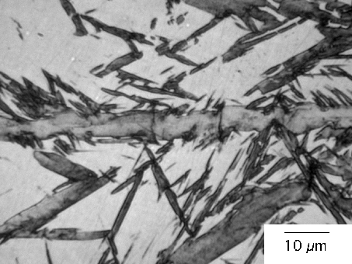
habit plane
orientation relationship
deformation
c
r

Slide 7

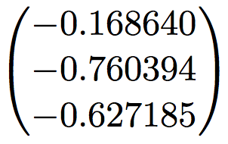

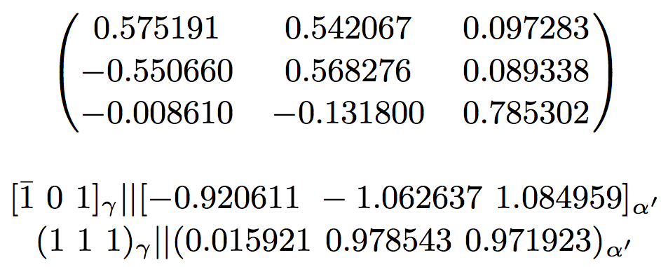
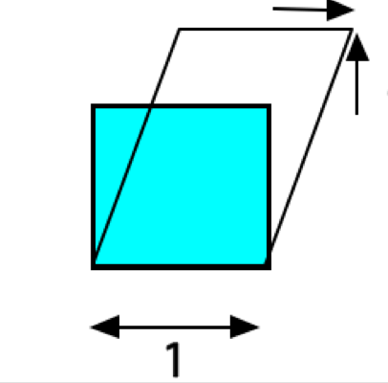

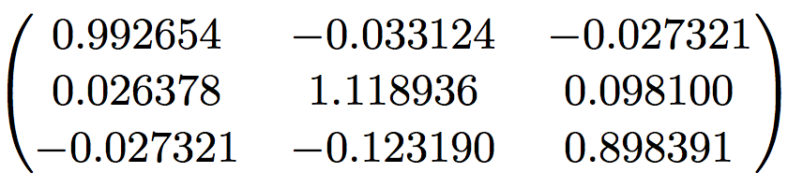

Slide 8
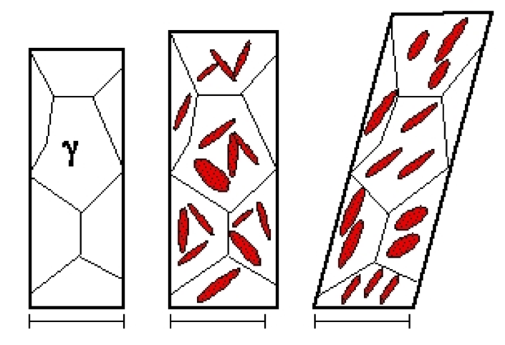
random to non-random transition
random texture in austenite
random ferrite texture
non-random ferrite texture

Slide 9
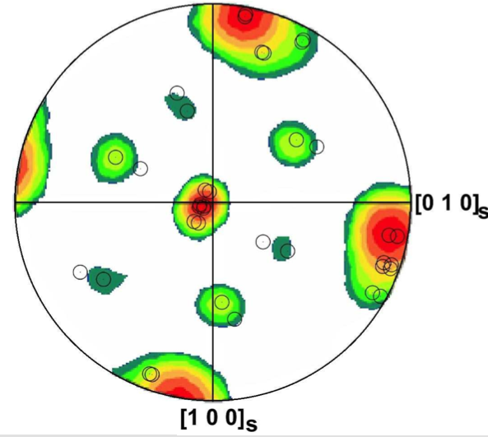

Slide 10
No method calculates INTENSITY, only POSITIONS of poles

Slide 11
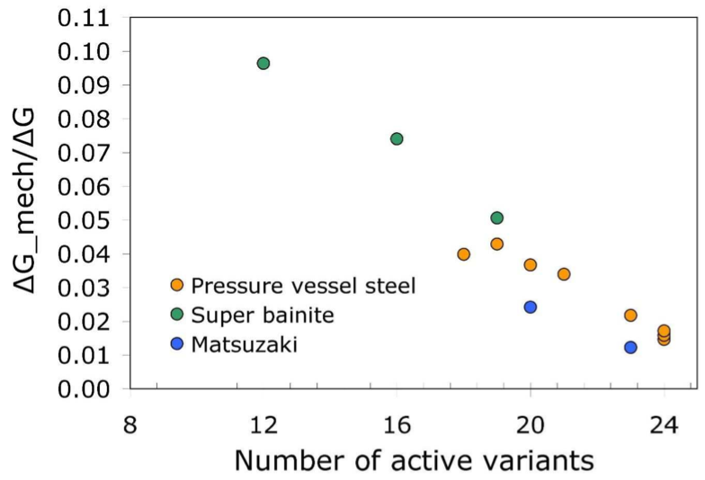

Slide 12
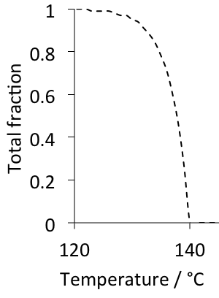
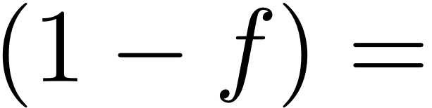
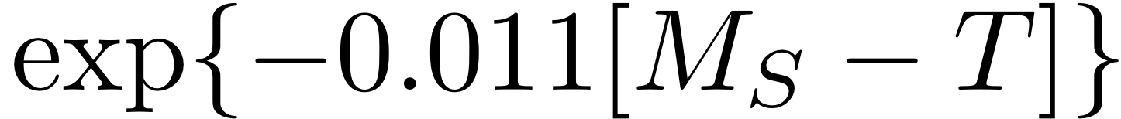
Kinetics of martensite
Koistinen and Marburger (1959)

Slide 13
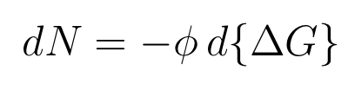
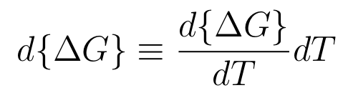

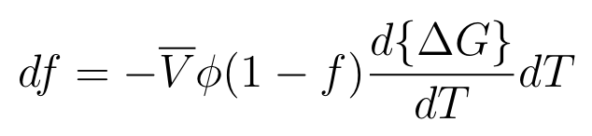
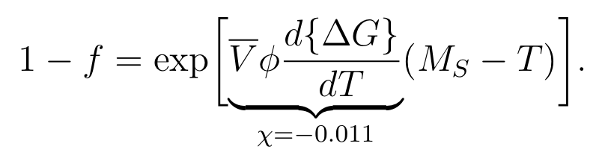

Slide 14
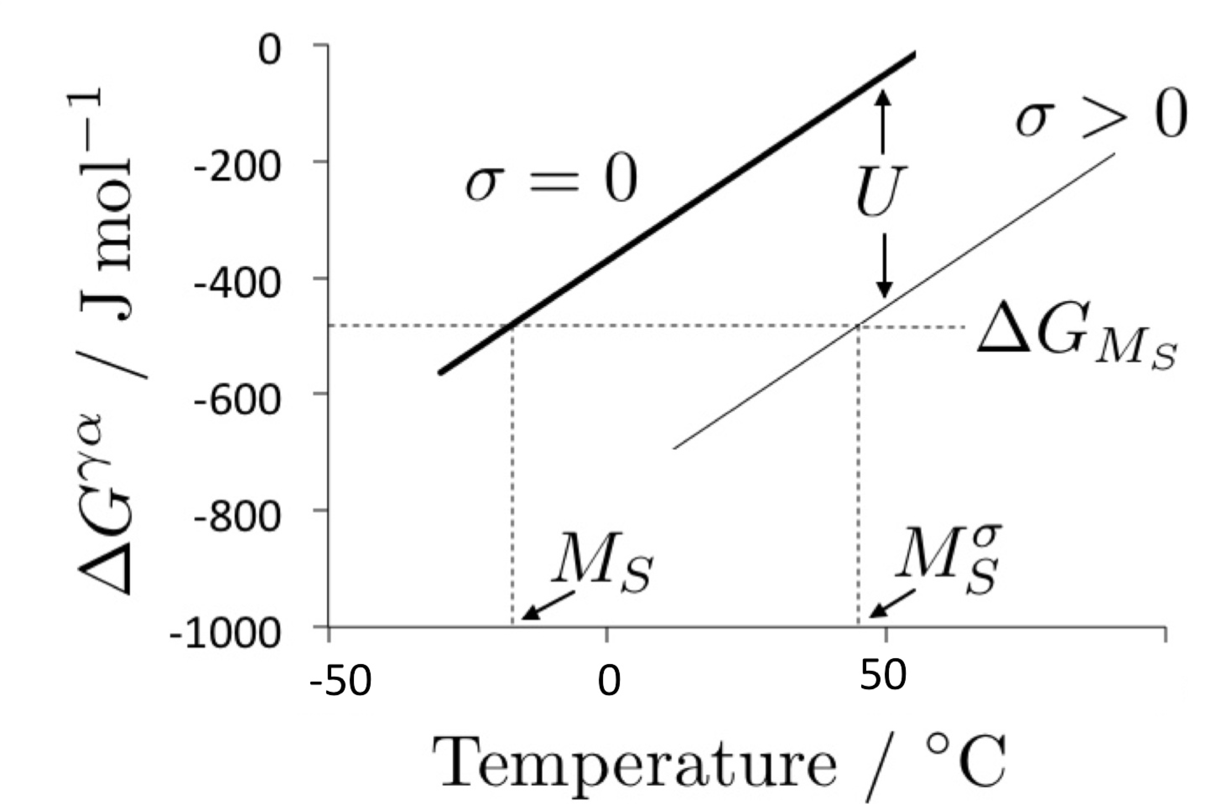

Slide 15
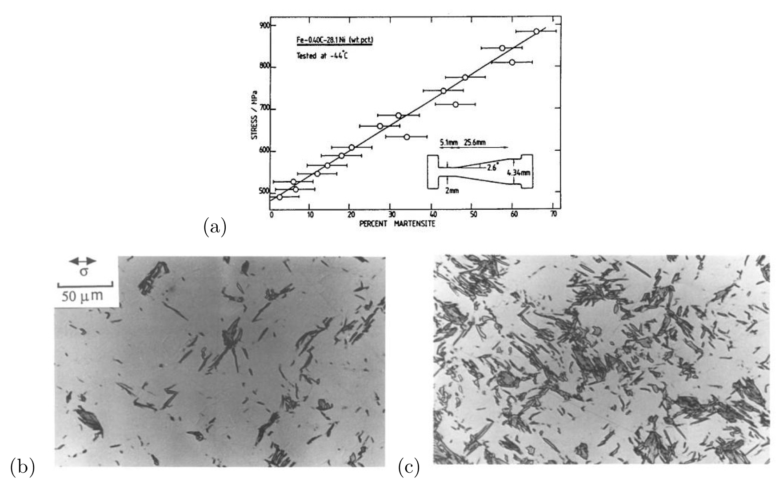
Each of 24 variants in a given austenite grain will have a different martensite-start temperature

Slide 16
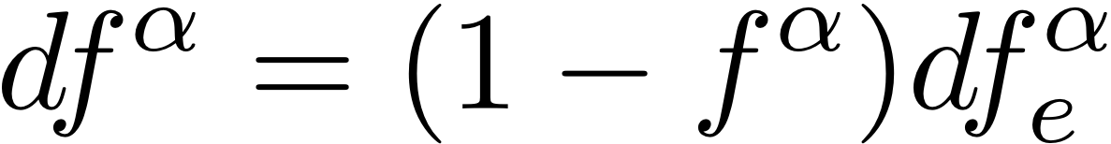
α
time = t
time = t+∆t

Slide 17
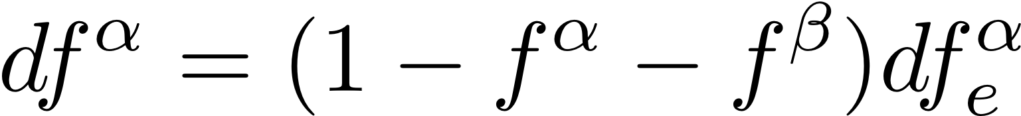
β
α
time = t
time = t+∆t

Slide 18
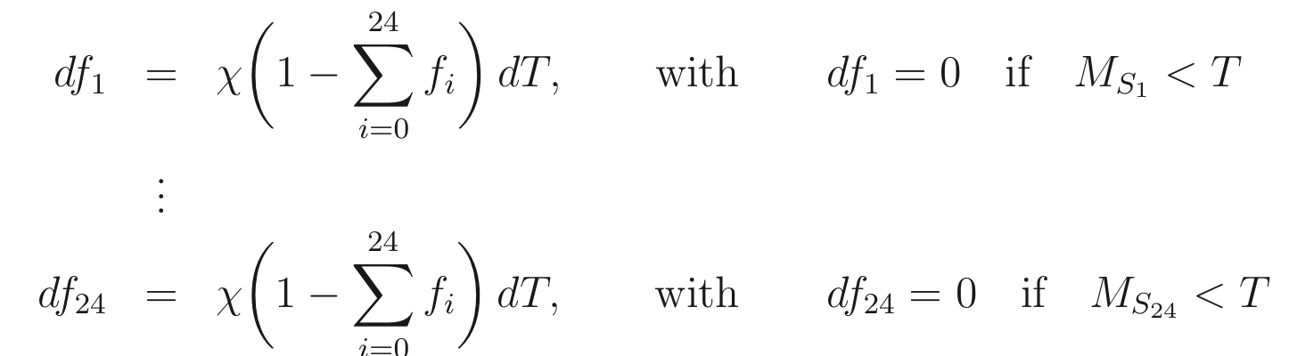
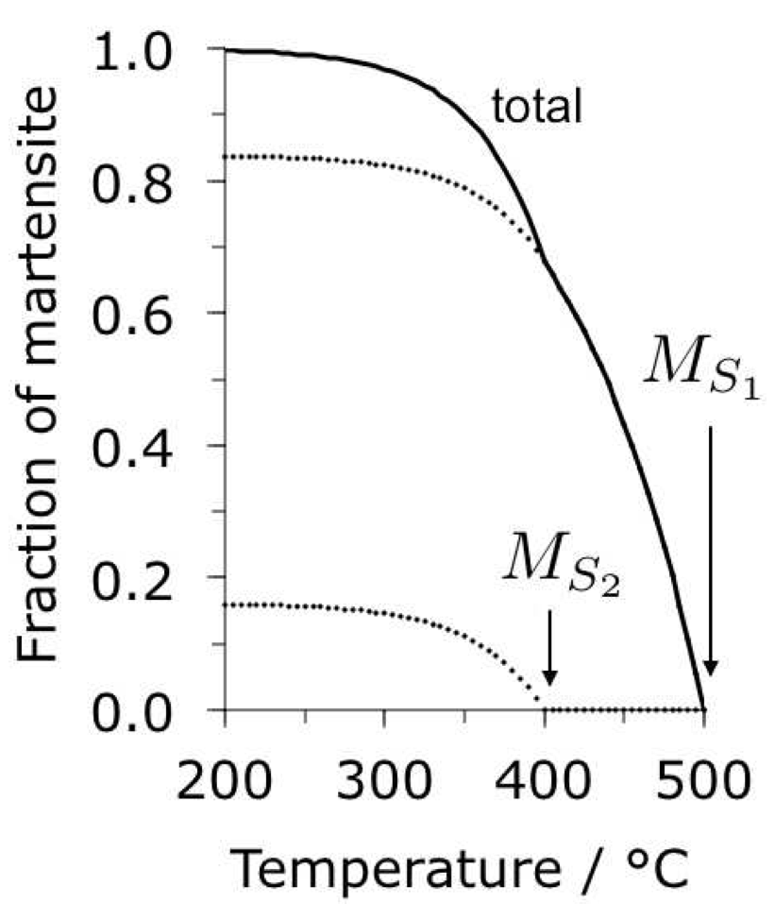
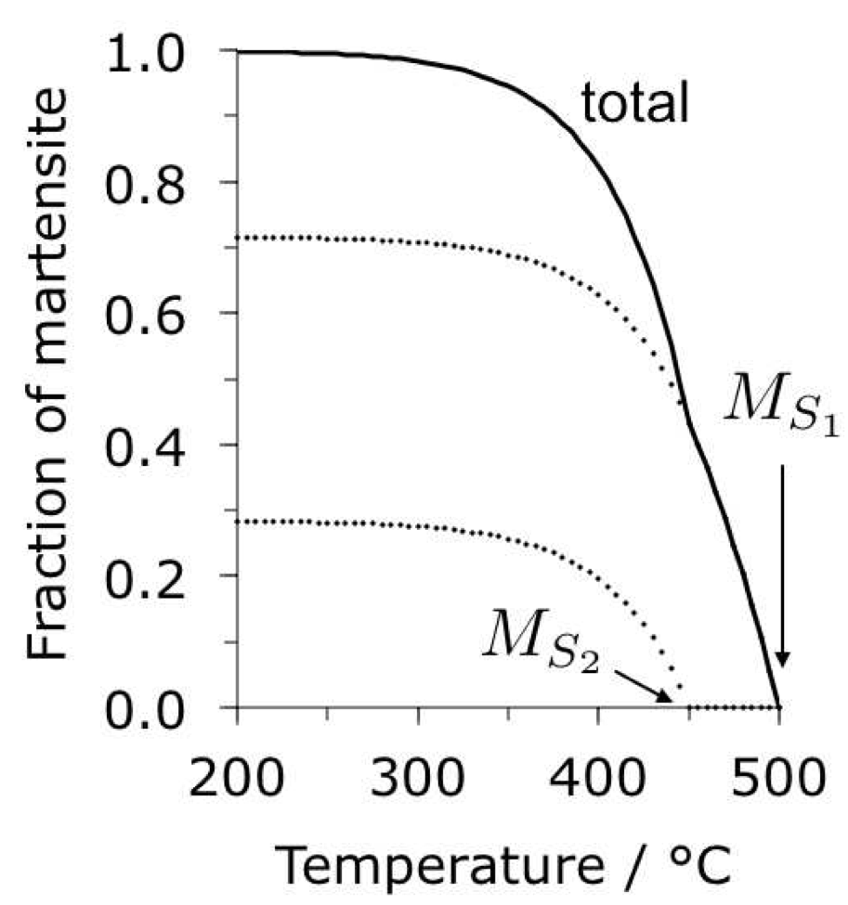

Slide 19
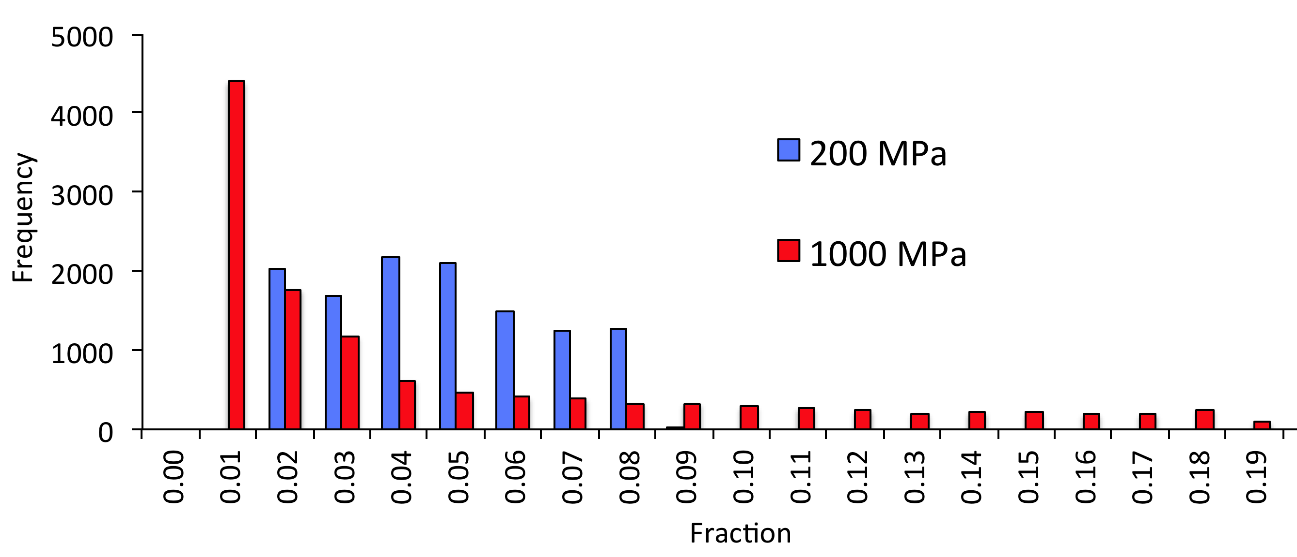
Distribution of volume fractions broader at large stress

Slide 20
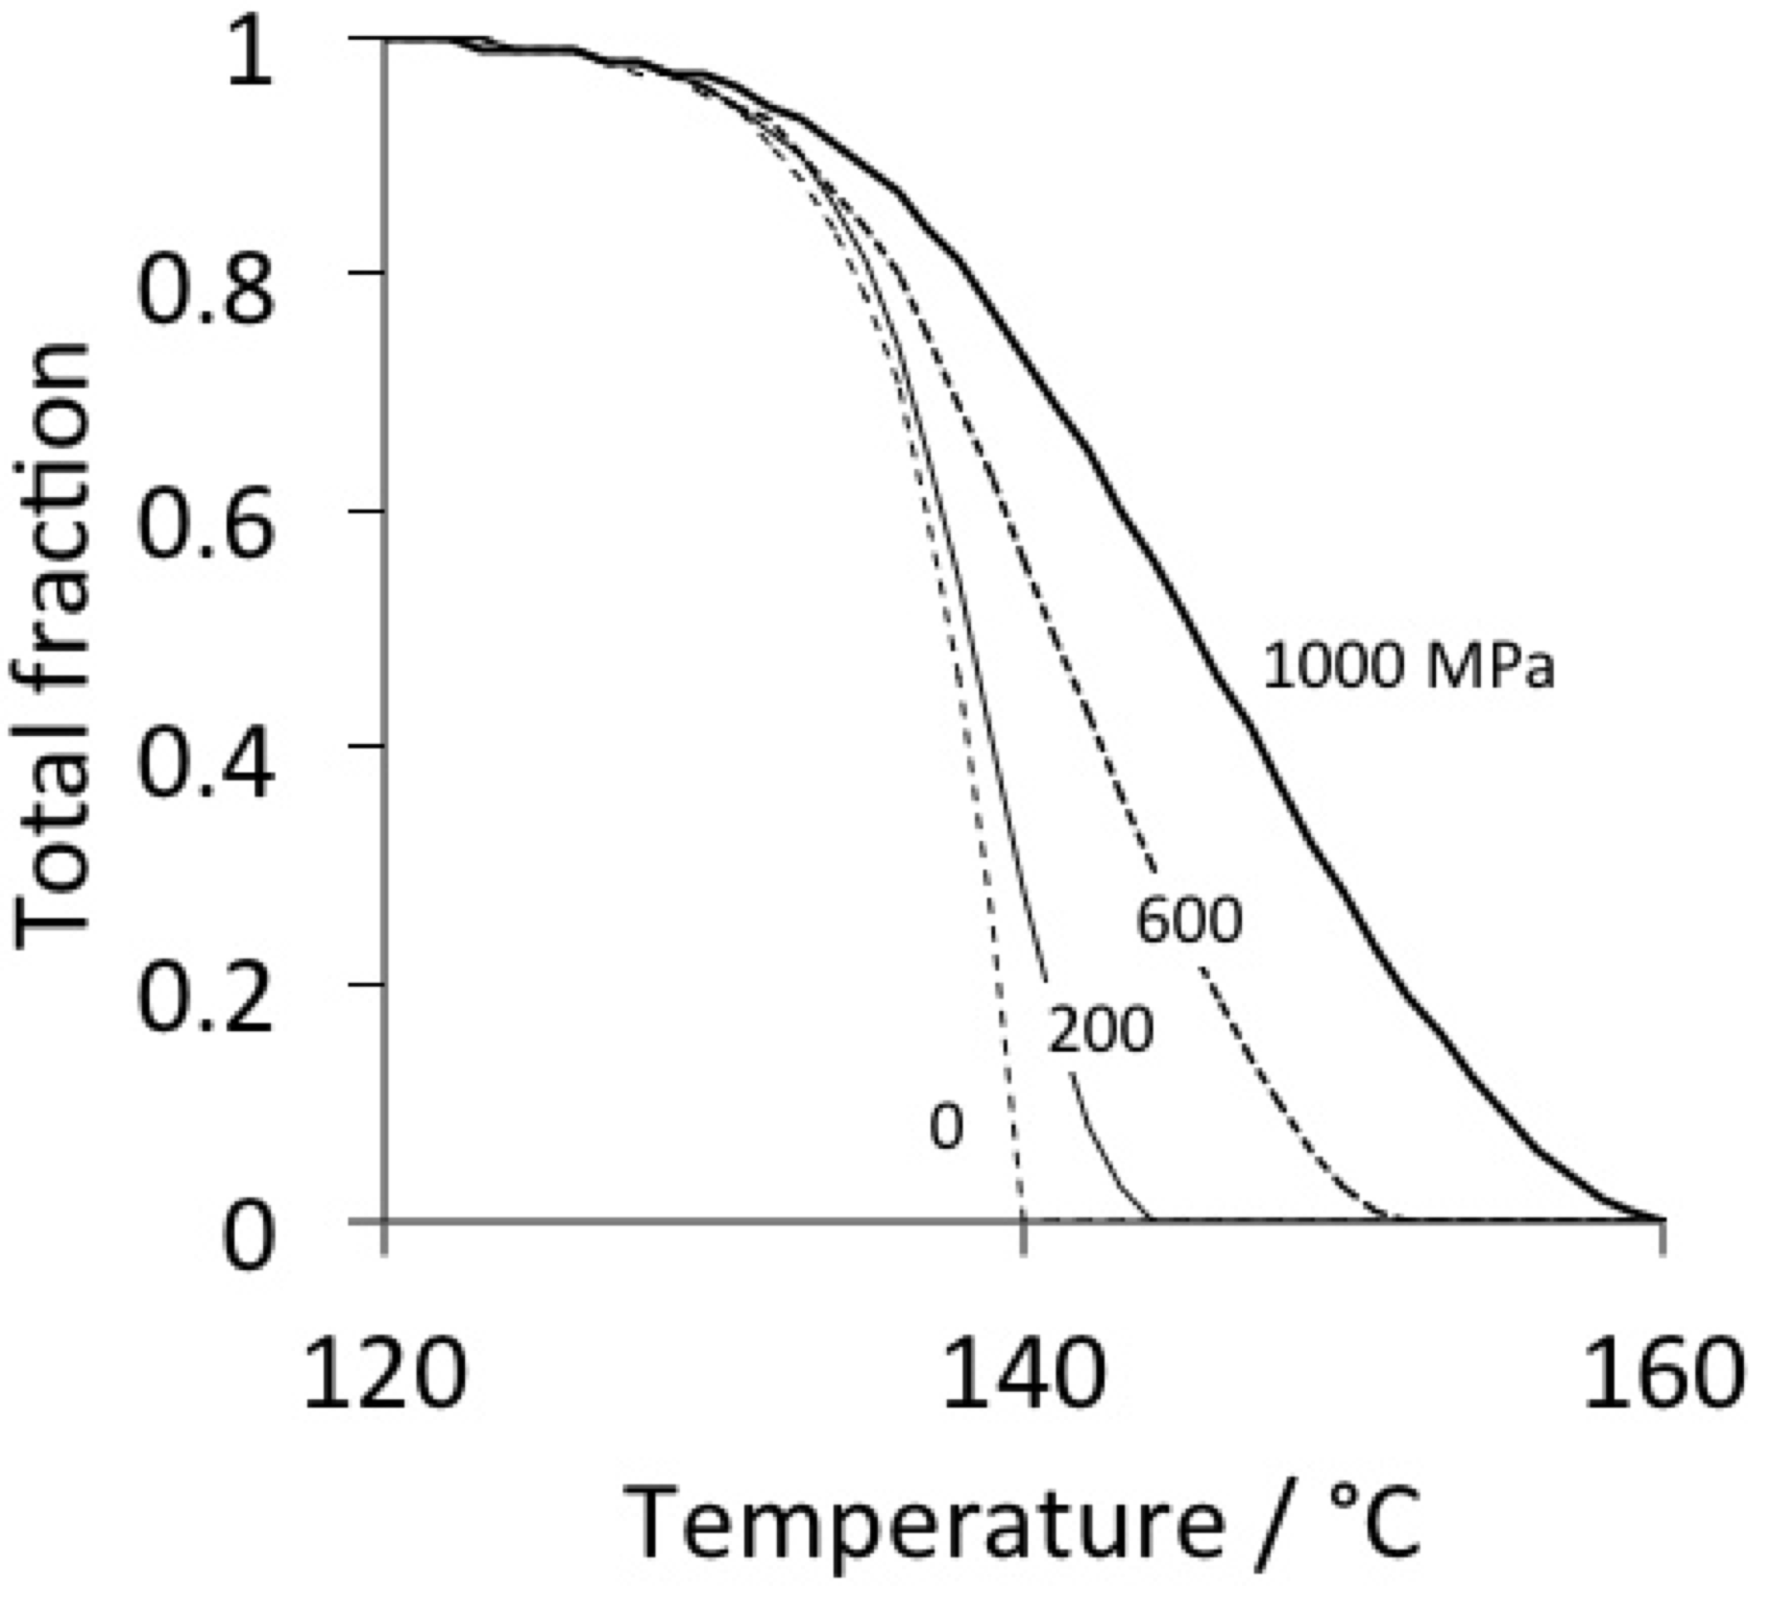

Slide 21
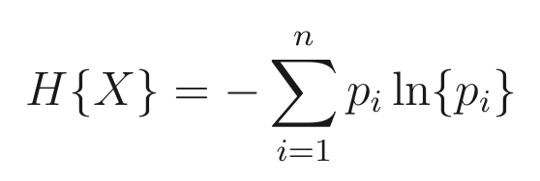
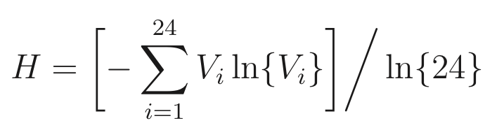
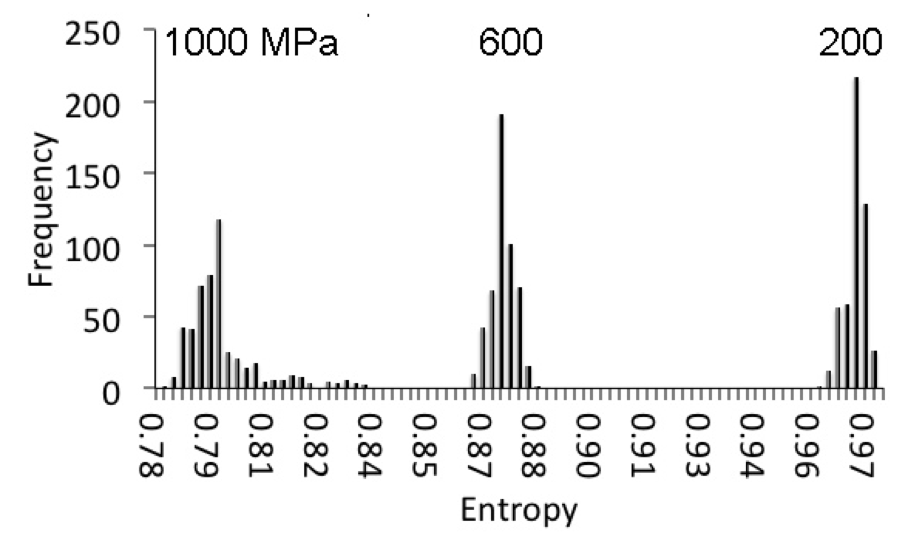

Slide 22
Estimate volume fractions of variants with different martensite-start temperatures.
Allows intensity in textures to be calculated.
Can be generalised to any scenario which introduces differences in martensite-start temperatures.
stress,
magnetic field,
non-uniform cooling,
mixed alpha and epsilon.

