Slide 1
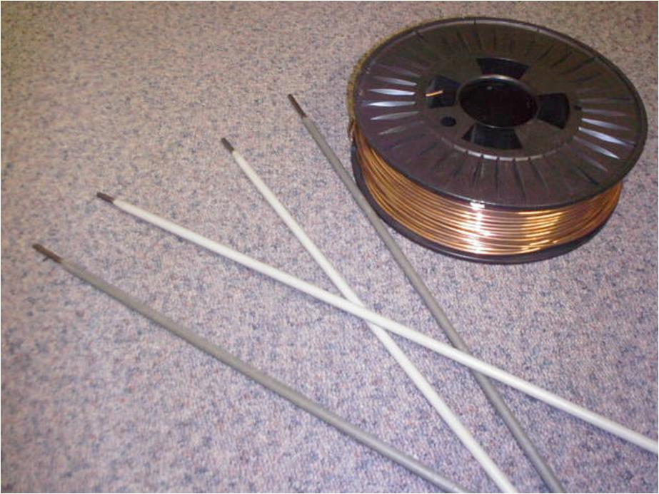
What science is there in welding?
Lars-Erik Svensson, University West, Engineering Science, Production West, Welding Technology

Slide 2

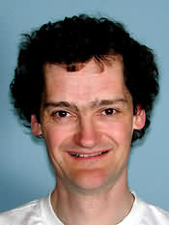
US Home security
Young PhD student
What will you do in the US?
I will attend a conference
What kind of conference?
A scientific conference
What subject?
Welding
What science is there in welding?
Lars-Erik Svensson, University West, Engineering Science, Production West, Welding Technology

Slide 3
What science is there in welding?
Technology/science
High strength – low weight?
High strength – low weight – long life?
Process–material–design-heat–stresses–deformation–microstructure–properties
Mechanisation–control–quality-ergonomics–health&safety
Economy
Lars-Erik Svensson, University West, Engineering Science, Production West, Welding Technology

Slide 4
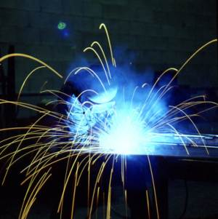
Technology/science
Lars-Erik Svensson, University West, Engineering Science, Production West, Welding Technology

Slide 5
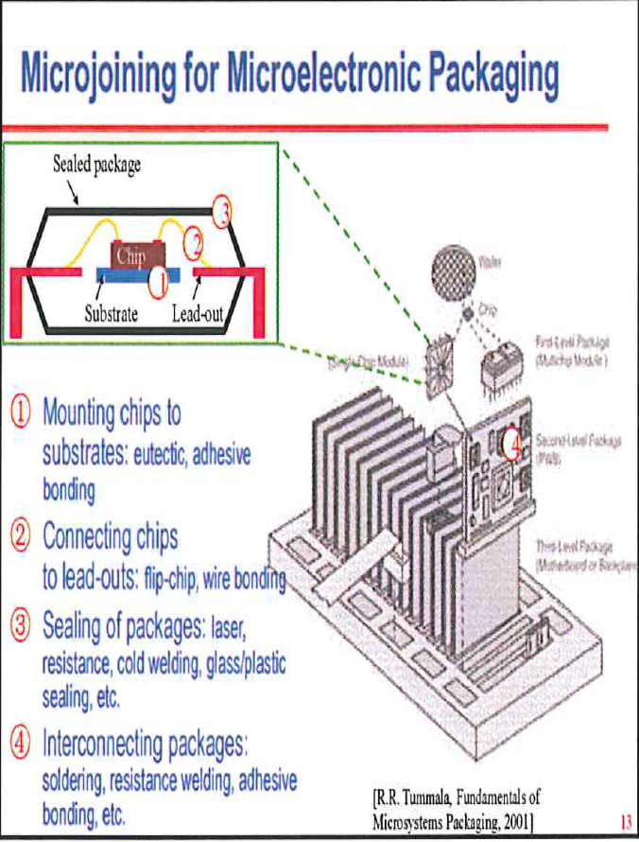
Technology/science
Lars-Erik Svensson, University West, Engineering Science, Production West, Welding Technology

Slide 6
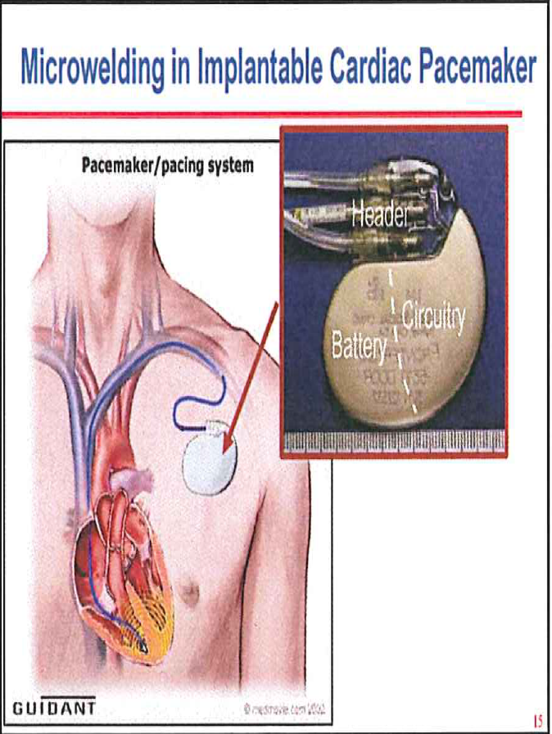
Technology/science
Lars-Erik Svensson, University West, Engineering Science, Production West, Welding Technology

Slide 7
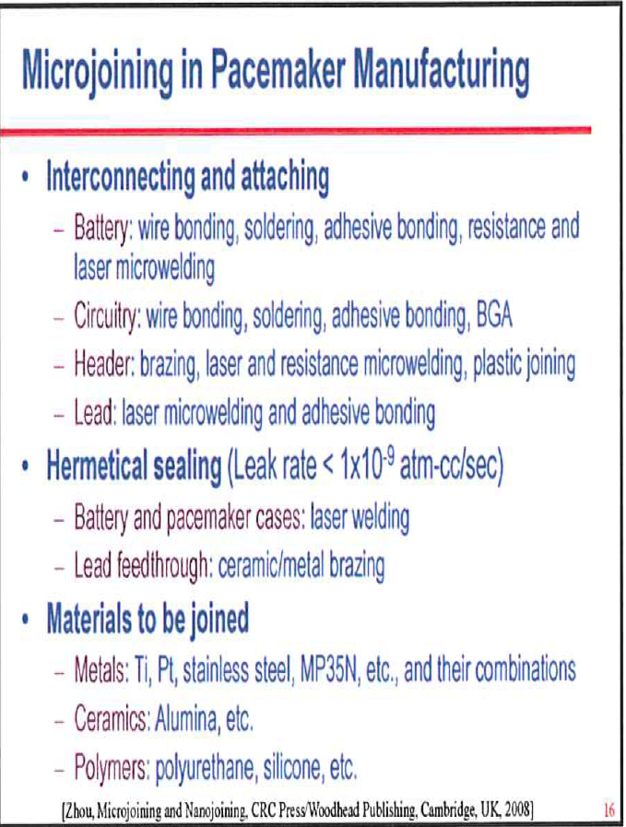
Technology/science
Lars-Erik Svensson, University West, Engineering Science, Production West, Welding Technology

Slide 8
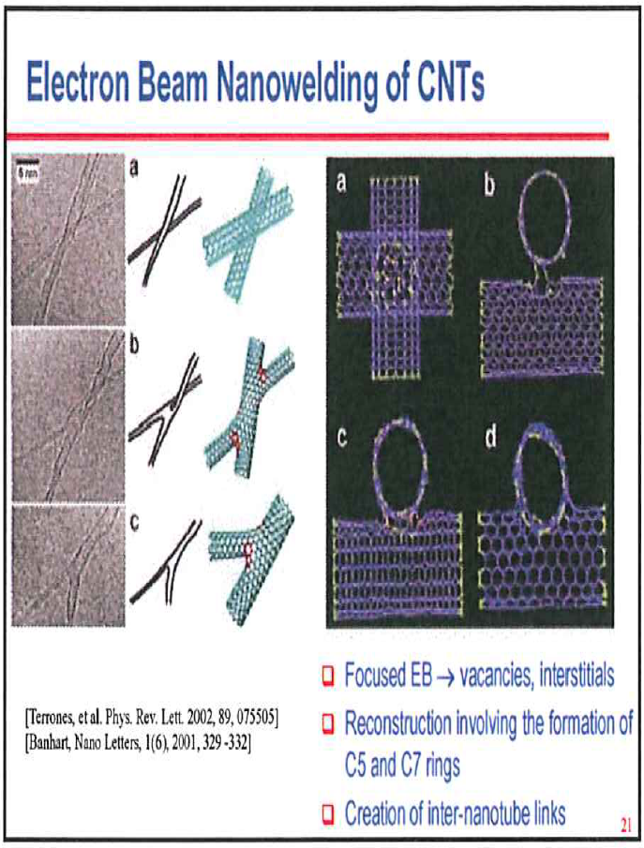
Technology/science
Lars-Erik Svensson, University West, Engineering Science, Production West, Welding Technology

Slide 9
Technology/science
Lars-Erik Svensson, University West, Engineering Science, Production West, Welding Technology

Slide 10
High strength – low weight
Steel (Fe – 0.2%C – 1% Mn – (0.5% Cr – 1% Ni – 0.5% Mo - 0.01 Ti/Nb/V)
Yield Strength 200 – 1100 MPa
(Stainless steel)
(Aluminium)
Lars-Erik Svensson, University West, Engineering Science, Production West, Welding Technology

Slide 11
High strength – low weight
High strength of weld metal????
Lars-Erik Svensson, University West, Engineering Science, Production West, Welding Technology

Slide 12
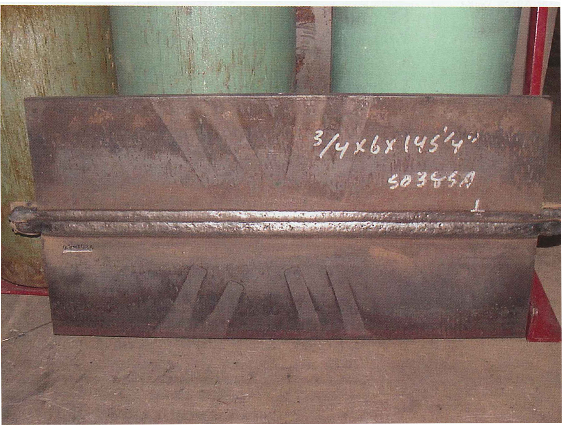
High strength – low weight
Lars-Erik Svensson, University West, Engineering Science, Production West, Welding Technology

Slide 13
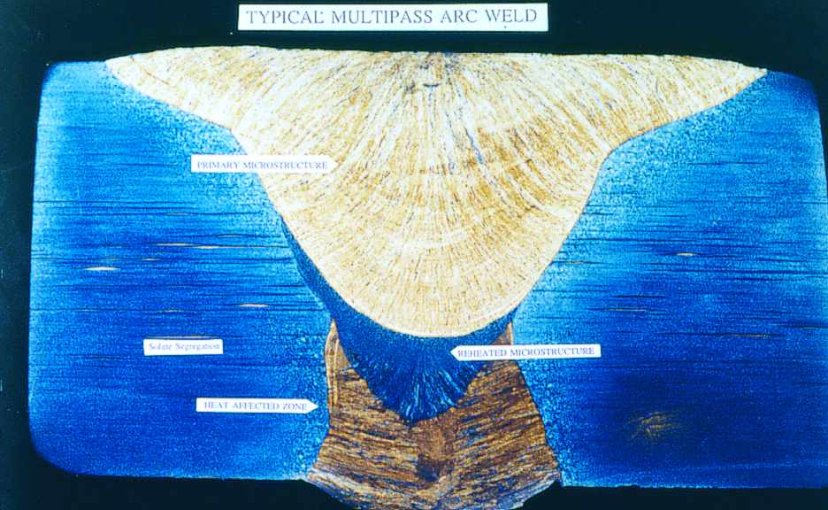
High strength – low weight
Lars-Erik Svensson, University West, Engineering Science, Production West, Welding Technology

Slide 14
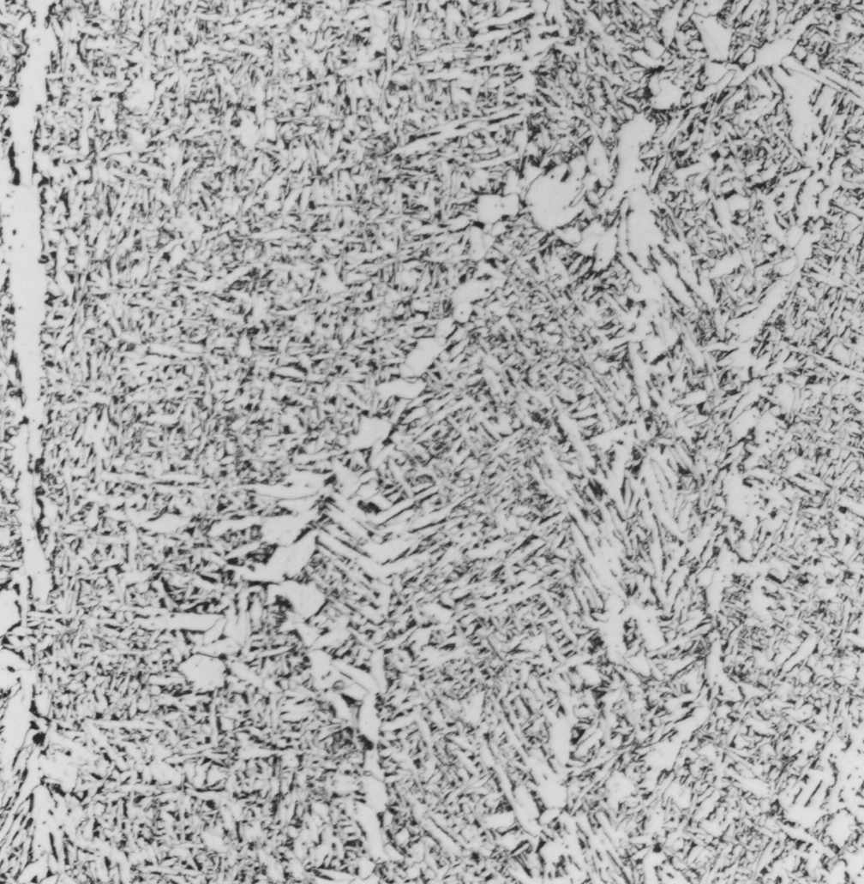
High strength – low weight
Microstructure - low and medium strength
AF
GBF
WF
Lars-Erik Svensson, University West, Engineering Science, Production West, Welding Technology

Slide 15
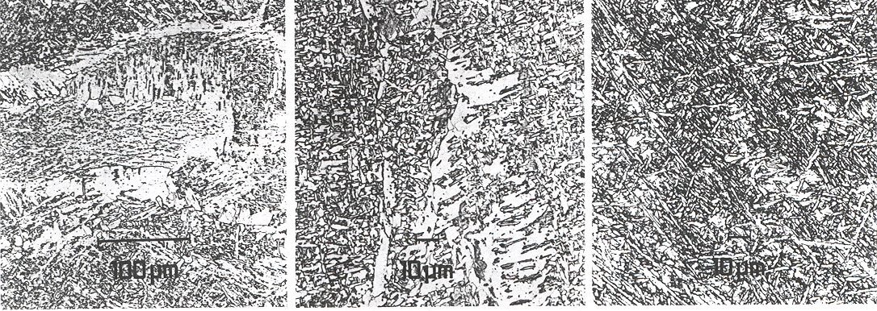
High strength – low weight
Microstructure low – high strength
”Ferrite”
Bainite + Martensite
500 MPa 700 MPa 900 MPa
Yield Strength (MPa)
Lars-Erik Svensson, University West, Engineering Science, Production West, Welding Technology

Slide 16
High strength – low weight
Toughness vs strength
Lars-Erik Svensson, University West, Engineering Science, Production West, Welding Technology

Slide 17
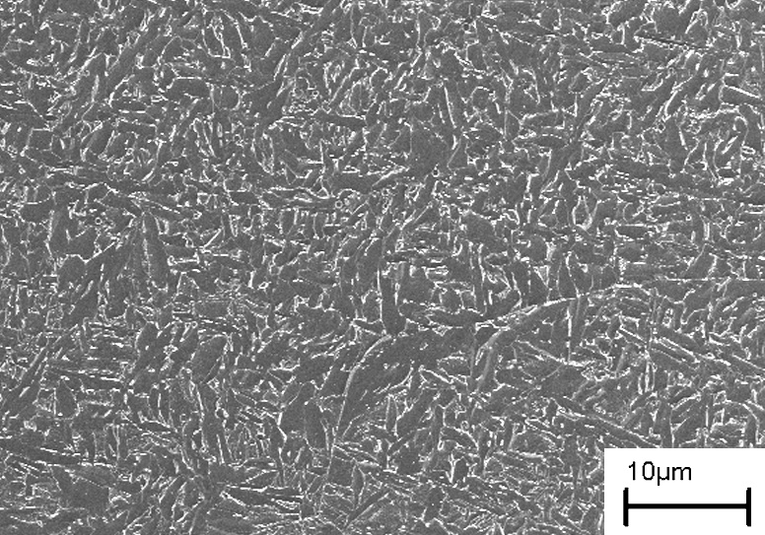
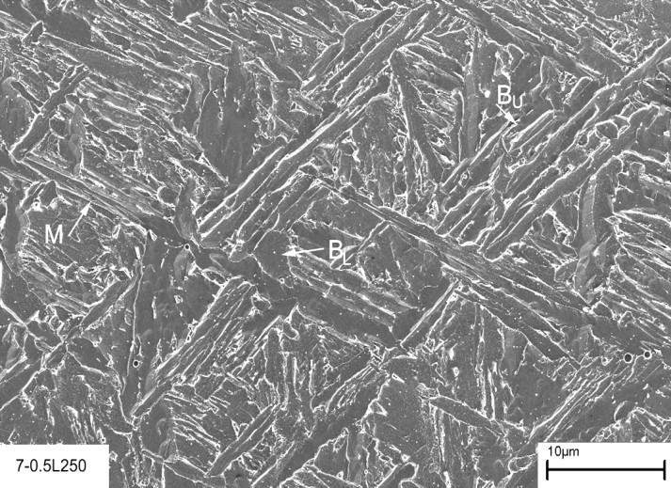
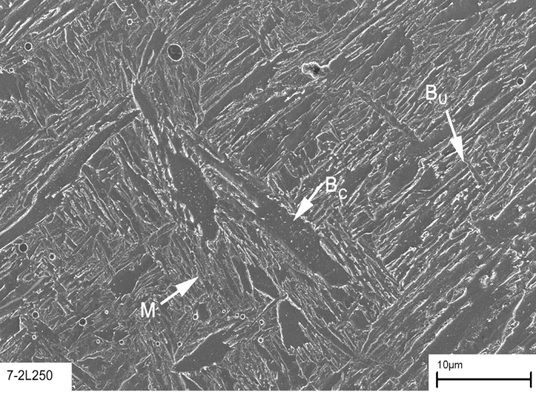
High strength – low weight
Keehan
OK 75.78
0.5 Mn – 7 Ni
2 Mn – 7 Ni
Lars-Erik Svensson, University West, Engineering Science, Production West, Welding Technology

Slide 18
High strength – low weight
Lars-Erik Svensson, University West, Engineering Science, Production West, Welding Technology

Slide 19
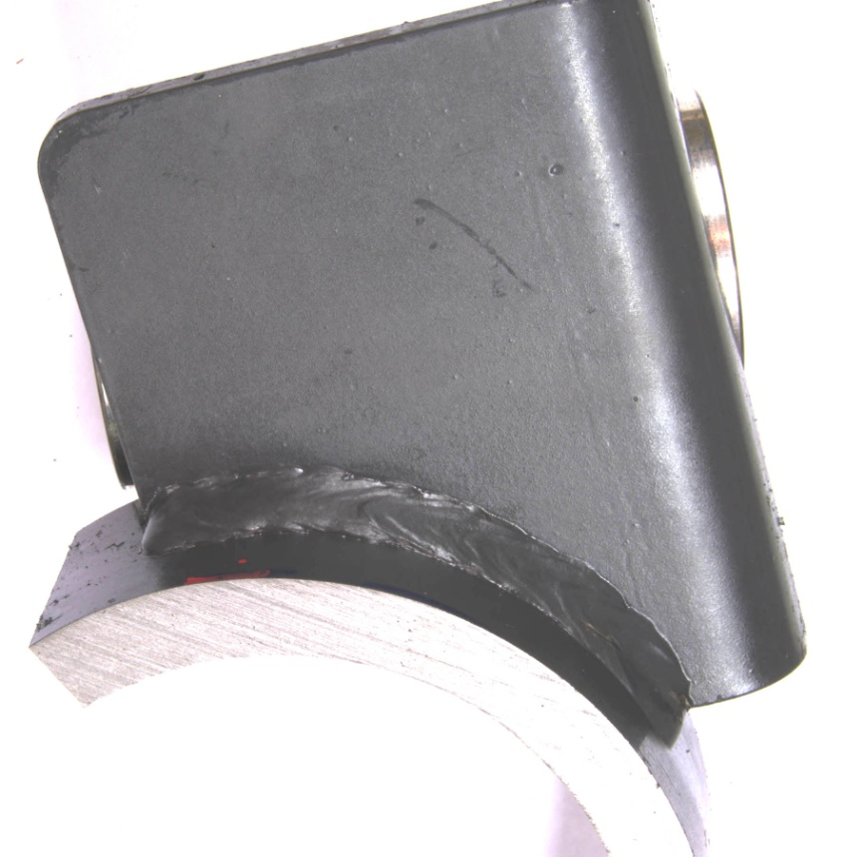
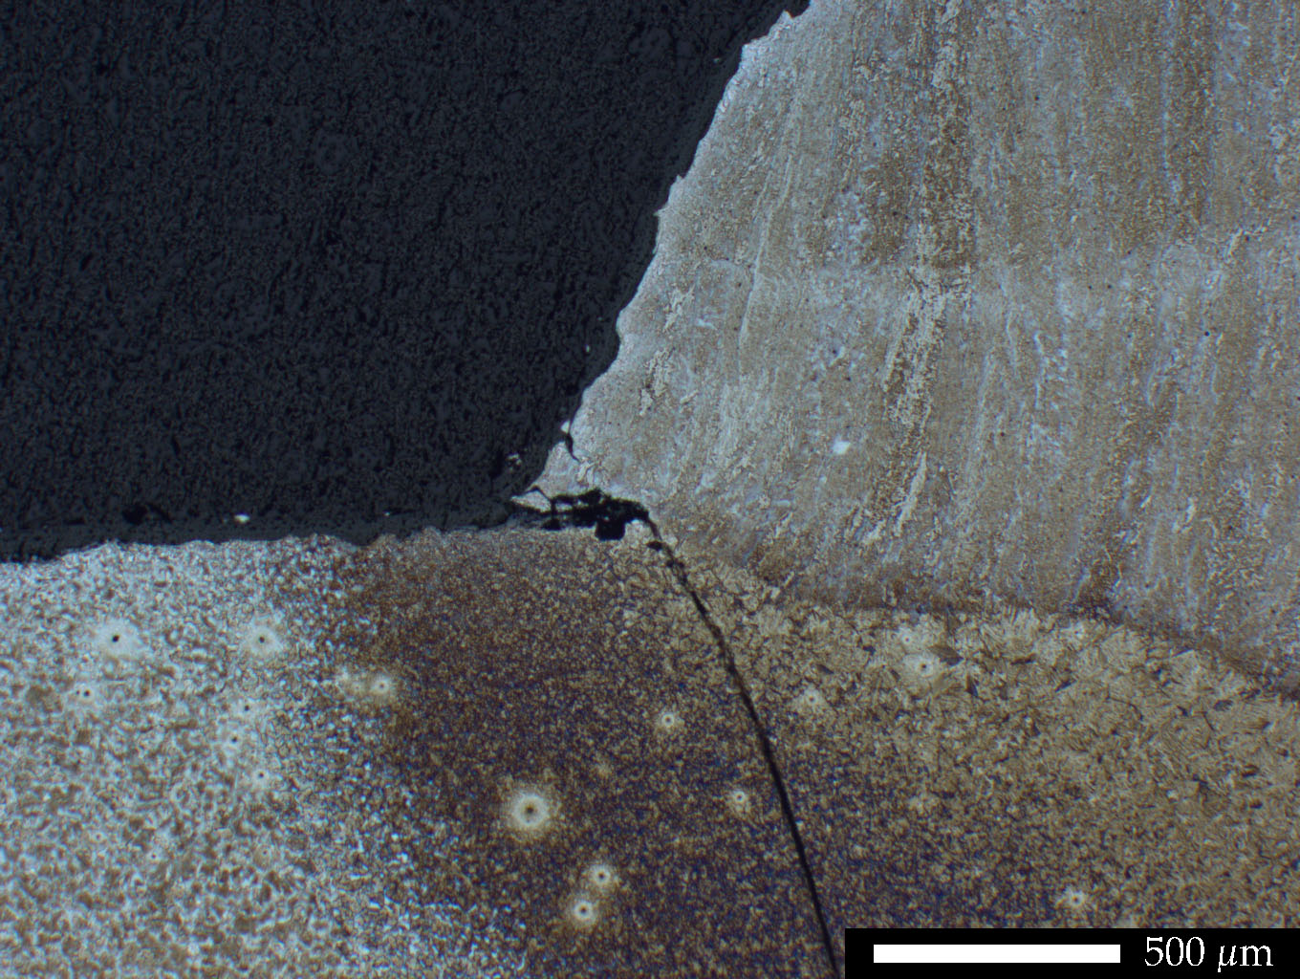
High strength – low weight - long life fatigue
Lars-Erik Svensson, University West, Engineering Science, Production West, Welding Technology

Slide 20
High strength – low weight - long life fatigue
Lars-Erik Svensson, University West, Engineering Science, Production West, Welding Technology

Slide 21
High strength – low weight - long life fatigue
Stress concentration
Defects
Residual stresses
Lars-Erik Svensson, University West, Engineering Science, Production West, Welding Technology

Slide 22
High strength – low weight - long life fatigue
Conventional approaches: Improvement methods
Grinding (affects stress concentration, maybe defect occurrence)
TIG remelting (affects stress concentration, defect occurrence although not completely and residual stress)
Blasting/shot-peening/hammer peening (introduce compressive stress)
Lars-Erik Svensson, University West, Engineering Science, Production West, Welding Technology

Slide 23

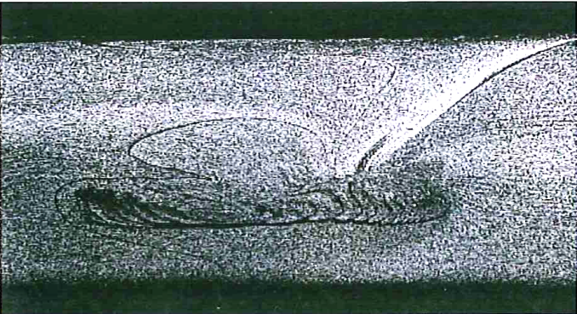
High strength – low weight - long life fatigue
Assuming a smooth weld without defects
Would we see:
?
Lars-Erik Svensson, University West, Engineering Science, Production West, Welding Technology

Slide 24
What science is there in welding?
A lot Sir
But it’s impossible to explain for someone who don’t understand!*
*Free translation of reply by Ingemar Stenmark, Swedens most famous downhill ski master, in a TV interview, on the question: Why did you not win today?
Lars-Erik Svensson, University West, Engineering Science, Production West, Welding Technology

